Slide 1
Assessing the Vulnerability of Populations in Vietnam to Tropical Cyclones
By Robert Kearney and Caroline Williams
IDCE 30306: GIS for International Development in Practice
April 8, 2021

Slide 2
Background
Vietnam is one of the most severely impacted countries by anthropogenic climate change and is threatened by potential increasing and intensifying tropical cyclone events (Tinh & Tuan, 2015)
Additionally, the West Pacific Basin is the most active and features the highest human mortality risk, thereby exposing Vietnam to tropical cyclones (Kossin, Emanuel, & Camargo, 2016)
Mangroves play an essential role between terrestrial and mangrove ecosystems by protecting coastal communities and ecosystems (Ellison & Zhou, 2012)

Slide 3
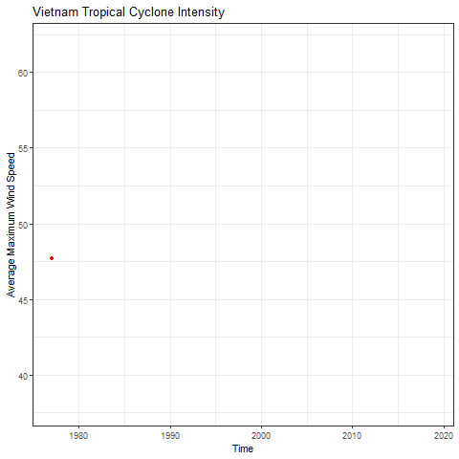
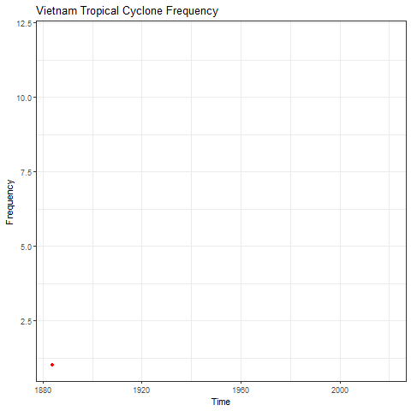

Slide 4
Problem Statement
This study aims to identify the vulnerability of populations in Vietnam to tropical cyclones within the context of anthropogenic climate change, and identify strategies that would help mitigate the impacts of future tropical cyclone events. This includes examining the presence of mangrove ecosystems as a form of mitigation.
Objectives
Create a vulnerability index including an analysis on the exposure, sensitivity, and adaptive capacity of populations in Vietnam to tropical cyclones
Provide maps and guidelines to mitigate impacts of cyclones

Slide 5
Data
Variable | Data | Data Type | Spatial Resolution | Source
Tropical Cyclones | IBTrACS | netCDF, csv, shapefile (point & line) | NA | NOAA
Precipitation | WorldClim | GeoTIFF | 2.5 min | Worldclim
Elevation | SRTM | GeoTIFF | 10, 5, 2.5 min, 30 sec | Worldclim
Mangrove Forests | Aquaculture Data | GeoTIFF | 15 m | Clark Labs
Administrative Boundaries | Administrative boundary polygons | Shapefile/GDB | NA | OCHA
Population Data | Population Density & Persons Per Pixel | GeoTIFF | 1 km, 100m | WorldPop
Land Cover | Global Land Cover Data | GeoTIFF | 300 m | ESA CCI
Protected Areas | World Database on Protected Areas (WDPA) | shapefile | NA | Protected Planet
Health Facilities | HOTOSM Viet Nam Health Facilities | shapefile | NA | OCHA
Roads | Digital Maps & Geospatial Data | shapefile | NA | Princeton University

Slide 6
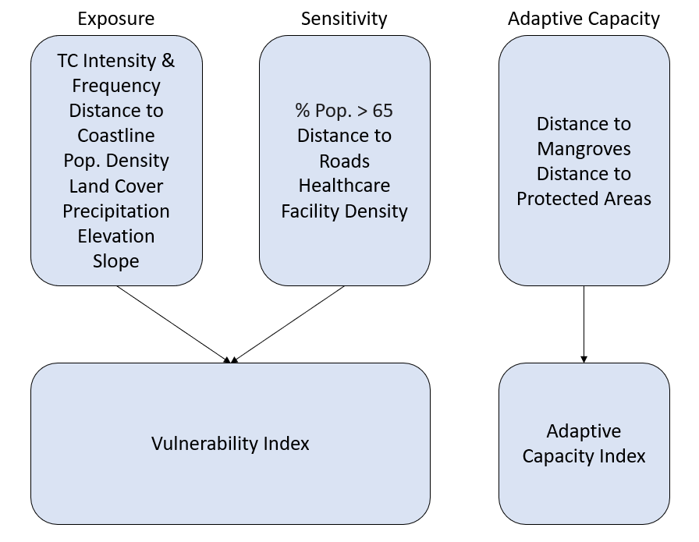
Framework

Slide 7
Methods
Reclassify data from 1 (Low) - 5 (High)
Use Raster Calculator to combine reclassified data layers and create an Index
  Exposure (8) + Sensitivity (3)) / 11
  Adaptive Capacity (2) / 2
Create table of values using Zonal Statistics for provincial data
  Mean Vulnerability
  Mean Adaptive Capacity
Join tables to administrative boundary features
Apply bivariate symbology (Quantile)

Slide 8
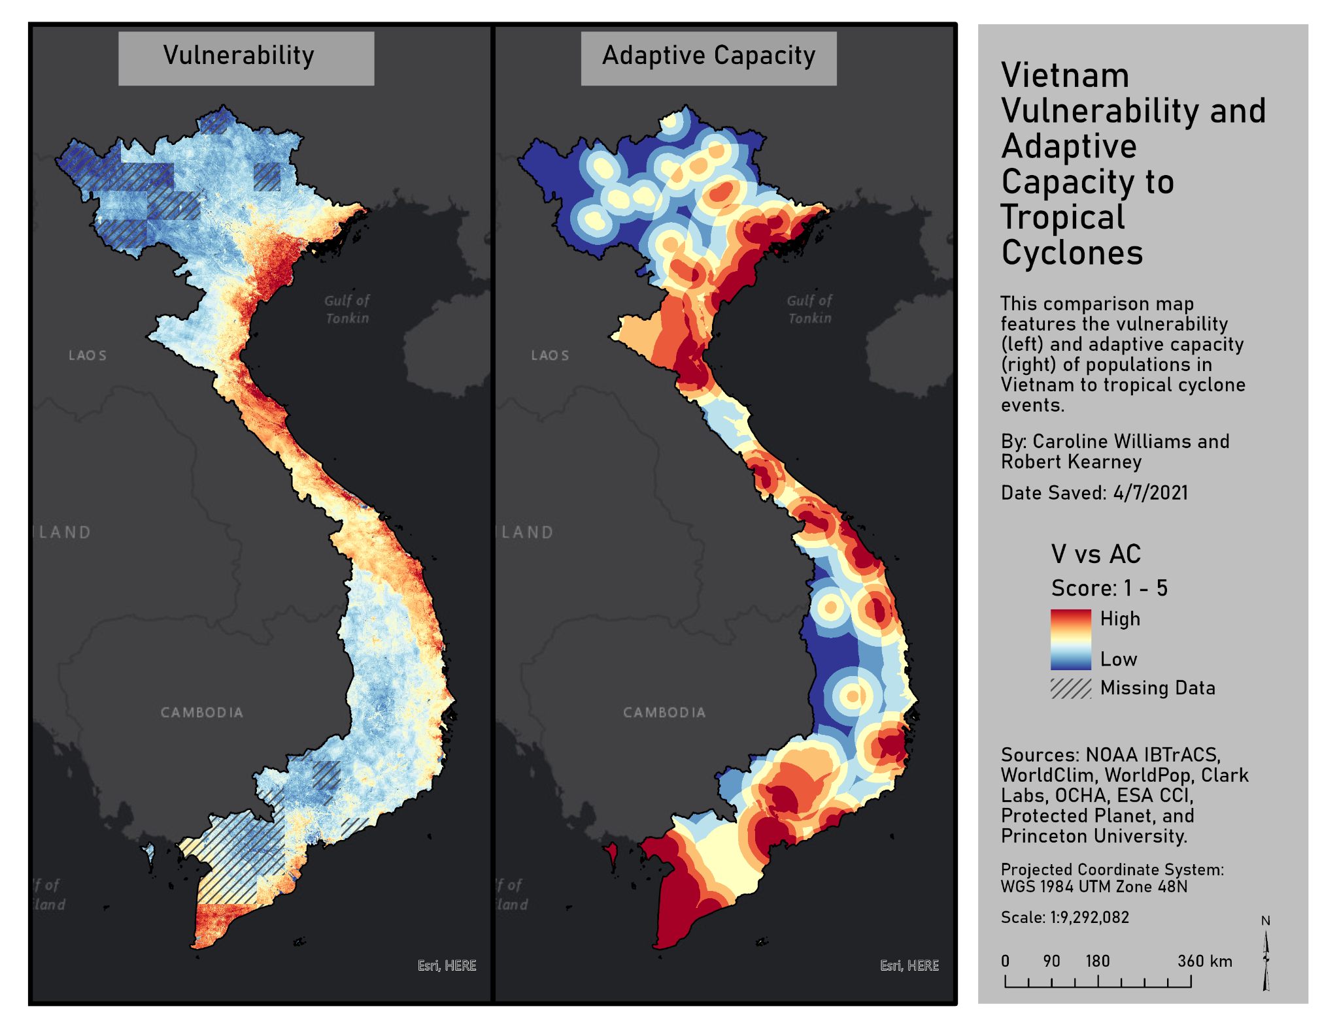
Results
Missing Data
Number of Variables
Clear Breaks in Index Values

Slide 9
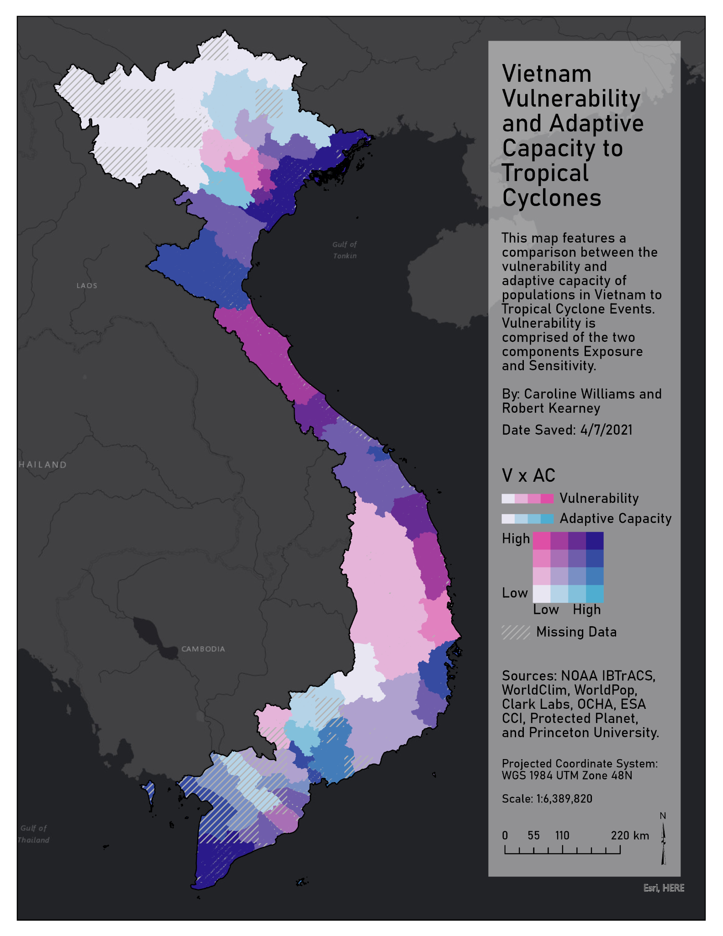
Results
Missing Data
Shades of Pink represent areas with higher average vulnerability
Shades of Blue represent areas with higher average adaptive capacity
Darker colors represent higher values and lighter colors represent lower values

Slide 10
Discussion
The northern coastline of Vietnam is highly vulnerable to tropical cyclones but also features a high adaptive capacity due to the protection of nearby mangrove forests and protected areas
Limitations includes the uneven distribution of variables between the three components, exposure, sensitivity, and adaptive capacity
  Ideally, sensitivity and adaptive capacity would include more variables, however there were limitations in data availability
One of the clear limitations of this modeling approach is that it is entirely qualitative.
Notes:
For example, even with data that is quantitative (distance, slope, elevation, density), the values are reclassified and ranked. These groupings are based on preferential/non-preferential conditions and represented as ordinal data.

Slide 11
Conclusion
Future work should include projected variables to predict the vulnerability at various climate scenarios (RCP 4.5 and RCP 8.5)
  Projected variables can include predicted annual and monthly temperature and precipitation (WorldClim CMIP6), predicted land cover and mangroves using LCM in TerrSet 2020, and any other available projected climate and socio- economic data
Additionally, future analyses should incorporate additional variables in the sensitivity and adaptive capacity components
We also recommend exploring aspects of direction in tropical cyclones and at what angle they often face mangrove areas
This framework is widely used and should continue to be incorporated into geospatial vulnerability assessments. While using and MCE approach is sufficient, we also suggest further exploration on alternative methods of aggregating data

Slide 12
References
Ali, S. A., Khatun, R., Ahmad, A., & Ahmad, S. (2019). Assessment of Cyclone Vulnerability, Hazard Evaluation and Mitigation Capacity for Analyzing Cyclone Risk
using GIS Technique: a Study on Sundarban Biosphere Reserve, India. Earth Systems and Environment, 4. doi:10.1007/s41748-019-00140-x
Cerveny, R. S., & Newman, L. E. (2000). Climatological Relationships between Tropical Cyclones and Rainfall. Monthly Weather Review, 128(9), 3329-3336.
doi:10.1175/1520-0493(2000)128<3329:Crbtca>2.0.Co;2
de Sherbinin, A., Bukvic, A., Rohat, G., Gall, M., McCusker, B., Preston, B., . . . Zhang, S. (2019). Climate vulnerability mapping: A systematic review and future
prospects. WIREs Climate Change, 10(5), e600. doi:https://doi.org/10.1002/wcc.600
Ellison, J. C., & Zouh, I. (2012). Vulnerability to Climate Change of Mangroves: Assessment from Cameroon, Central Africa. Biology, 1(3), 617-638.
doi:10.3390/biology1030617
Elsner, J., Hodges, R., & Jagger, T. (2012). Spatial grids for hurricane climate research. Climate Dynamics, 39(1/2), 21-36. doi:10.1007/s00382-011-1066-5
Kossin, J. P., Emanuel, K. A., & Camargo, S. J. (2016). Past and Projected Changes in Western North Pacific Tropical Cyclone Exposure. Journal of Climate, 29(16),
5725-5739. doi:10.1175/JCLI-D-16-0076.1
Nguyen T, T., Hoang D., C., Nguyen X., H., & Chanh, K. (2020). Relationship between sea surface temperature and the maximum intensity of tropical cyclones
affecting Vietnam's coastline. International Journal of Climatology, 40(5), 2527. doi:10.1002/joc.6348
Nguyen, T. P., & Parnell, K. E. (2019). Coastal land use planning in Ben Tre, Vietnam: constraints and recommendations. Heliyon, 5(4), e01487.
doi:10.1016/j.heliyon.2019.e01487
Takagi, H., Thao, N., Esteban, M., Tam, T., Knaepen, H., & Mikami, T. (2012). Vulnerability of coastal areas in Southern Vietnam against tropical cyclones and storm
surges.
Tinh, P. H., & Tuan, M. S. (2015). Vulnerability to climate change of mangroves in Xuan Thuy National Park, Vietnam. Journal of Agricultural and Biological Science,
10(2), 55-60.
Weis, S. W. M., Agostini, V. N., Roth, L. M., Gilmer, B., Schill, S. R., Knowles, J. E., & Blyther, R. (2016). Assessing vulnerability: an integrated approach for mapping
adaptive capacity, sensitivity, and exposure. Climatic Change, 136(3), 615-629. doi:10.1007/s10584-016-1642-0

