Slide 1
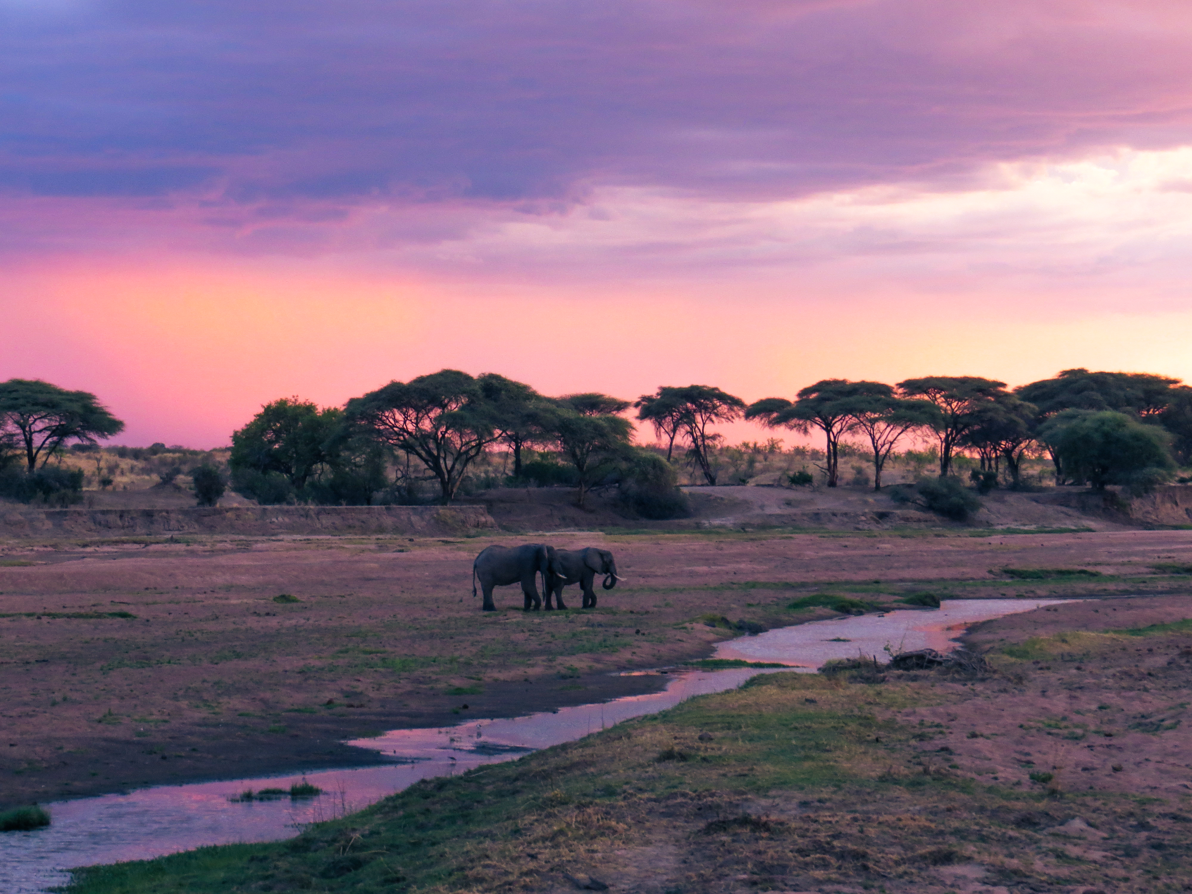
Environmental Trends Analysis of the Ruaha and Katavi National Parks of Tanzania
Advanced Remote Sensing & Clark Consulting with the Wildlife Conservation Society
Caroline Williams & Rowan Moody
Thursday, 6/3/2021

Slide 2
Research Objectives
Monitor trends in fire occurrences, vegetation, human population, precipitation, and surface water over Ruaha and Katavi study area between the years 2000 and 2020
Based on previous trends, provide information on potential impacts of environmental change on wildlife habitat and migration corridors within study area
Rate Ruaha, Katavi, and non-national park areas within the study area based on recorded trends
Notes:
Examine and describe the land cover transformation over the last 20 yrs, processes that affect land cover (e.g., wildfires, rainfall, etc)
Identify how these processes will affect people and wildlife as the climate continues to change
Characterize

Slide 3
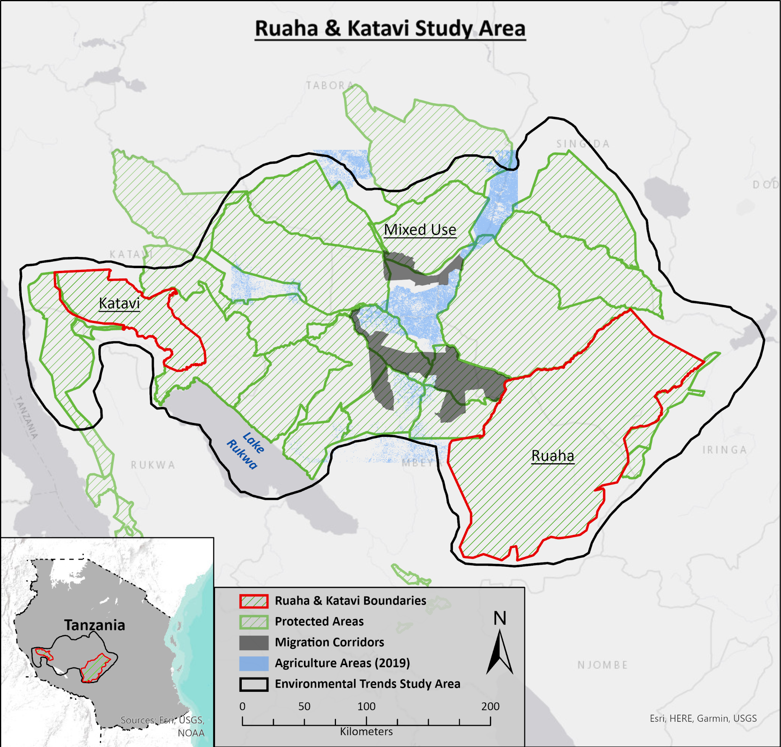
Tanzania: 885,800 km²
Study Area: ~119,214 km²
Ruaha Area: 20,264.4 km²
Katavi Area: 4,279.7 km²
Mixed Use Area: 94,669.9 km²

Slide 5
Data Table
Variable | Type | Spatial Resolution | Temporal Resolution | Source
Agriculture | Raster | 30 m | 2009, 2014, 2019 | Landsat 8 - https://www.usgs.gov/core-science-systems/nli/landsat/landsat-8?qt-science_support_page_related_con=0#qt-science_support_page_related_con
Fire | Shapefile/Raster | Point aggregated to 10 km | 2001-2020 | MODIS - https://firms.modaps.eosdis.nasa.gov/active_fire/#firms-shapefile
Population | Raster | 1 km | 2000 - 2020 | WorldPop - https://www.worldpop.org/geodata/listing?id=75
Precipitation | Raster | 2.5 minutes | 2000-2018 | WorldClim - https://www.worldclim.org/data/monthlywth.html
Surface Water | Raster | 10° | 1984 - 2019 | Global Surface Water Explorer - https://global-surface-water.appspot.com/
Vegetation | Raster | 250 m | 2000 - 2020 | MODIS - https://modis.gsfc.nasa.gov/data/dataprod/mod13.php

Slide 6
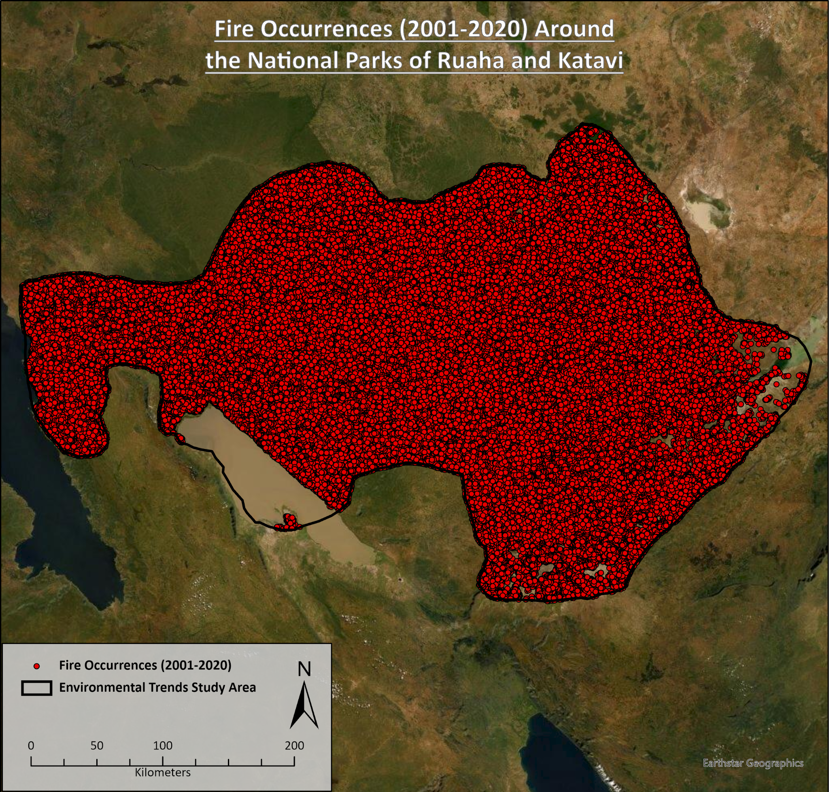
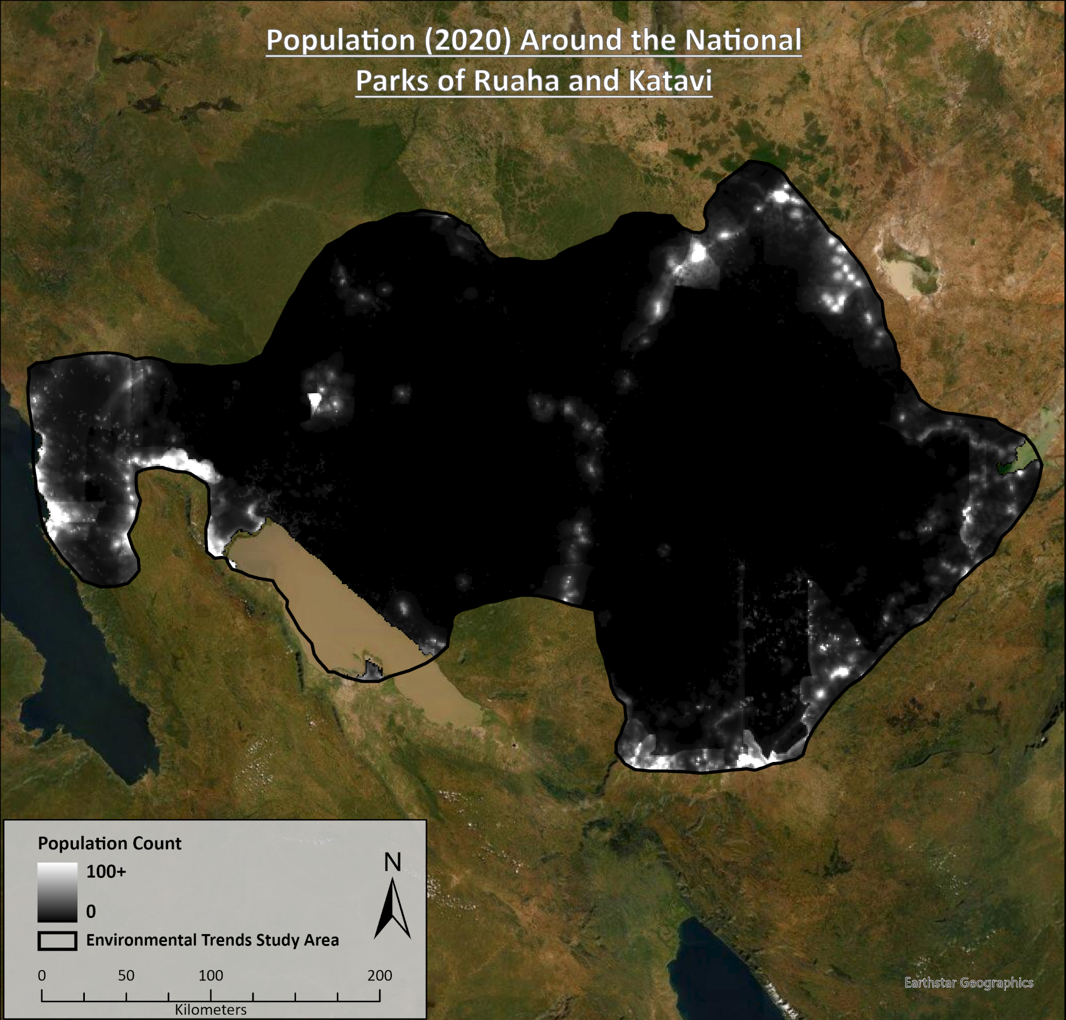
Fire Occurrences
Population

Slide 7
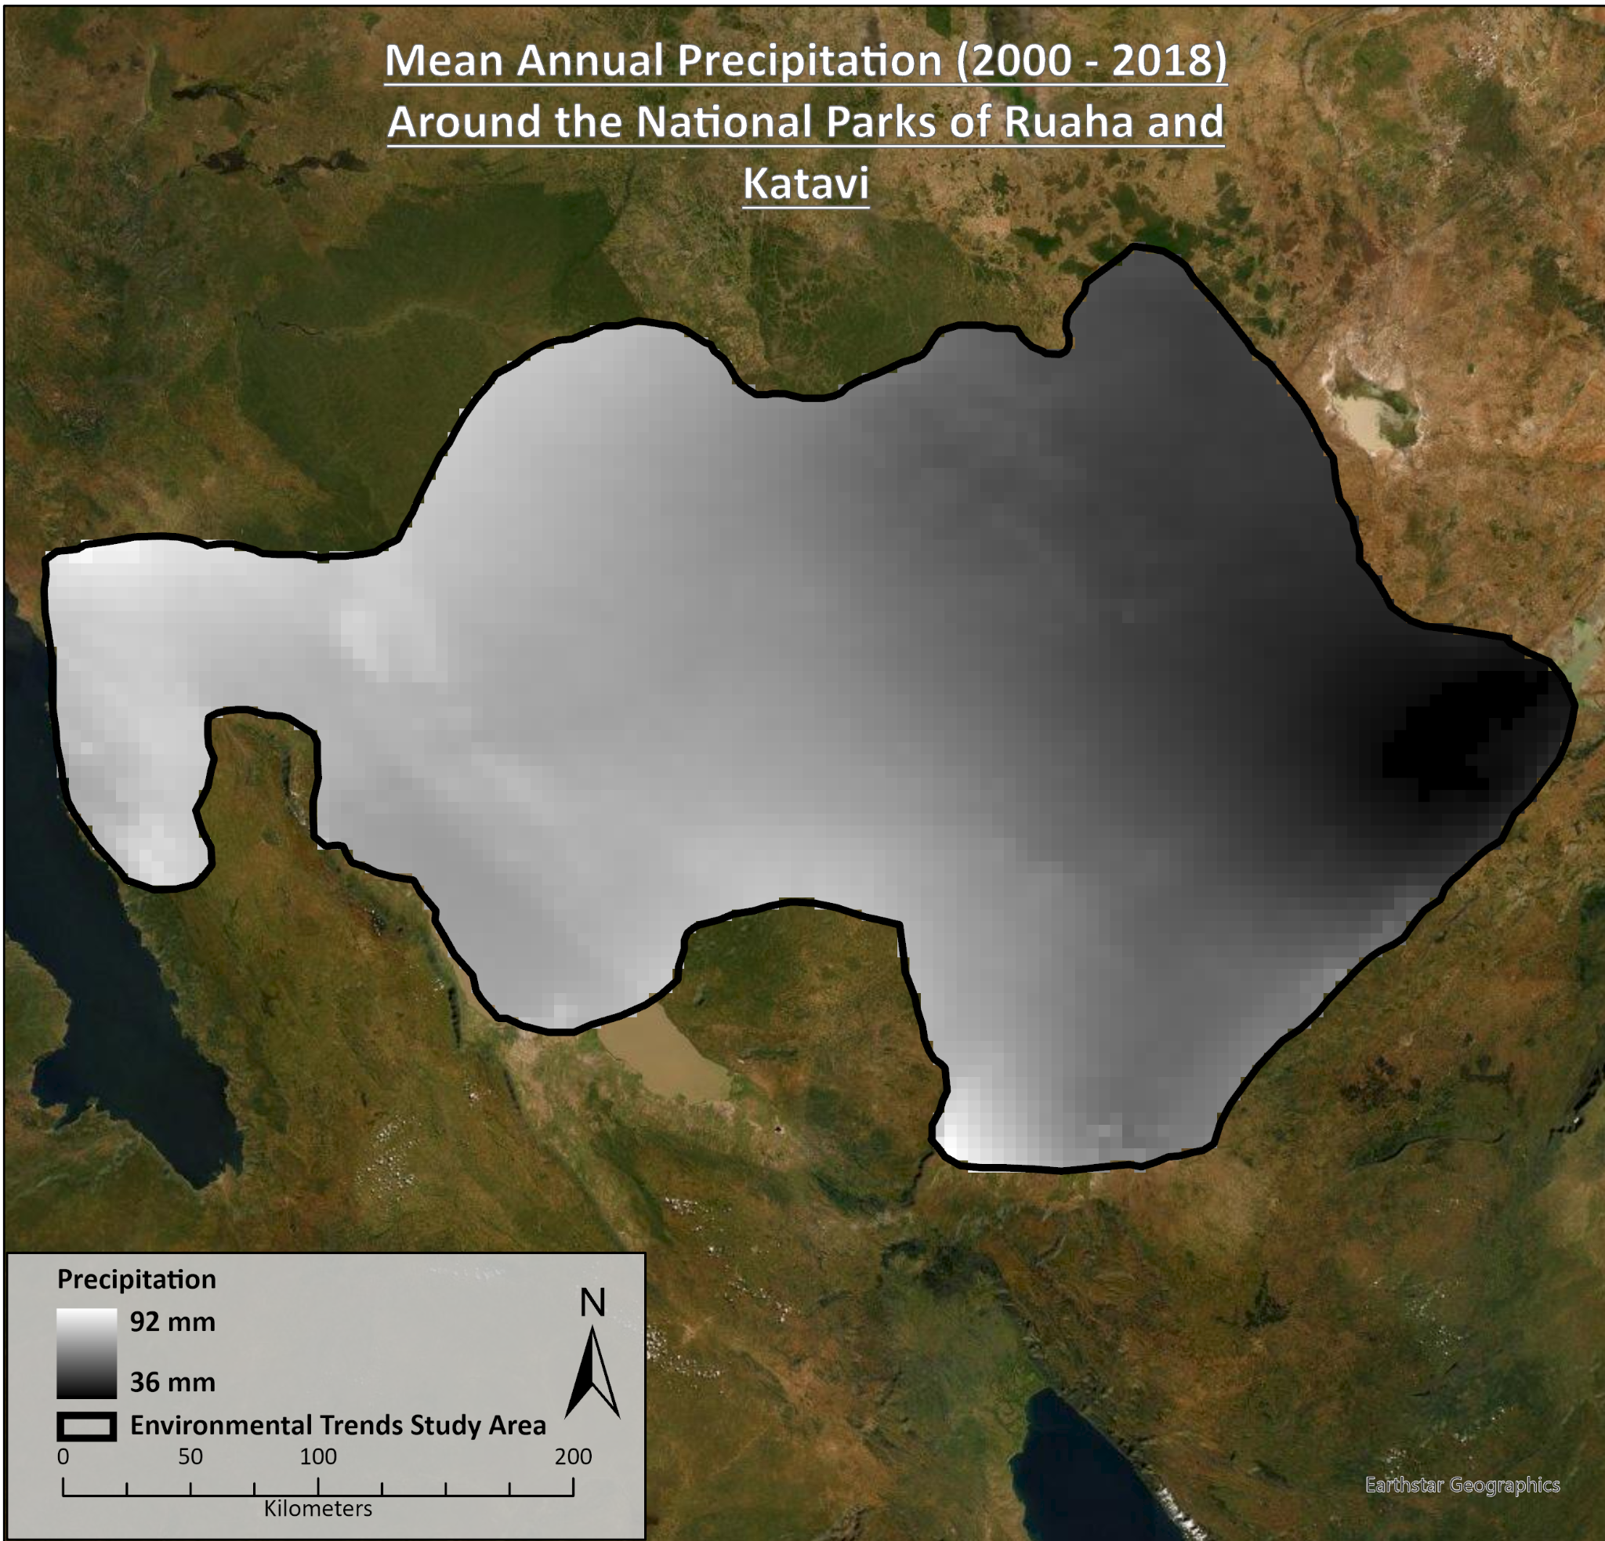
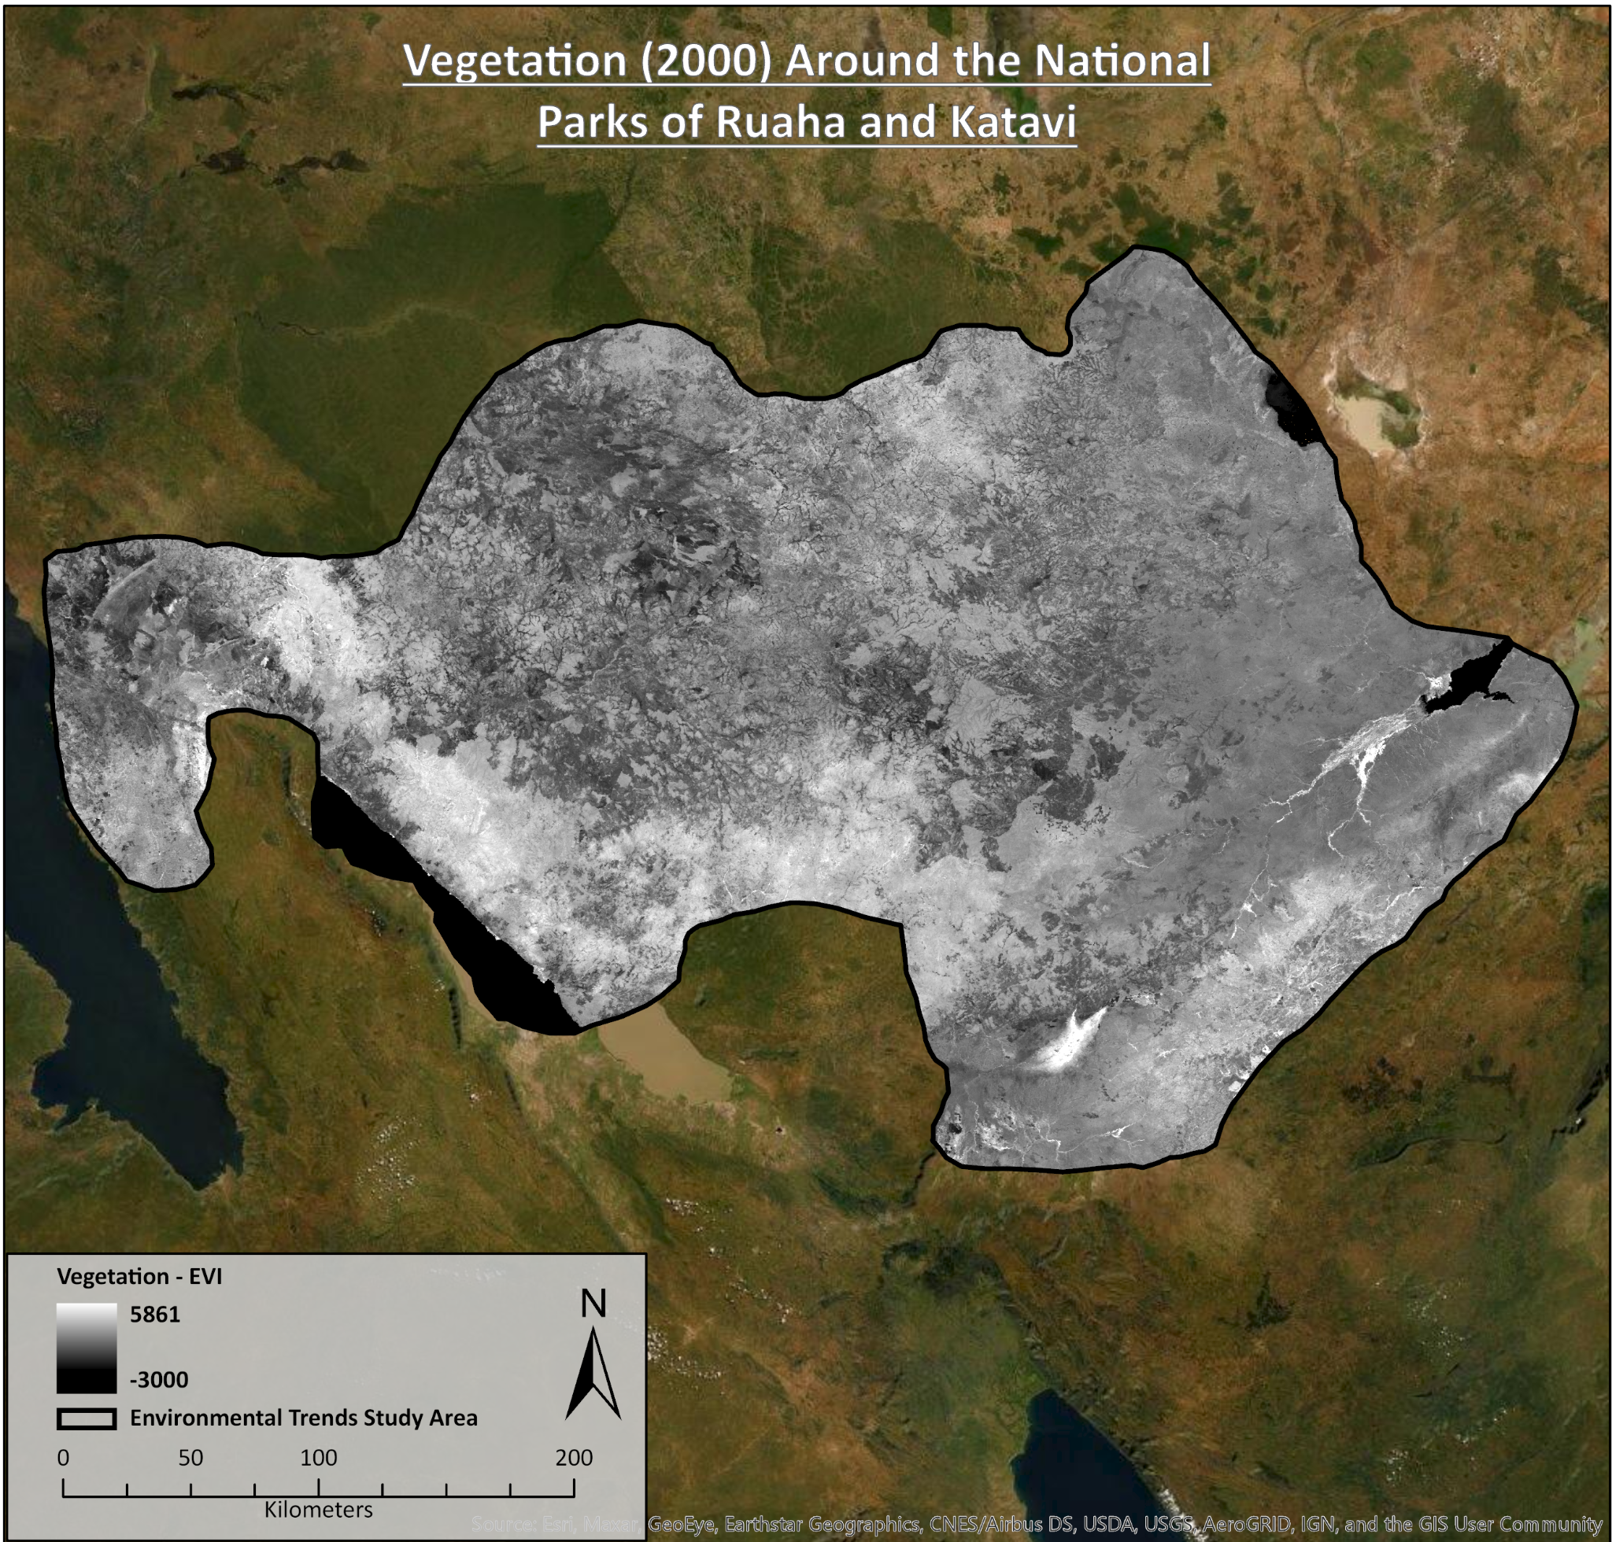
Precipitation
Vegetation

Slide 8
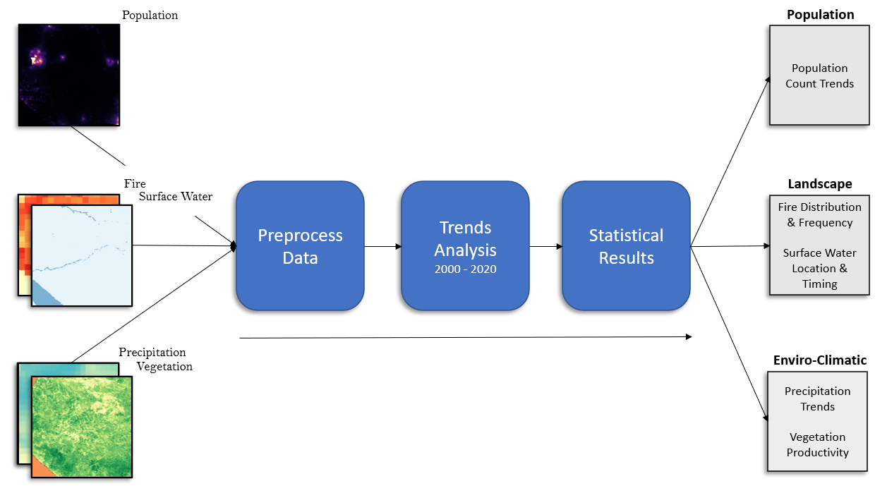
Methodology

Slide 9
Results

Slide 10
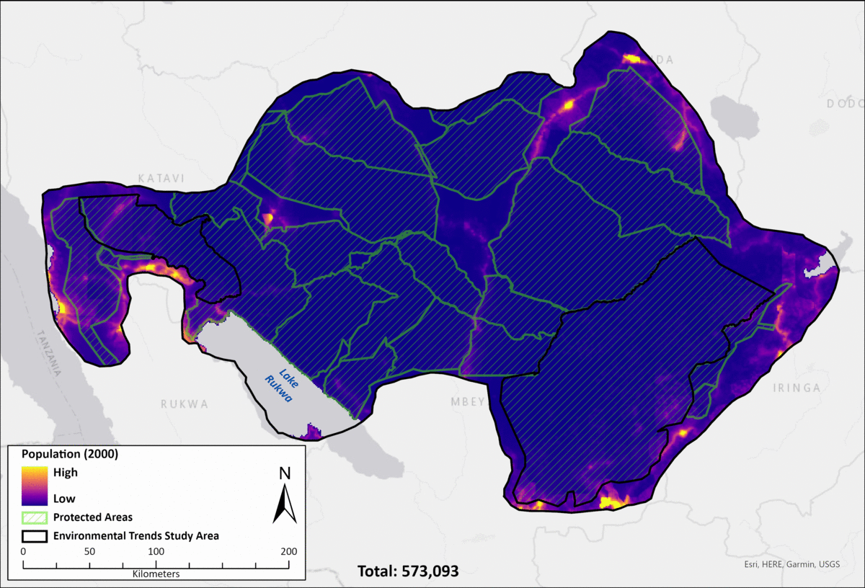
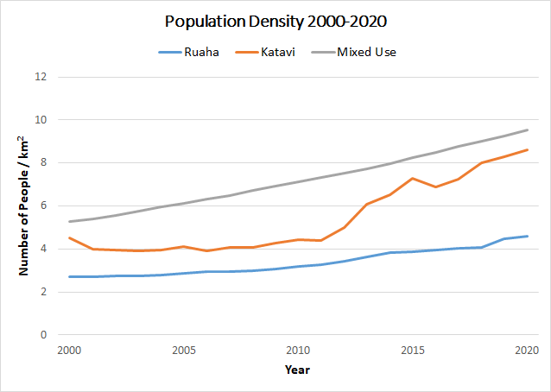
Population Trends 2000-2020
Population Change | Katavi | Ruaha | Mixed Use | Study Area
2000 | 19,380 | 55,049 | 498,665 | 573,093
2020 | 36,838 | 92,669 | 902,437 | 1,031,944
Percent Change | +90.08% | +68.34% | +80.97% | +80.07%

Slide 11
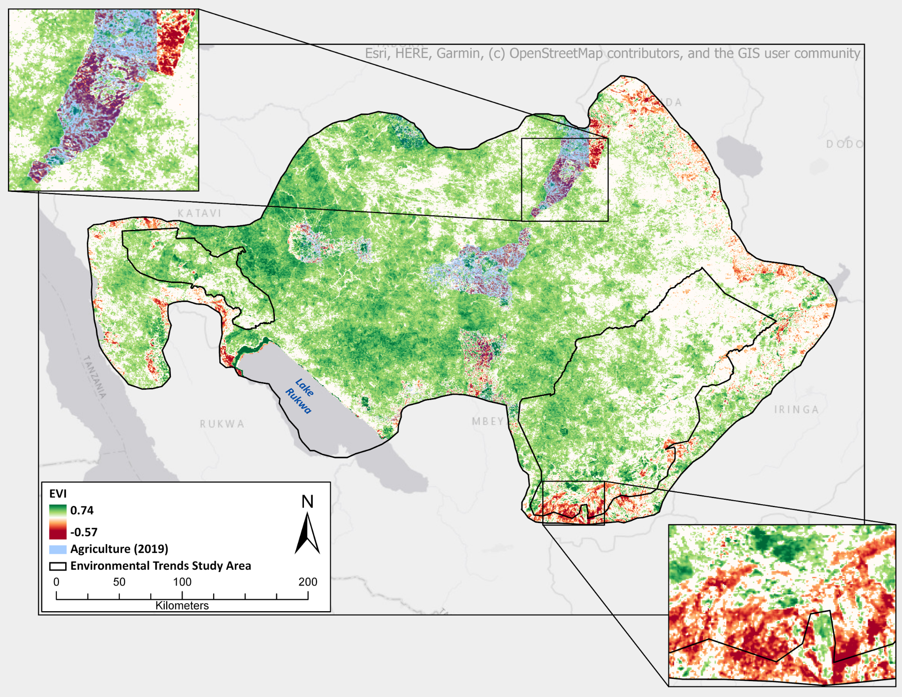
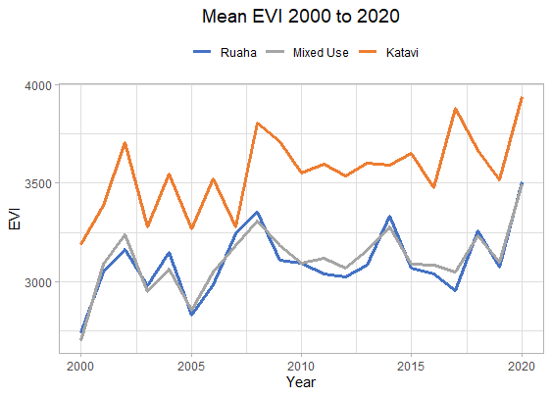
Vegetation Trends 2000-2020
Ruaha: 16.59% Increase
Katavi: 17.27% Increase
Mixed Use: 15.40% Increase
*based on 2001 and 2020 Annual Means

Slide 12
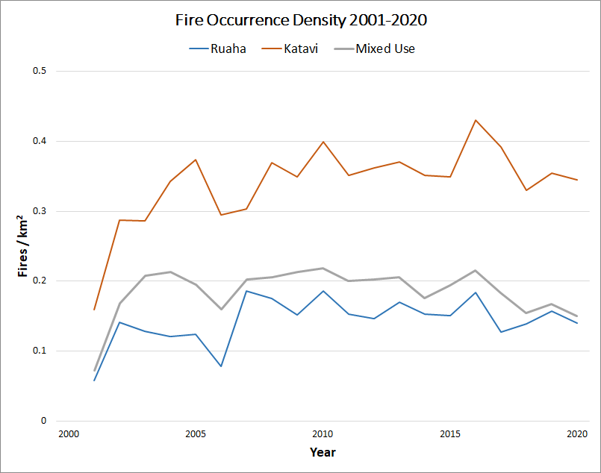
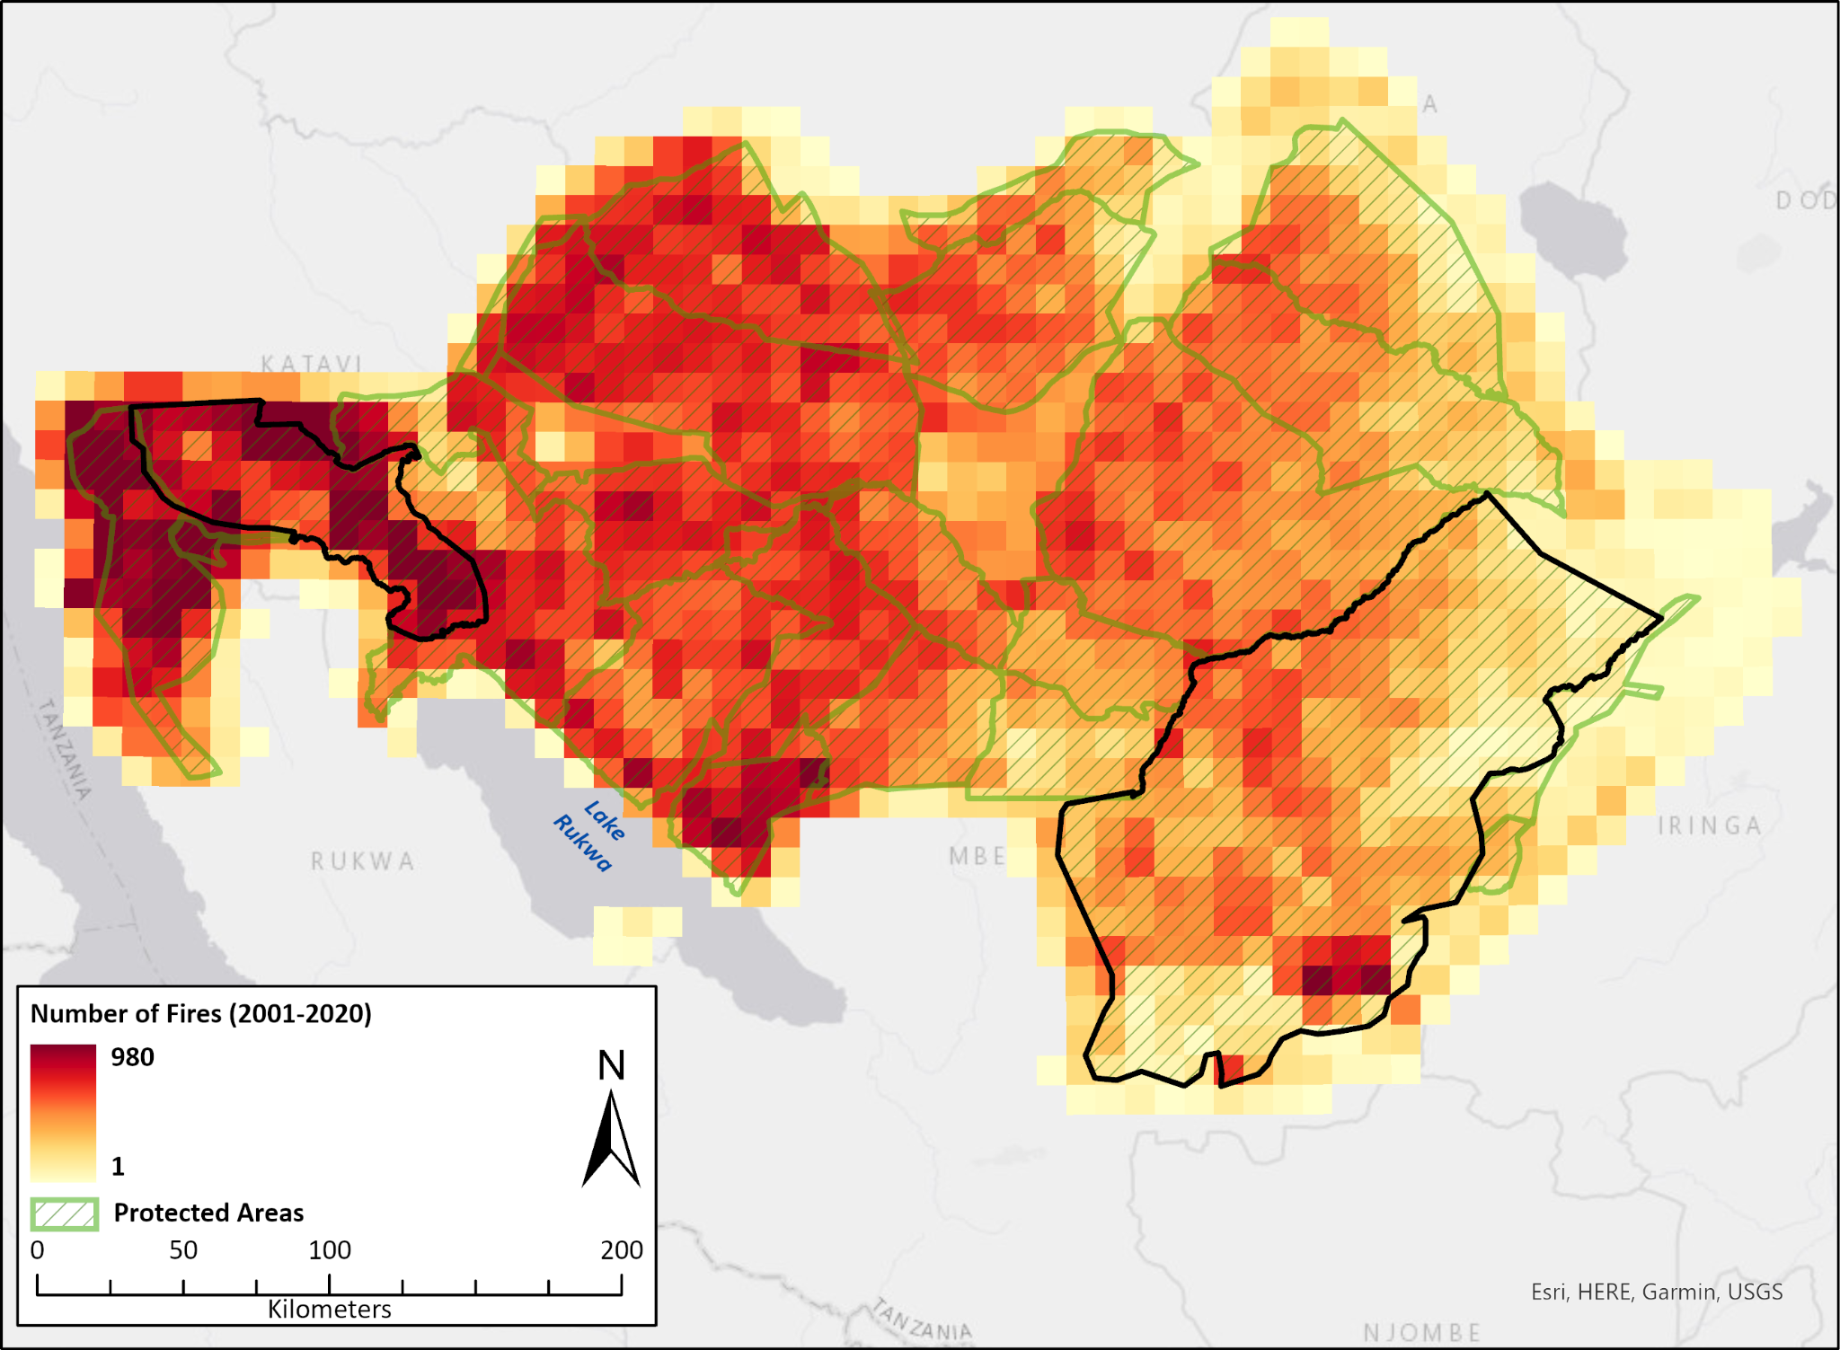
Fire Frequency and Distribution 2001-2020
Ruaha: 15.87% Increase
Katavi: 14.78% Increase
Mixed Use: 11.13% Decrease
*based on 2005 and 2020 Five-Year Mean (excluding 2001)

Slide 13
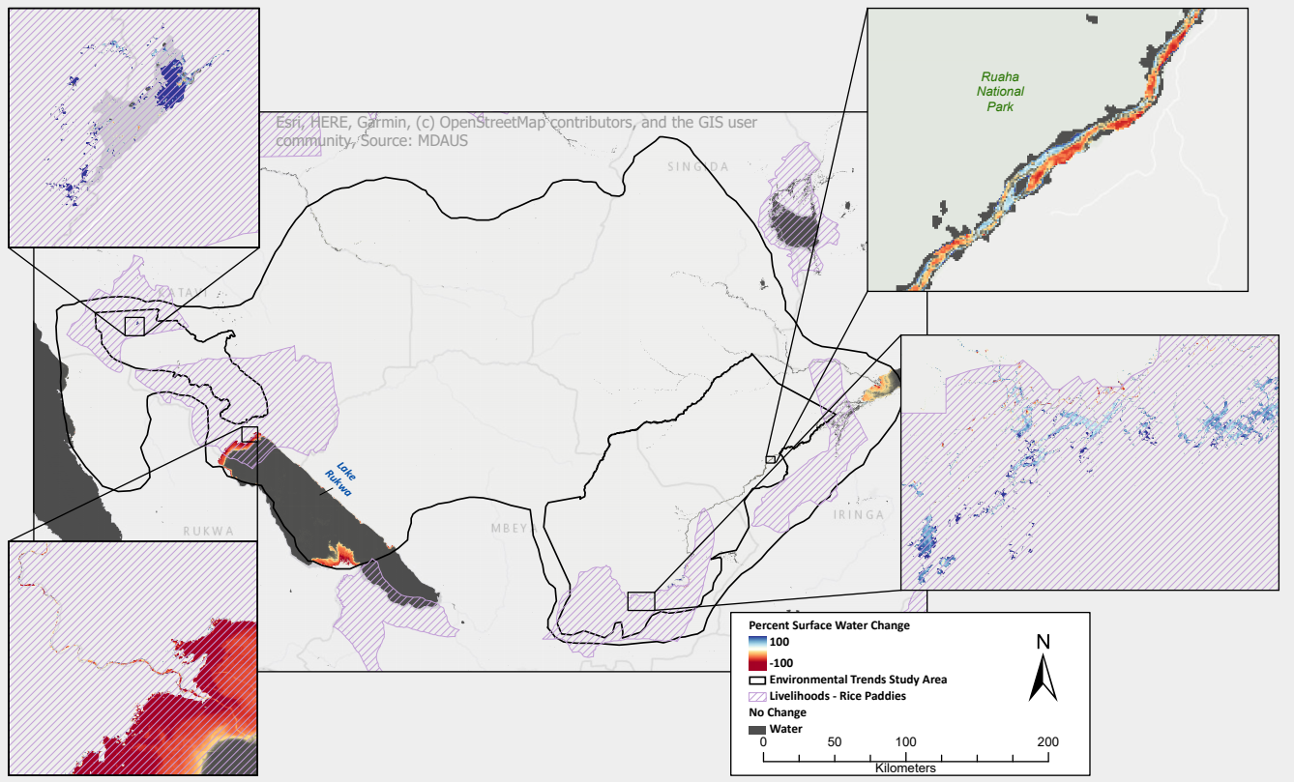
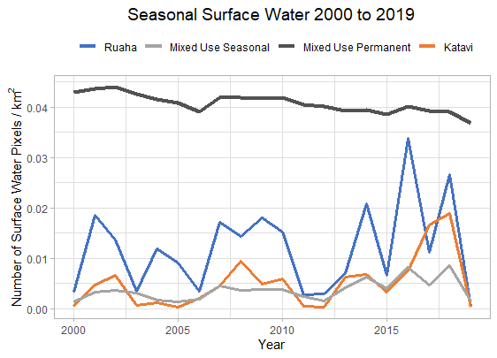
Surface Water Trends 2000-2019
Ruaha: 0.21% Increase
Katavi: 0.15% Increase
Mixed Use: 0.78% Decrease

Slide 14
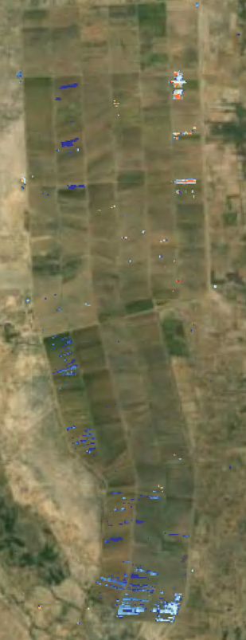
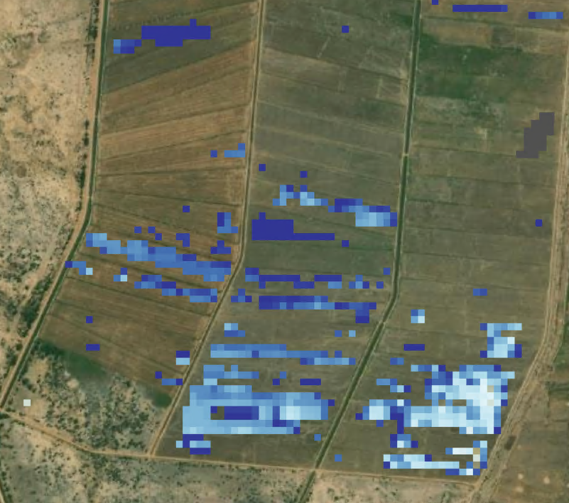
Notes:
Example of rice paddy agriculture featuring increasing surface water trends. This example corresponds to the livelihoods rice paddy layer included in slide 13 on surface water trends.

Slide 15
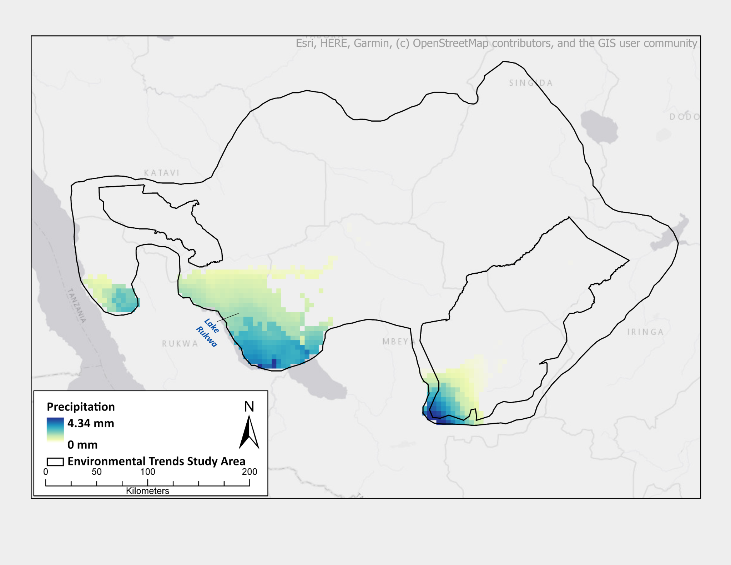
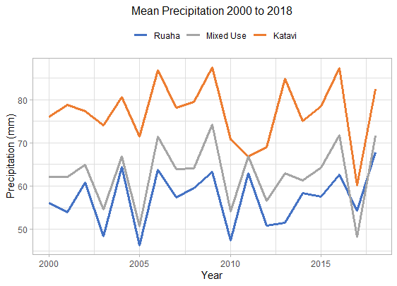
Precipitation Trends 2000-2018
Ruaha: 20.97% Increase
Katavi: 8.45% Increase
Mixed Use: 15.86% Increase
*based on 2000 and 2018 Annual Means

Slide 16
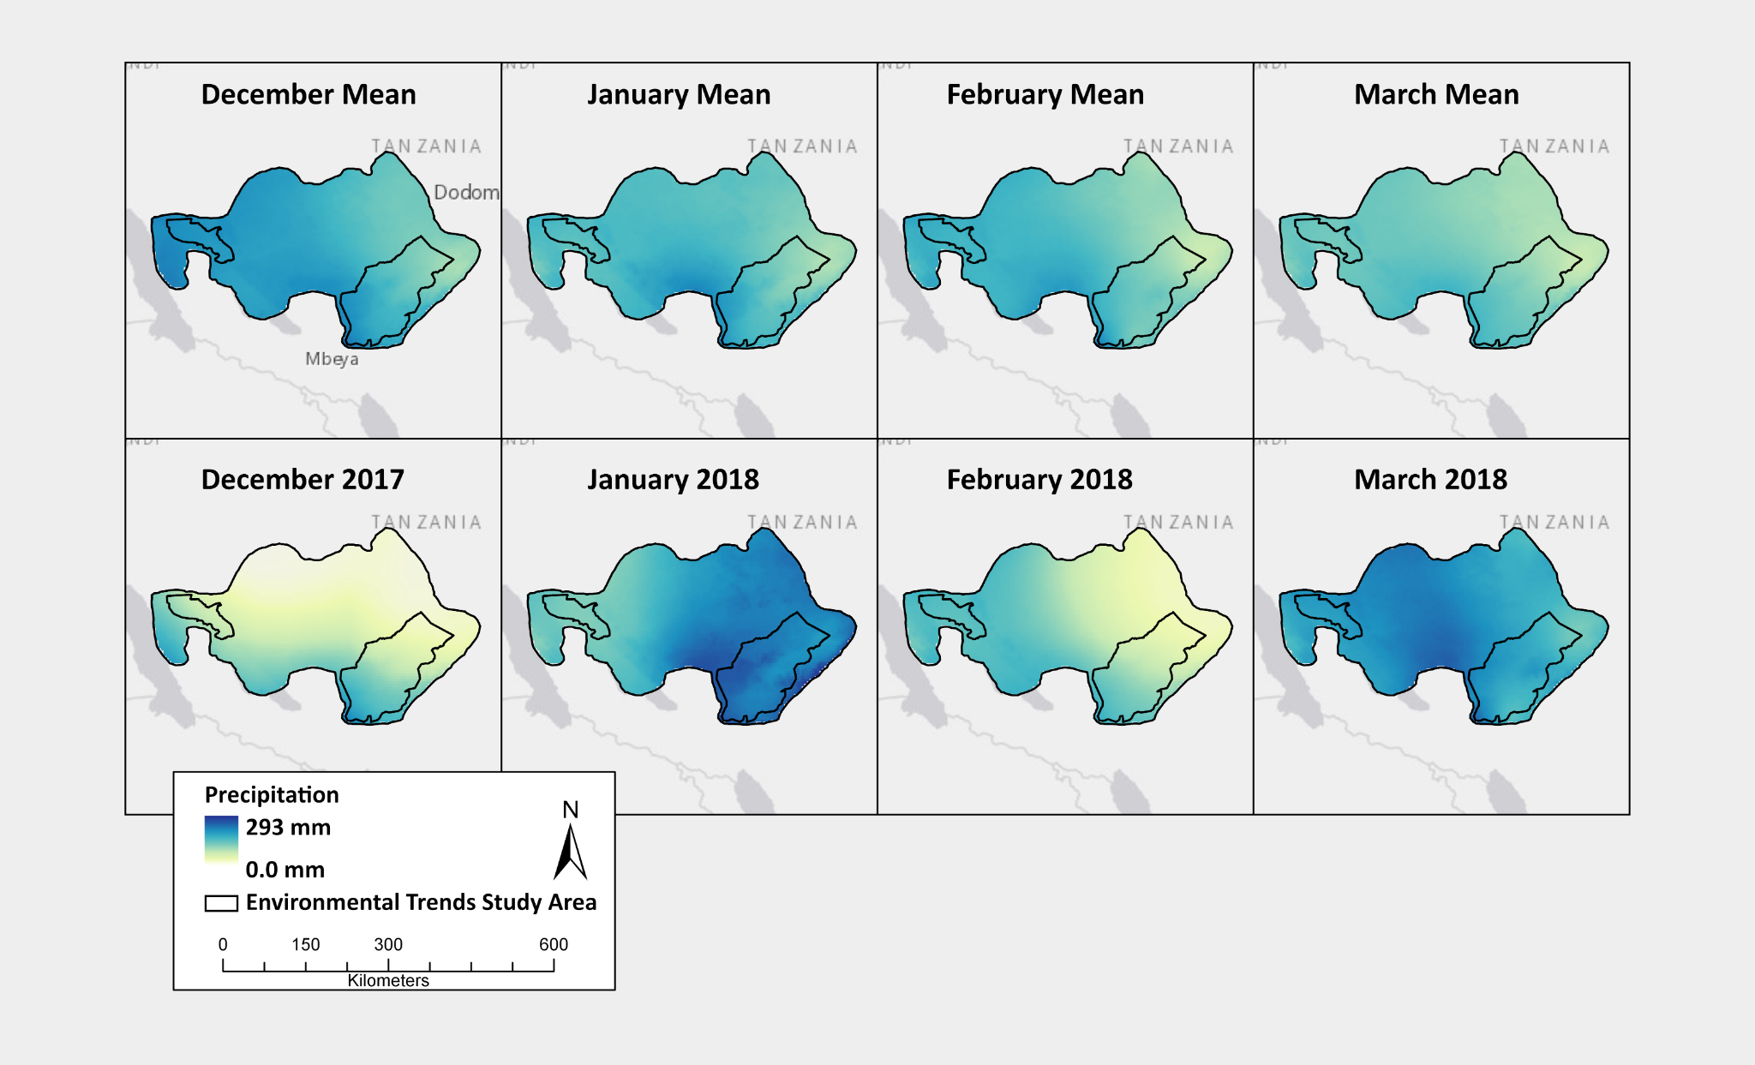
Wet Season
4.5

Slide 17
Ruaha Report Card
+68.34%
Population
+16.59%
Vegetation
+15.87%
Fire
+20.97%
+0.21%
Precipitation
Surface Water

Slide 18
Katavi Report Card
+90.08%
Population
+17.27%
Vegetation
+14.8%
Fire
+8.45%
+0.15%
Precipitation
Surface Water

Slide 19
Mixed Use Report Card
+80.97%
Population
+15.40%
Vegetation
-11.13%
Fire
+15.86%
-0.78%
Precipitation
Surface Water

Slide 20
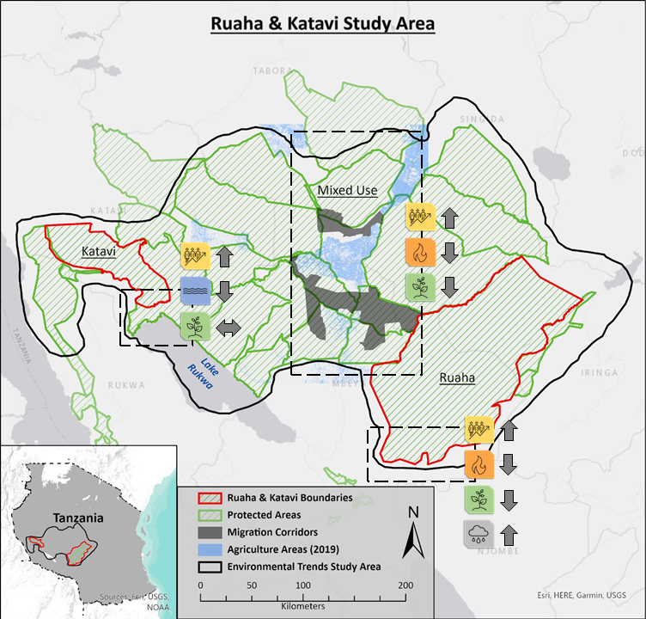
Conclusions
Ruaha and Katavi National Parks are experiencing an increasing trend across all variables included in this study
Increases in population, fire, and vegetation are especially prominent in Katavi, meanwhile Ruaha is demonstrating a high increase in precipitation and surface water
The Mixed Use area is showing both increasing and decreasing trends across the landscape
Specifically, there is a notable decrease in fire and surface water

Slide 21
Acknowledgements
Many thanks to David Wilke and Danielle LaBruna of the Wildlife Conservation Society (WCS) for their collaboration on this project.
Additional thanks to John Rogan and Nicholas Geron of Clark University for their support and mentorship throughout this semester.

Slide 22
Thank you!
Any questions?

