Slide 1
CENTRAL AMERICA
Disasters
Using Earth Observations to Map Flooding for Disaster Monitoring, to Inform Potential Risk, and Prepare for Possible Response
Lauren Carey, Maria De Los Santos, Deanna Fanelli, Payton Ireland, and Caroline Williams
Alabama – Marshall
Notes:
Speaker:
This projected was conducted by Lauren Carey, Maria De Los Santos, Deanna Fanelli, Payton Ireland, and Caroline Williams (Project Lead), remotely at the Marshall Space Flight Center (MSFC) node. We examined the floods impacts of Hurricanes Eta and Iota as well as produce historical surface water maps, precipitation maps, and a code tutorial for the Central America region.

Slide 2
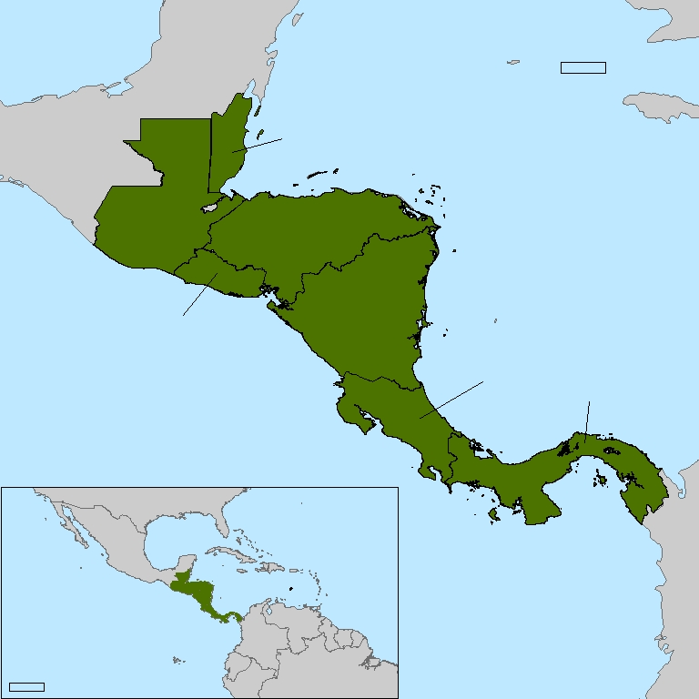

STUDY AREA
Central America including:
  Belize
  Costa Rica
  El Salvador
  Guatemala
  Nicaragua
  Honduras
  Panama
150 KM
BELIZE
HONDURAS
<Include editable study area map here>
GUATEMALA
NICARAGUA
  Case Study Analysis
    Oct 17, 2020 – Dec 2, 2020
  Historical Surface Water Maps
    Jan 2015 – Oct 2021
  Precipitation Analysis
    Oct 31, 2020 – Nov 18, 2020
EL SALVADOR
COSTA RICA
STUDY PERIOD
PANAMA
1000 KM
STUDY AREA
Notes:
Speaker:
Our project was focused on the Central American region. The specific countries studied were Belize, Guatemala, El Salvador, Honduras and Nicaragua along with portions of Costa Rica and Panama. These areas were selected as they were the most impacted by Hurricanes Eta and Iota. The case study analysis was centered on the events of Hurricane Eta and Iota which devastated Central America in November of 2020. The study focused two weeks prior to Eta, October 17, 2020, to two weeks post Iota, December 2, 2020. The historical surface water maps we produced start in January 2015 and commence in October 2021. The precipitation analysis focused on the two hurricane events which was conducted within the same time period as the case study analysis, October 31, 2020 to November 12, 2020.
-------------------------Image Information Below-------------------------
Image Credit: Lauren Carey (DEVELOP team member)
Image Source: https://hub.arcgis.com/datasets/UIA::uia-world-countries-boundaries/explore?location=-2.688200%2C0.000000%2C0.99 (UIA World Countries Boundaries. Published May 30, 2015. Last updated April 14, 2021. ESRI Master License. - Created by DEVELOP team member Lauren Carey)

Slide 3


OBJECTIVES
</>
Identify
areas of possible flood vulnerability through the creation of historical surface water and precipitation maps.
Demonstrate
the potential of the HYDRAFloods tool for disaster analysis through a case study of Hurricanes Eta and Iota.
Design
a HYDRAFloods code tutorial to support and enhance partners' monitoring capacity.
Image Credit: "Search" by iconlabs from the Noun Project, "Hurricane" by icon 54 from the Noun Project
Notes:
Speaker:
The overarching goal of the project was to support partners’ current disaster monitoring and response through remote sensing analysis and training materials.
Within this framework, the project had three objectives:
- First, we wanted to identify areas vulnerable to flooding by producing surface water and precipitation maps for the Central American region.
- Second, as our partners were new to HYDRAFloods, we conducted a case study analysis of Hurricanes Eta and Iota to demonstrate the applicability of HYDRAFloods for disaster monitoring in the study region.
- Finally, create a code tutorial or guide for HYDRAFloods tool that could be used by partners to conduct their own analyses.
-------------------------Image Information Below-------------------------
Icon sources from left to right from users:
"Search" by iconlabs from the Noun Project https://thenounproject.com/search/?q=search&i=4366060 (CC-BY)
"Hurricane" by icon 54 from the Noun Project https://thenounproject.com/search/?q=hurricane&i=1925975 (CC-BY)
Note – the last image is just simply a textbox with "</>"

Slide 4
Sistema de la Integración
Centroamericana (SICA)
PARTNERS
Comité Regional de Recursos
Hidráulicos (CRRH)
Centro de Coordinación
para la Prevención de los Desastres en América Central y República Dominicana
(CEPREDENAC)​
SICA: coordinates political and economic activities between member states
CRRH: focuses on water resource management
CEPREDENAC: examines disaster response and mitigation strategies
Notes:
Speaker:
For this project, we partnered with 3 organizations. Sistema de la Integración Centroamericana, or the Central American Integration System, coordinates economic and political activities between Central American countries since 1993. The administrative center is based in El Salvador.
Comité Regional de Recursos Hidráulicos, or the Regional Water Resources Committee, is an intergovernmental body under SICA that focuses on water resource management – specifically by coordinating and facilitating projects and working to strengthen national water management policies.
Centro de Coordinación para la Prevención de los Desastres en América Central y República Dominicana, or The Coordination Center for the Prevention of Disasters in Central America and the Dominican Republic, is also an intergovernmental body under SICA. This organization promotes international cooperation and the exchange of information and technical support in disaster prevention, response, and mitigation.

Slide 5
COMMUNITY CONCERNS
Environmental changes are increasing the frequency and intensity of Hurricanes
Hurricanes destroy homes and infrastructure and pose a threat to human life
The storms severely damaged homes and infrastructure, causing an estimated $738 million in damages and 189 deaths
Hurricane Eta and Iota affected more than 8 million people in Central America
Image Credit: NASA
Notes:
Speaker:
Some community concerns that drive this project are that environmental changes increase the frequency and intensity of Hurricanes. These hurricanes destroy homes and infrastructure and pose a threat to human life.
On November 3rd, 2020, Hurricane Eta made landfall in Central America, and just two weeks later, on November 16th, Hurricane Iota followed a similar path. These storms brought catastrophic wind and rain to the region affecting more than 8 million people. Combined, these storms caused an estimated $738 million in damages and 189 deaths.
With the increasing frequency of these storms, it is crucial to understand how flooding has affected communities in Central America in an effort to prepare for future events.
-------------------------Image Information Below-------------------------
Image Source: NASA Goddard Space Flight Center License: CC-BY Unknown Author. https://www.flickr.com/photos/gsfc/42828604840/
Icon Source: PowerPoint (Office 2019) [World Icon: North and South America]

Slide 6

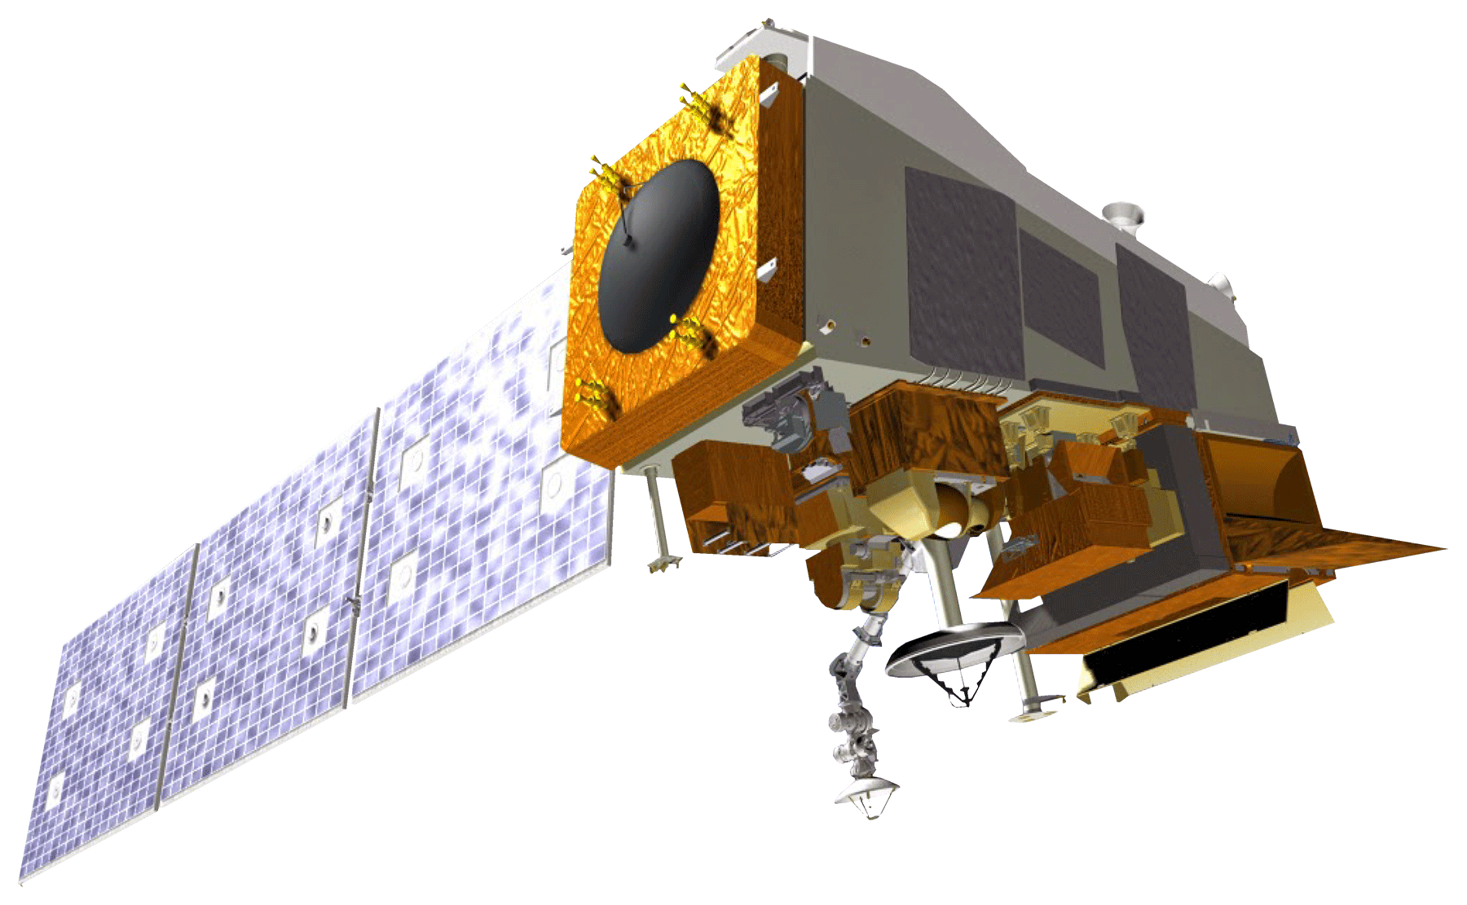

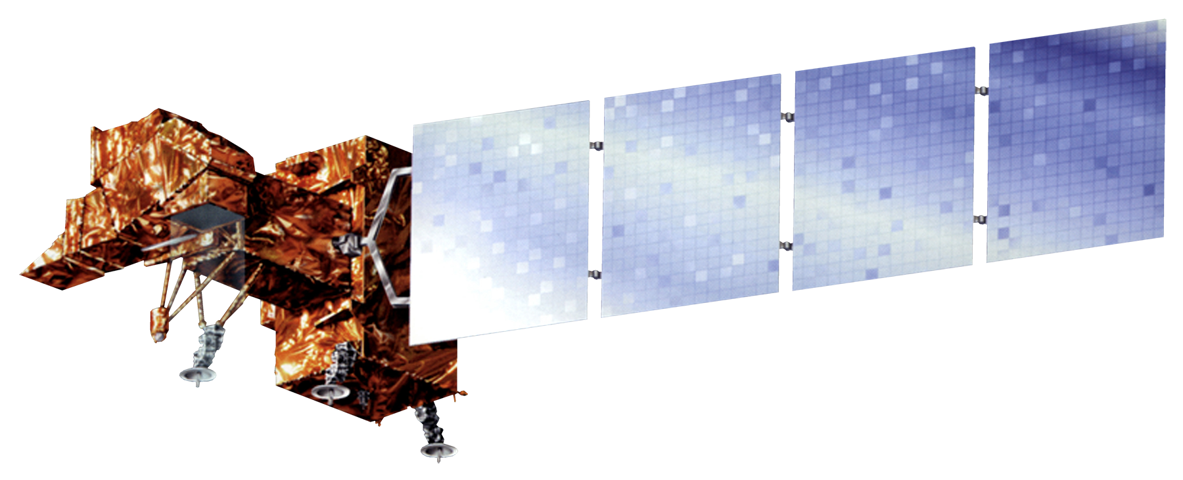
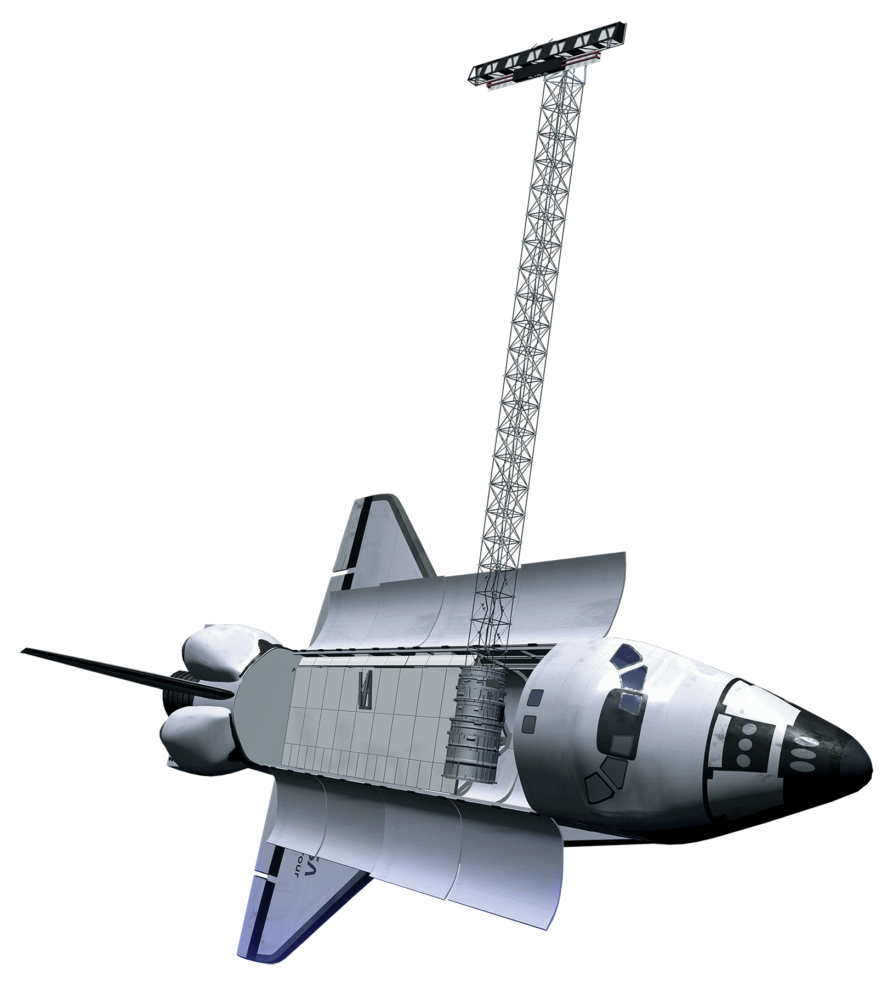
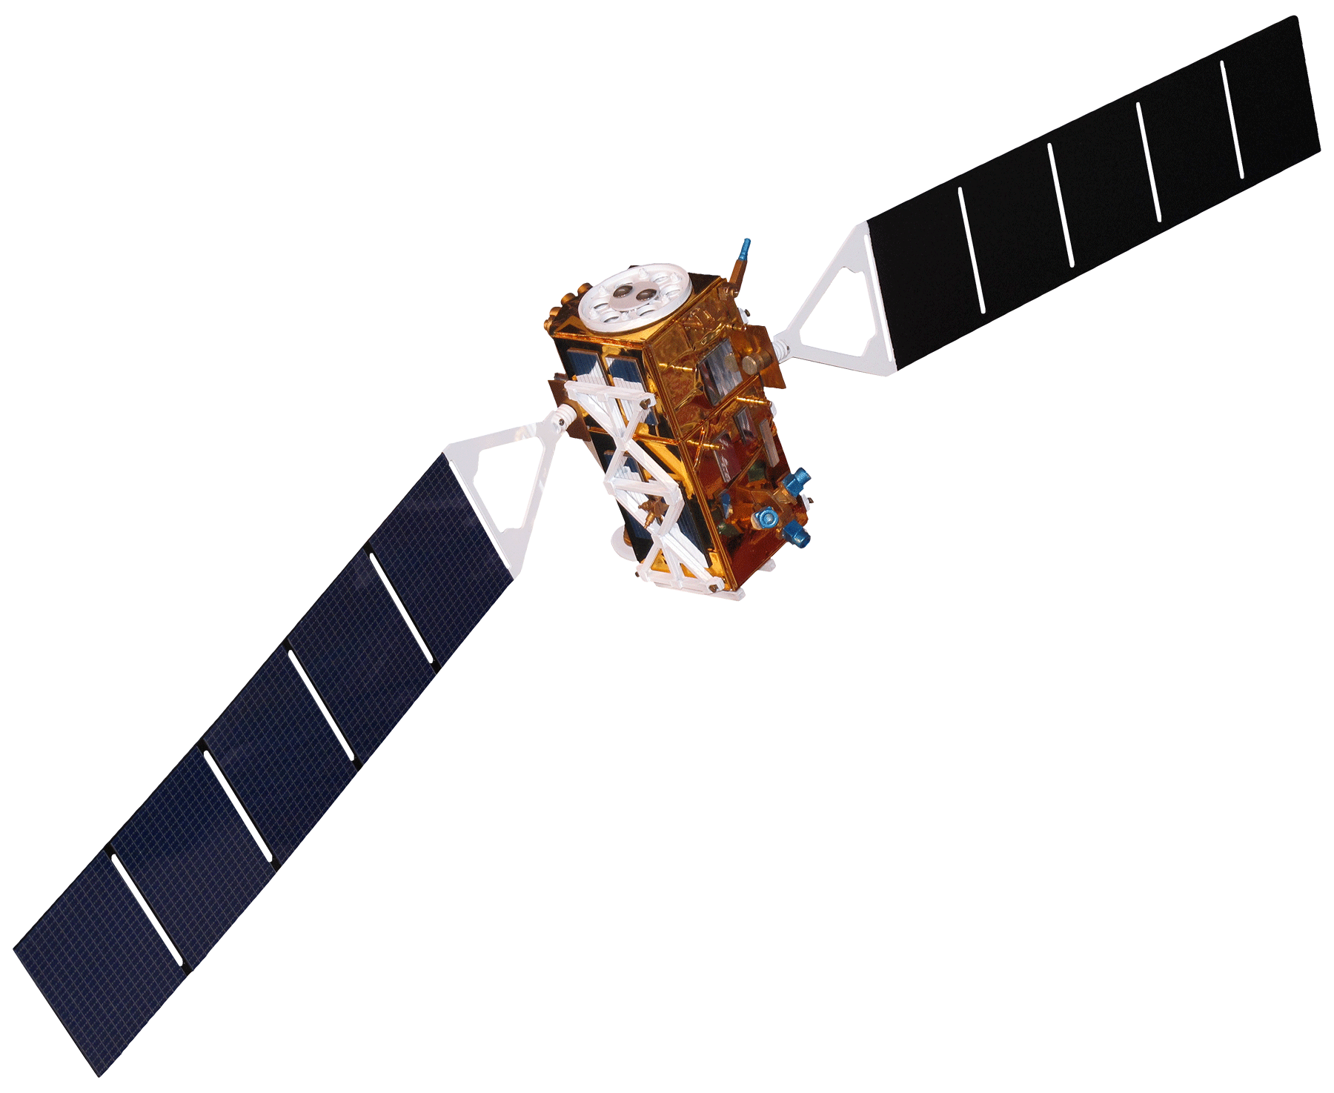
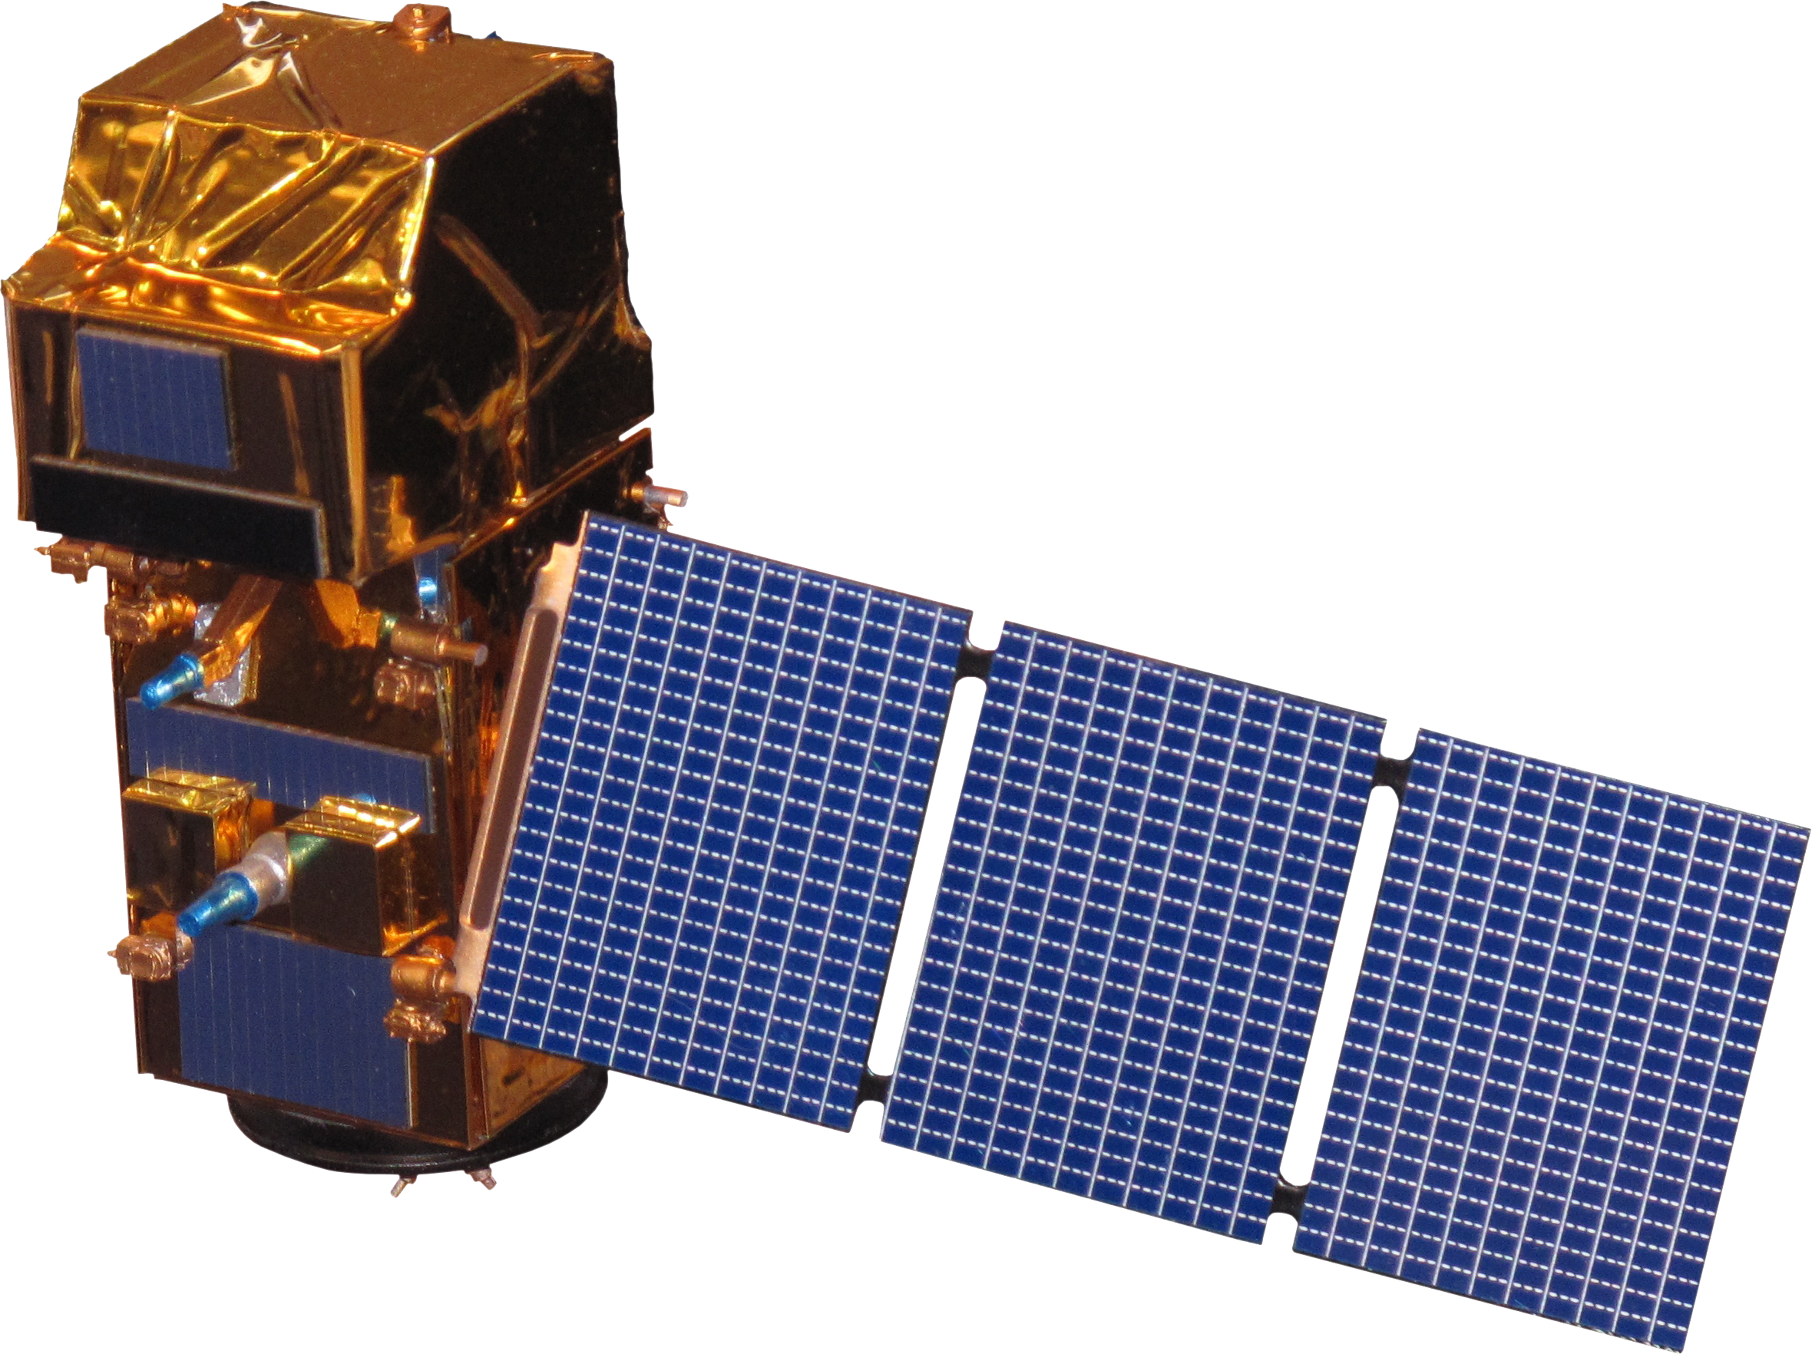
EARTH OBSERVATIONS
Landsat 8 OLI
Landsat 7 ETM+
Suomi NPP VIRRS
Terra MODIS
Sentinel-1 SAR
Sentinel-2 MSI
SRTM
Image Credit: NASA, ESA
Notes:
Speaker:
We utilized a variety of satellites and sensors including, Landsat 8 Operational Land Imager (OLI), Landsat 7 Enhanced Thematic Mapper Plus (ETM+), Sentinel-2 MultiSpectral Instrument (MSI), Suomi National Polar-orbiting Partnership (NPP) Visible Infrared Imaging Radiometer (VIIRS), and Terra Moderate Resolution Imaging Spectroradiometer (MODIS) for surface reflectance. Additionally, we acquired Sentinel-1 C-band Synthetic Aperture Radar (SAR) for measuring backscatter. We also used Shuttle Radar Topography Mission (SRTM) data for elevation.
-------------------------Image Information Below-------------------------
Satellite images from NASA Develop: http://www.devpedia.developexchange.com/dp/index.php?title=List_of_Satellite_Pictures
License: Public Domain (https://www.nasa.gov/multimedia/guidelines/index.html)

Slide 7
METHODOLOGY
Ancillary Data
Earth Observations
Optical Imagery
SAR
MERIT HYDRO
CHIRPS
ESA WorldCover 10m v100
Preprocessing
Filter by Study Area & Period
Filter by Study Area & Period
Filter by Study Area & Period
Cloud Masking
Pseudo-Terrain Flattening
Mosaic Imagery
Speckle Filter
Calculate MNDWI
Elevation Mask
Analysis
Edge Otsu Threshold
Aggregate Outputs
Validation & Statistics
Case Study Analysis Hurricanes Eta and Iota
Code Tutorial
Precipitation Analysis
Historical Surface Water Maps
Notes:
Speaker:
The analysis was divided into four components which involved primarily using NASA SERVIR's HYDRAFloods tool and the Google Earth Engine Python API. Producing the Historical Surface Water Maps focused on the use of Sentinel 1 C-band SAR imagery which involved preprocessing by filtering study area and period, pseudo-terrain corrections, speckle filtering, and masking by elevation. Following this, the Edge Otsu method was used and resulted in surface water maps for the region.
The Case study analysis focused on flood maps for before and after Hurricanes Eta and Iota. This analysis also used the same SAR preprocessing and analysis methods but in combination with optical imagery to increase the temporal resolution and coverage of the event. This optical imagery analysis includes using Landsat 7 ETM+, Landsat 8 OLI, Sentinel 2 MSI, Terra MODIS, and Suomi NPP VIIRS. These datasets automatically included cloud masking upon import in the HYDRAFloods tool. We then mosaic the images and filter by study area and period. Indices were then created, specifically the Modified Normalized Difference Water Index (MNDWI) and used in the Edge Otsu method. Following this, we then had to combine the flood map outputs from each satellite and sensor and mask out land cover that causes confusion such as urban area. We then calculated zonal statistics for flood by land cover type from the event.
In addition to these analyses, we also preprocessed CHIRPS data and produced supplementary precipitation maps for the partners. The precipitation analysis included obtaining Climate Hazards Group InfraRed Precipitation with Station data (CHIRPS) in Google Earth Engine(GEE). Additionally, we examined the total precipitation for both Hurricanes Eta and Iota. Finally, we also created a code tutorial based on the methods used.

Slide 8
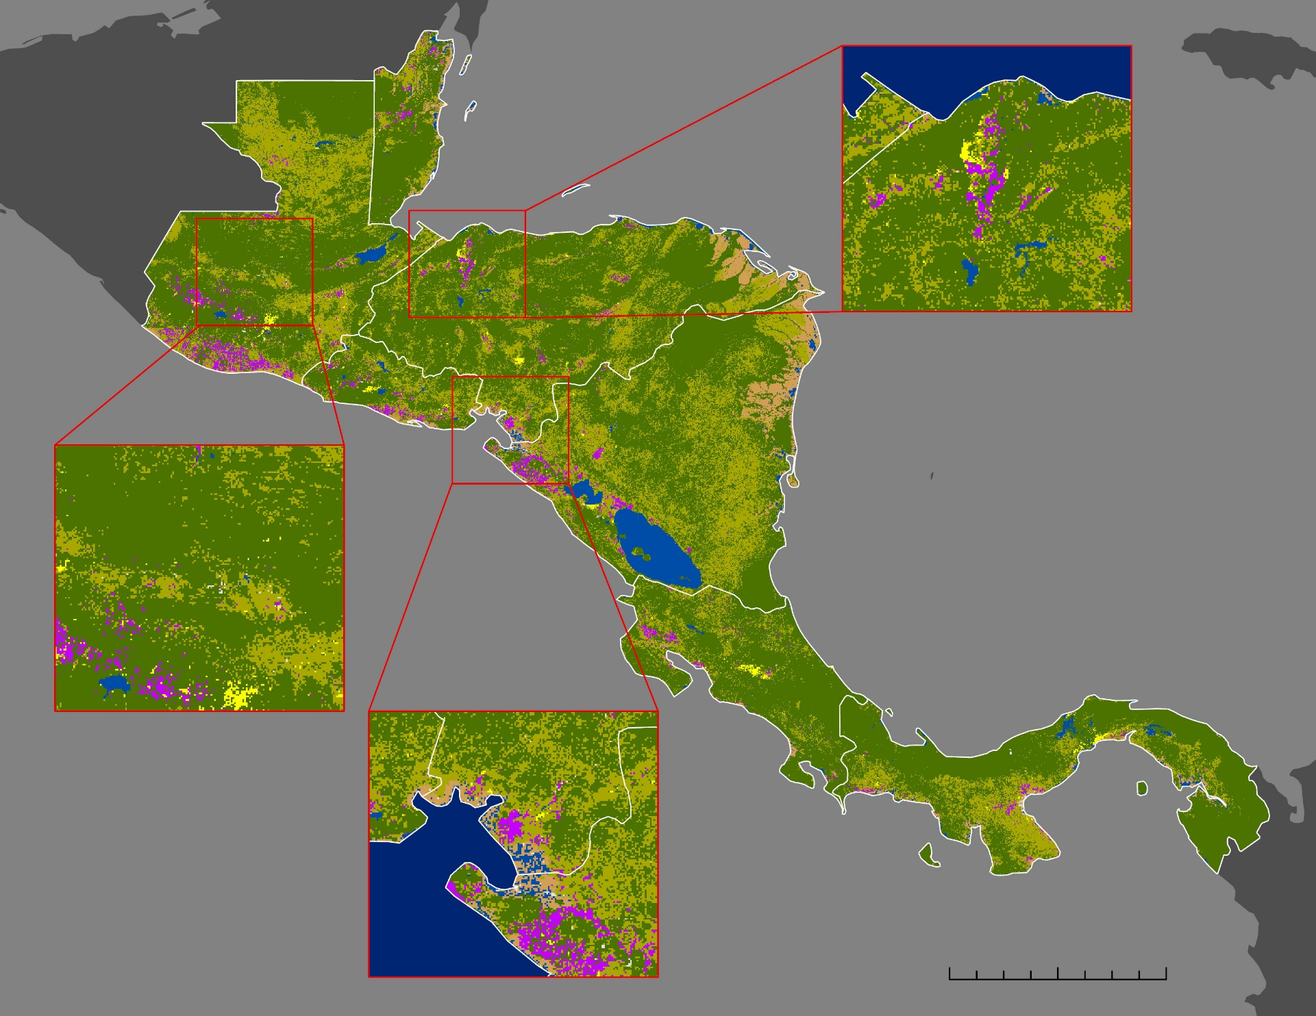

LANDCOVER
Forest
Vegetated
Cropland
Built up
Bare / sparse vegetated
Permanent water
Wetland / mangroves
Country borders
0
100
200 Km
Notes:
Speaker:
Landcover helps us contextualize the areas where floods occur. This is key to understanding flood impact.
This map shows the major landcover types for the study region. Central America is characterized by large forested and vegetated regions. Large, visible sections of cropland are seen on the southwestern coast of Guatemala, El Salvador and Nicaragua, with smaller sections seen as well in Costa Rica and Panama.
For this analysis we focused primarily on cropland, built-up and forest landcover classes to overlay on flooded areas. Areas of interest in Honduras and Guatemala that will be discussed later are highlighted in the inset boxes. Areas of interest in Guatemala were largely forested and vegetated, with small built-up areas. The Sula valley is characterized by cropland and built-up areas, surrounded by forest cover. The southwester coast of Honduras is similarly classified, with wetland areas at the coast.

Slide 9
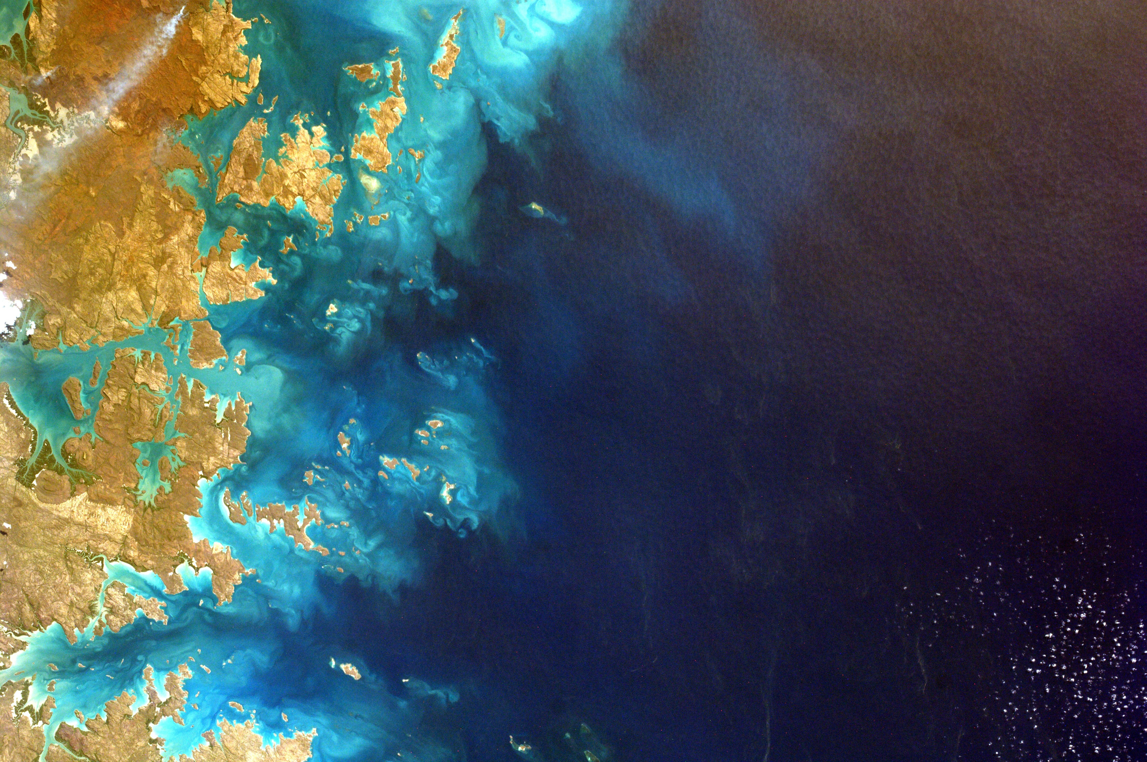
HISTORICAL SURFACE WATER METHODS
Identifying the period of analysis
Identifying the areas of interest
Processing SAR imagery using HYDRAFloods in Google Colab
Exporting historical surface water layers
Validating results with the JRC dataset
Image Credit: NASA
Notes:
Speaker:
We produced maps detailing surface water for every country in Central America to identify areas that could potentially be prone to flooding. The period of analysis requested by the partners was from 2015 to 2021, and we produced a surface water map for each year of the analysis. To get a better view of the surface water extent, we created inset maps that show more details. The inset maps in Nicaragua and Honduras were chosen based on priority areas identified by the partners. After processing SAR imagery using HYDRAFloods in Google Colab, we mapped the surface water outputs for each year using ArcGIS. To validate our results, we compared our outputs with the surface water outputs in the JRC dataset.
-------------------------Image Information Below-------------------------
Image Source: NASA License: CC-BY Unknown Author. https://unsplash.com/photos/6-jTZysYY_U

Slide 10
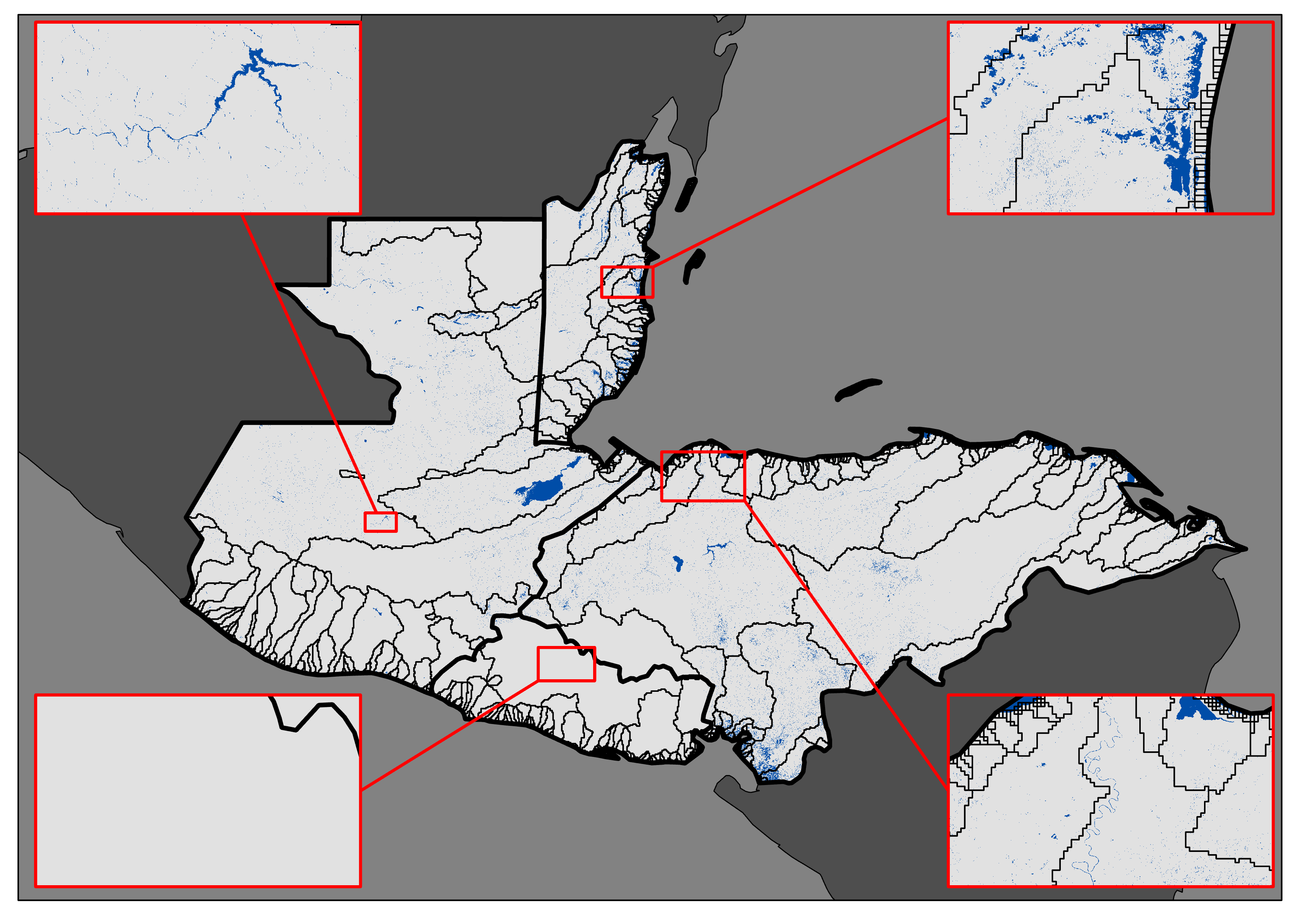
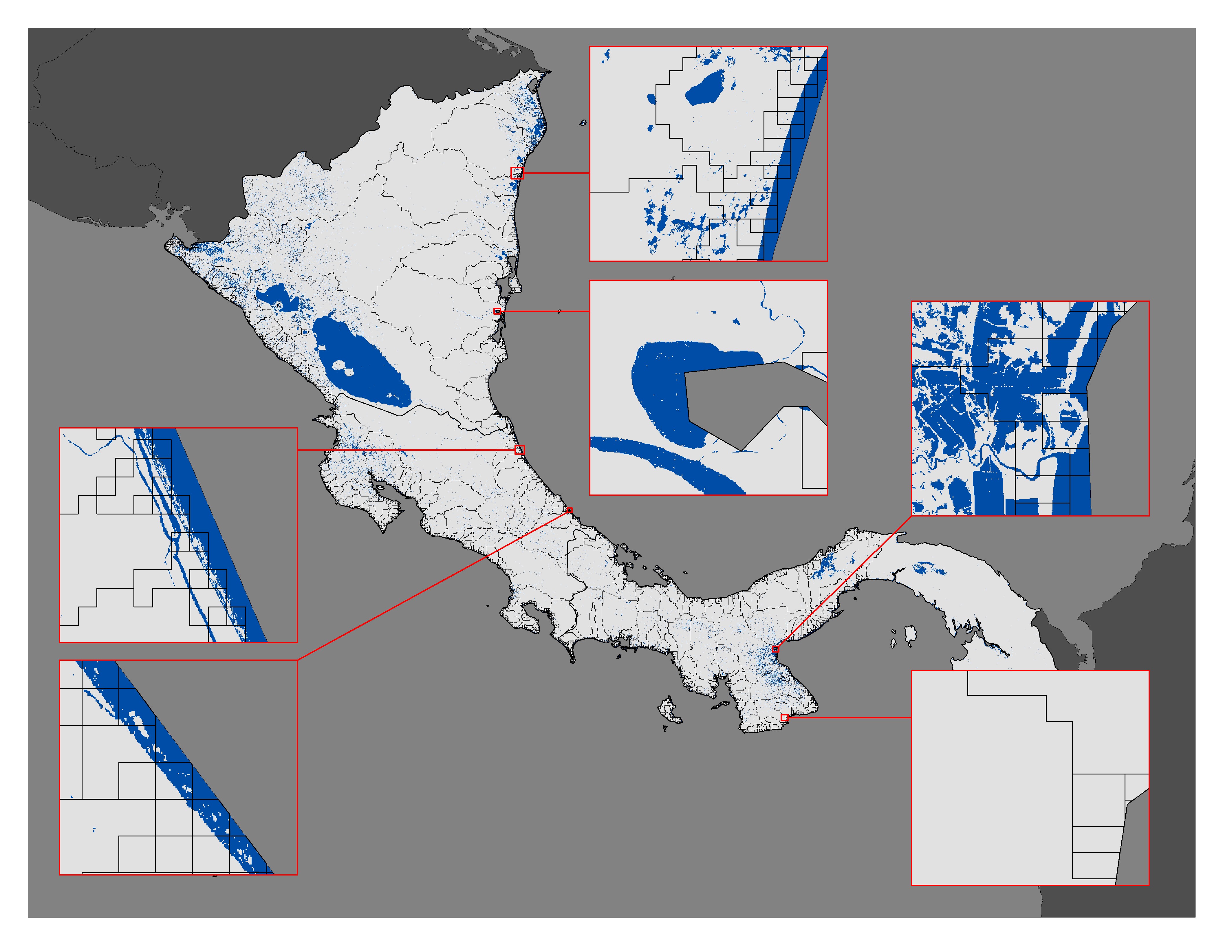

RESULTS: HISTORICAL SURFACE WATER (2015)
2015 Surface Water Map: (Guatemala, Belize, Honduras, El Salvador)
2015 Surface Water Map: (Nicaragua, Costa Rica, Panama)
0 160 322 Km
Surface Water
Study Area
Watersheds
0
80
160 Km
Notes:
Speaker:
These first two maps show the surface water in Central America for 2015. All of the following slides covering historical water will be split into two maps, with Guatemala, Belize, Honduras, and El Salvador on the left and Nicaragua, Costa Rica, and Panama on the right. The blue areas represent surface water, while the gray areas represent non-surface water. The black geometric lines represent watersheds. Each country has zoomed in areas of interest, which we will be following more closely as we examine the changes in surface water to the present.

Slide 11
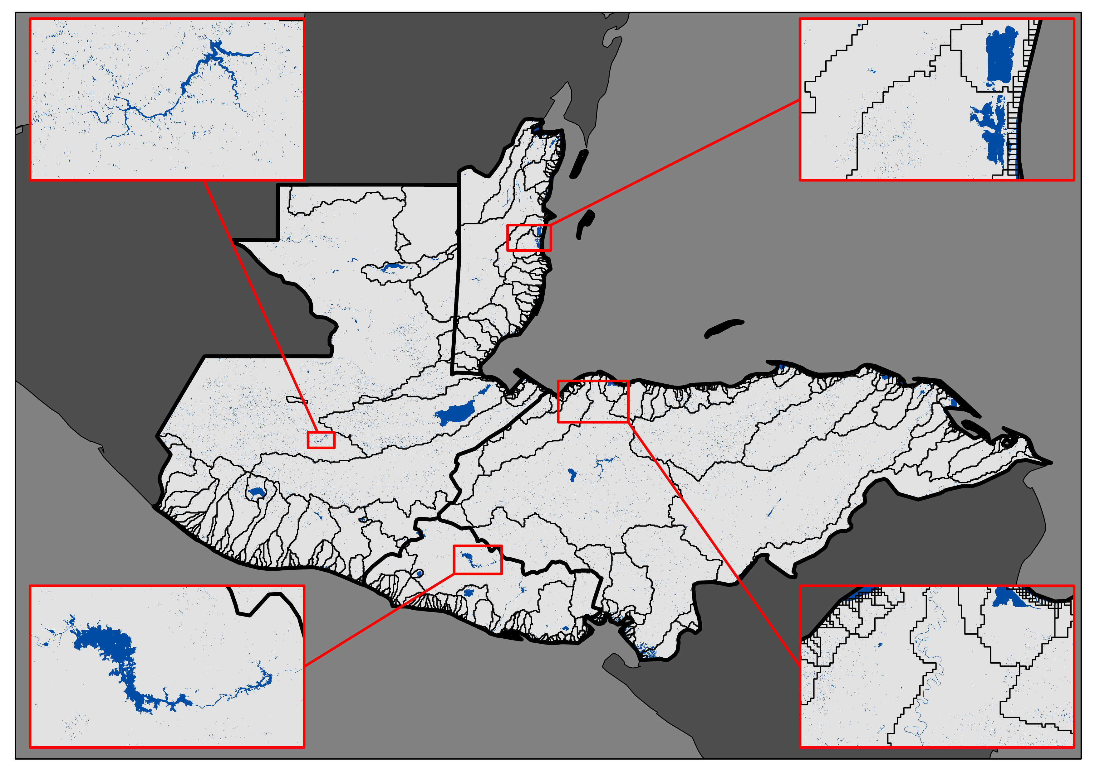
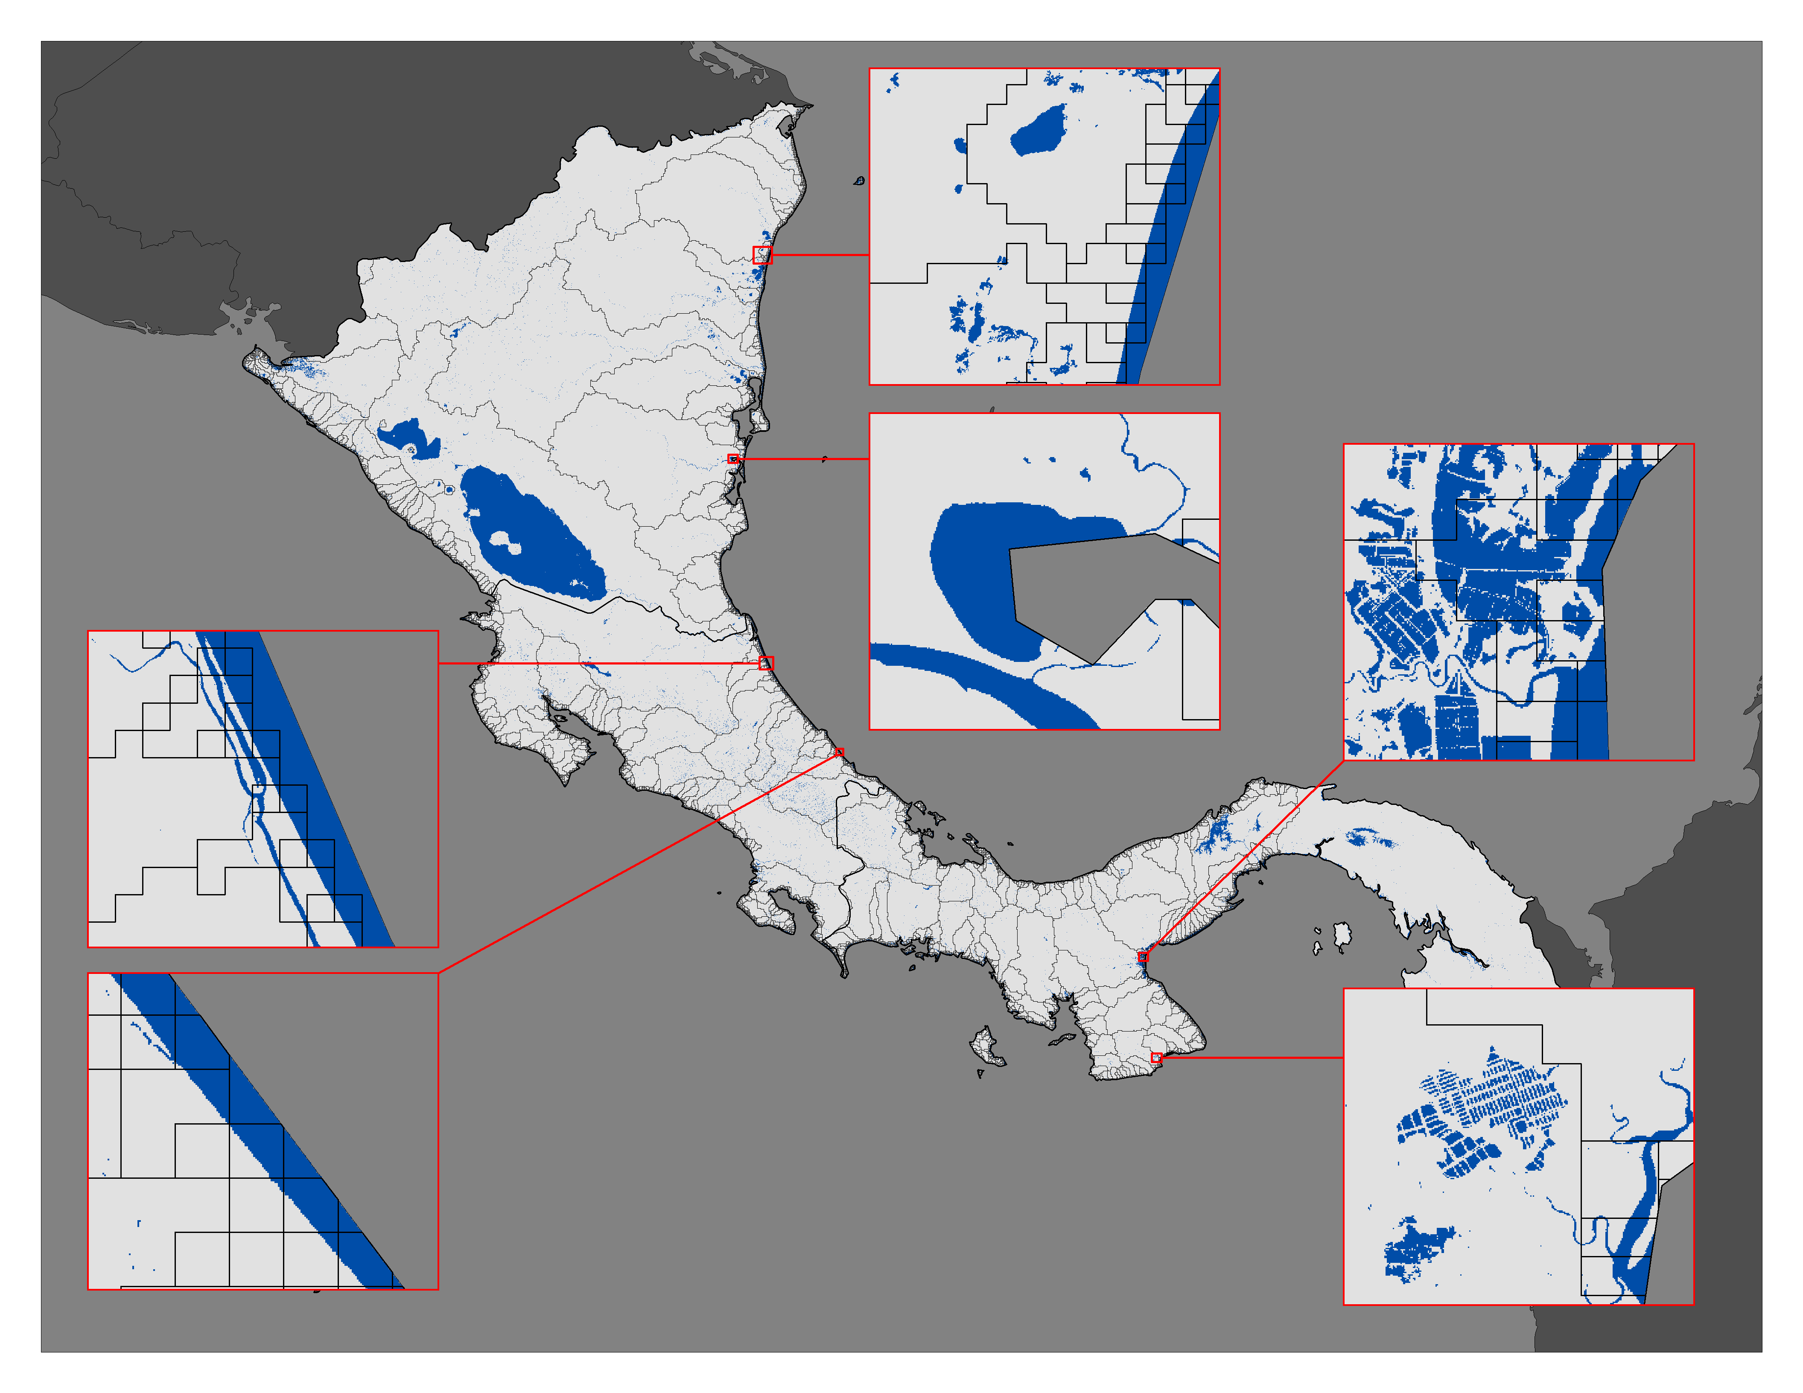
RESULTS: HISTORICAL SURFACE WATER (2020)
2020 Surface Water Map: (Guatemala, Belize, Honduras, El Salvador)
2020 Surface Water Map: (Nicaragua, Costa Rica, Panama)
0 160 322 Km
Surface Water
Study Area
Watersheds
0
80
160 Km
Notes:
Speaker:
These are the results from 2020, which is the year that both hurricanes hit Central America. The inset map in the bottom right corner for Panama shows an increase in surface water between 2015 and 2020. The inset map for El Salvador in the bottom left corner of the map on the left shows an increase in surface water as well. The inset map for Belize in the top right corner of the map on the left appears to decrease in surface water coverage. Honduras, the map in the bottom right corner of the map on the left does not show major differences between 2015 and 2020. Nicaragua and Costa Rica also look similar between 2015 and 2020.

Slide 12
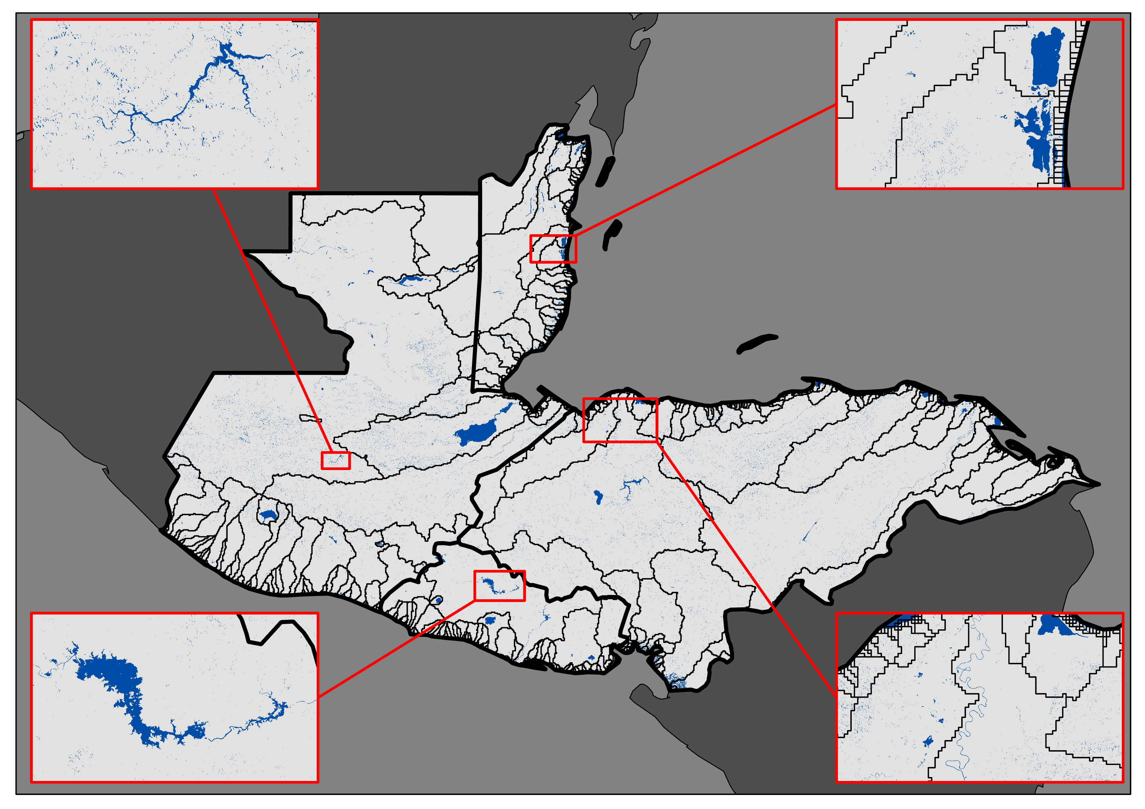
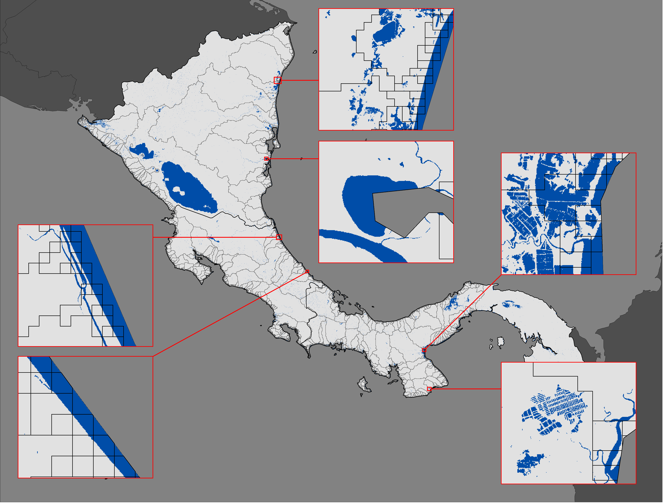
RESULTS: HISTORICAL SURFACE WATER (2021)
2021 Surface Water Map: (Guatemala, Belize, Honduras, El Salvador)
2021 Surface Water Map: (Nicaragua, Costa Rica, Panama)
0 160 322 Km
Surface Water
Study Area
Watersheds
0
80
160 Km
Notes:
Speaker:
These are our surface water maps for 2021, which includes data through October 2021. This is the last year of our study period. Many differences are evident between the 2015 maps and the 2021 maps. The inset maps for Panama shows a large increase in the presence of surface water from 2015 to 2021, as well as for El Salvador. The maps also show differences between 2020 and 2021. Honduras appears to have increased slightly in surface water from 2020 to 2021. The surface water extent for Nicaragua also increased between 2020 and 2021. Overall, the maps show how these identified priority areas increased the amount of surface water coverage from 2015 to 2021.

Slide 13
CHANGE DETECTION METHODS
Surface Water Outputs
2015 output
2021 output
Change Detection Analysis
Raster calculator
Change Detection Statistics
% change in surface water equation
Notes:
Speaker:
To understand how surface water has changed over time, we performed a change detection analysis by subtracting the surface water outputs between 2021 and 2015. This step was performed using the raster calculator in ArcGIS Pro. Once we got the change detection output, we performed a calculation to determine how the percentage of surface water changed over time. We took the difference between the changes to surface water and changes away from surface water, and divided it by the total number of pixels in the image. We then multiplied that number by 100 to get a percentage.

Slide 14
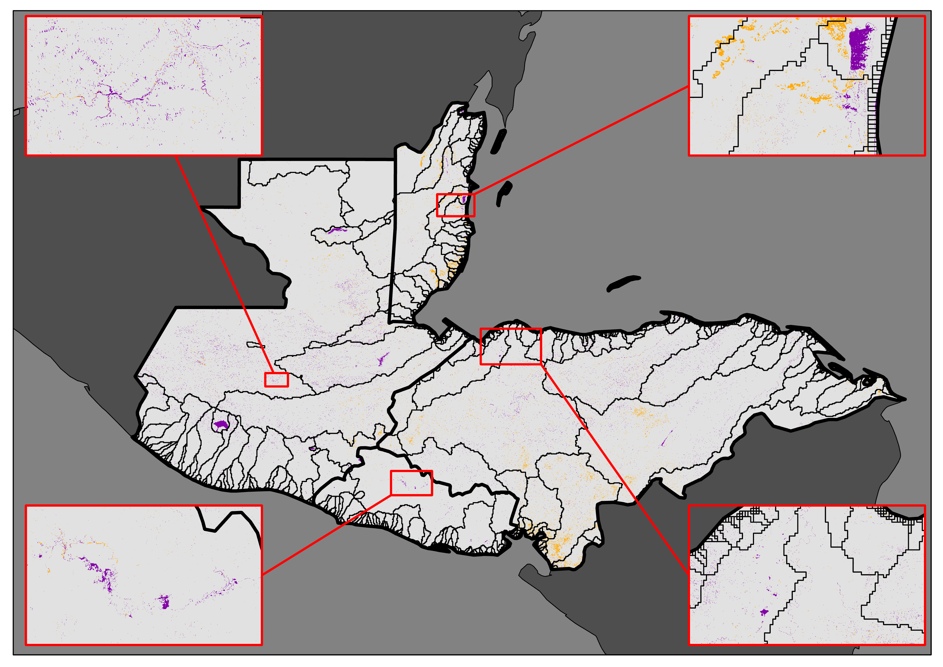
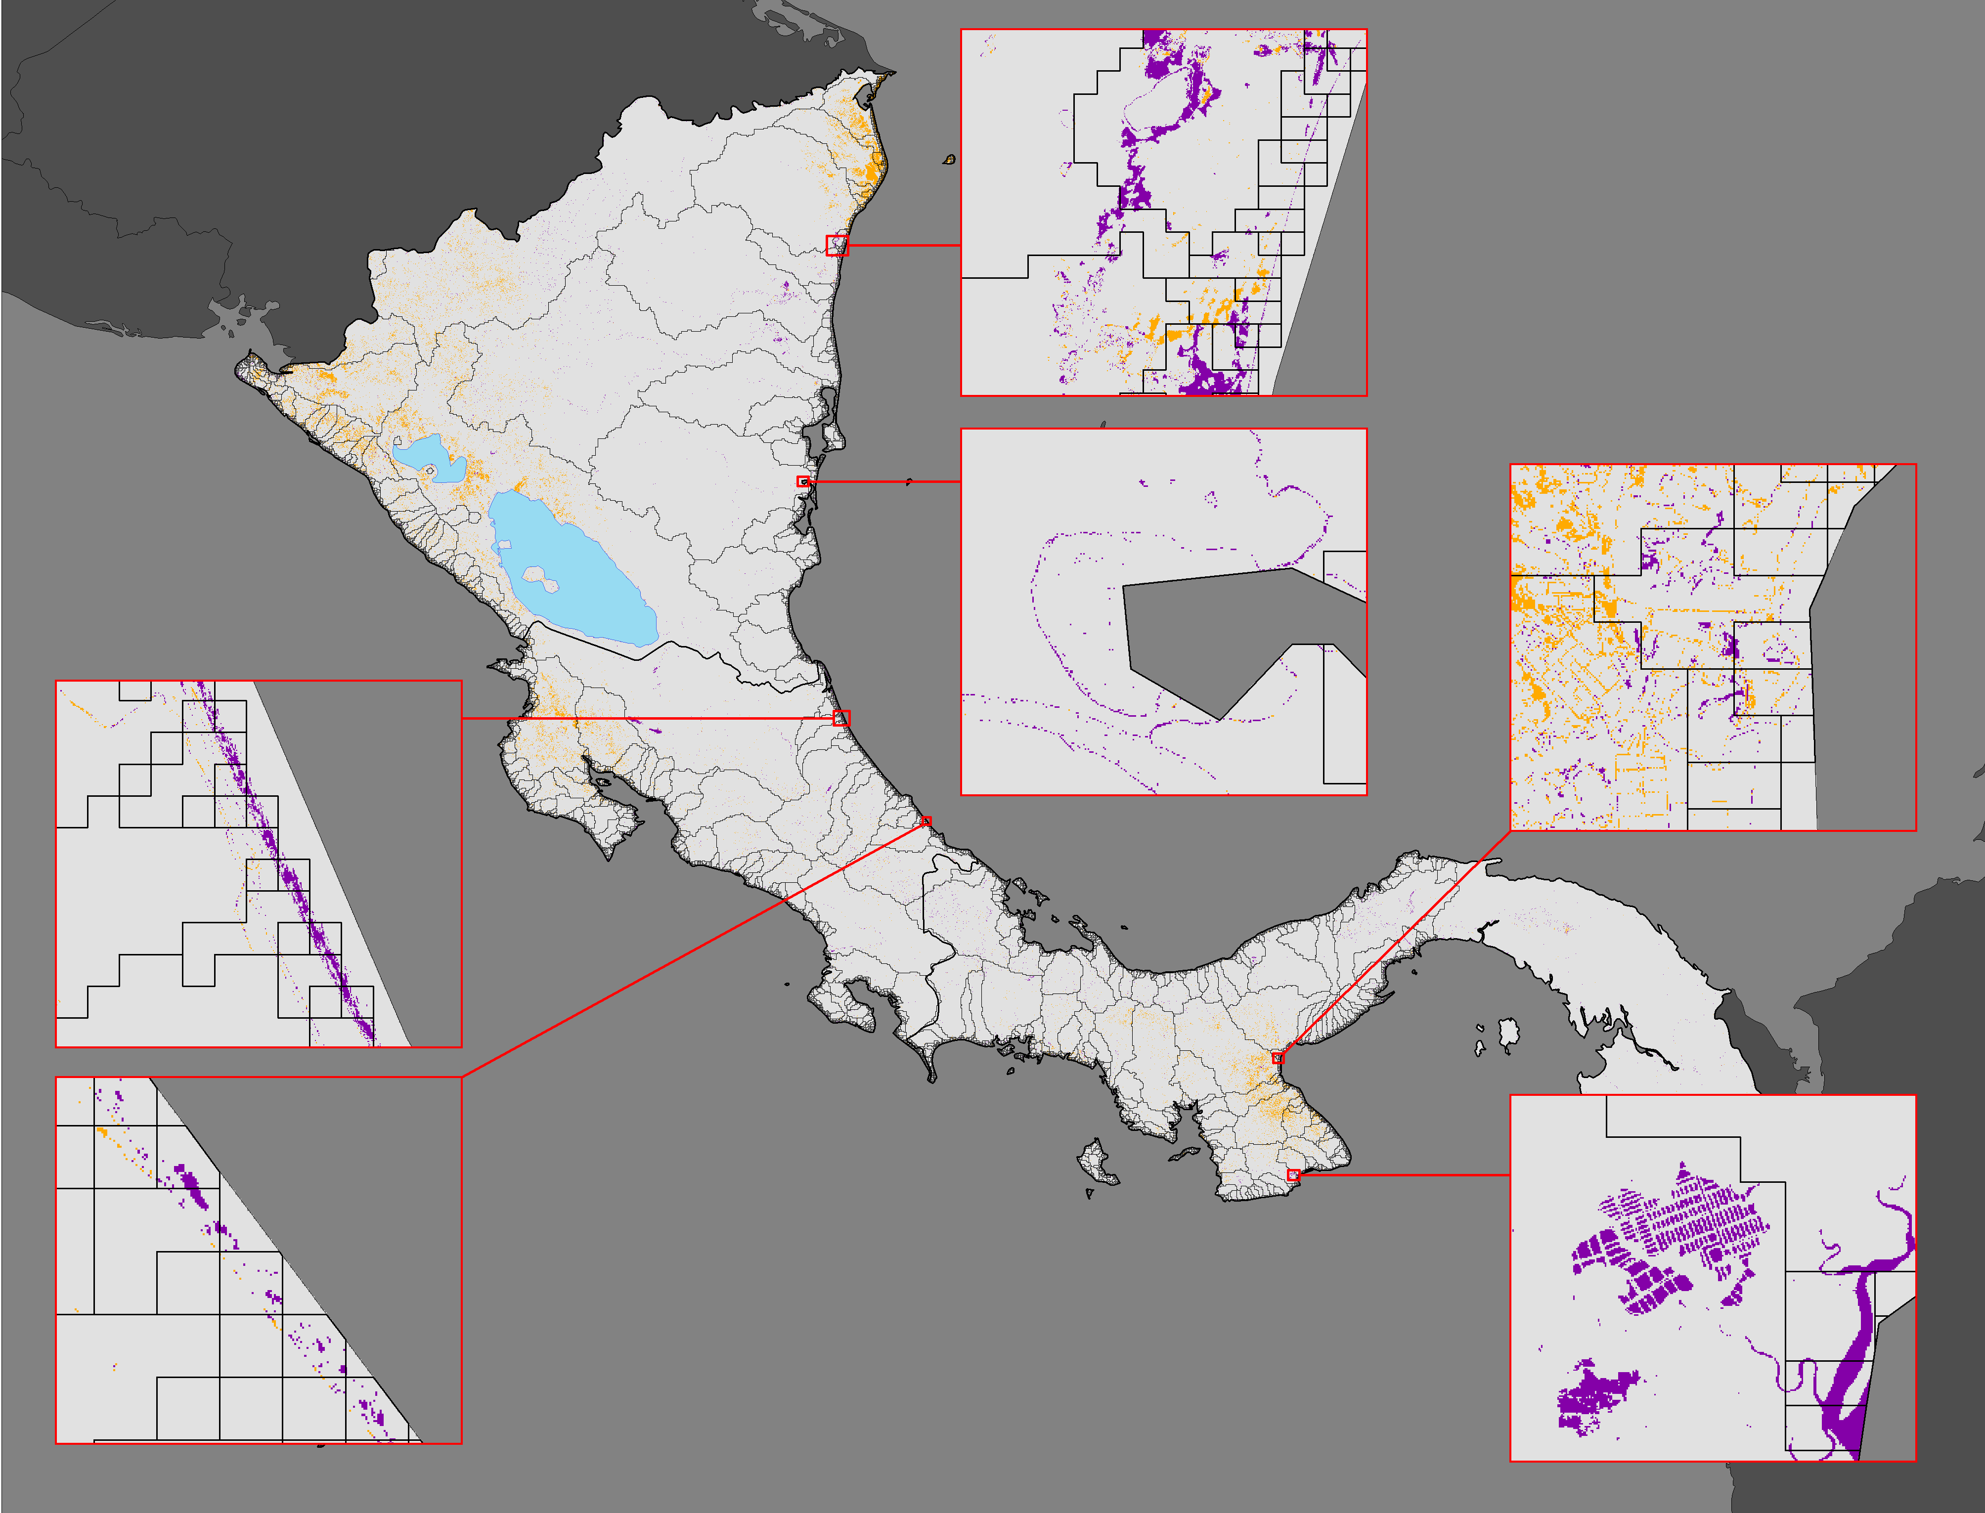
RESULTS: SURFACE WATER CHANGE DETECTION
Change in Surface Water (2015 to 2021)
Change in Surface Water (2015 to 2021)
0 160 322 Km
- Change (away from water)
No Change
0
80
160 Km
+ Change (to water)
Watersheds
Notes:
Speaker:
These maps show the results of the change detection analysis. The purple regions represent areas that changed into surface water, while the orange areas represent areas that were surface water in 2015 but not surface water in 2021. Gray areas indicate areas of no change. All of the inset maps have some presence of purple, indicating that these areas experienced changes to surface water across the study period. This is especially noticeable in Panama, Nicaragua, and Costa Rica. Belize, Guatemala, El Salvador, and Honduras also show an increase in surface water.
We also performed calculations on how the surface water changed over time using these images. The number of pixels classified as surface water actually slightly decreased for all countries except for El Salvador. This could potentially be due to increase in urban development, but this is an area for future research.

Slide 15
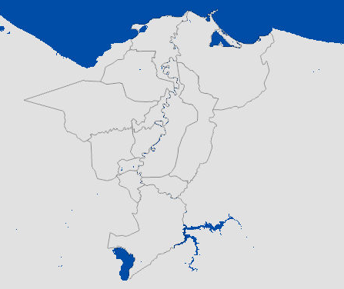
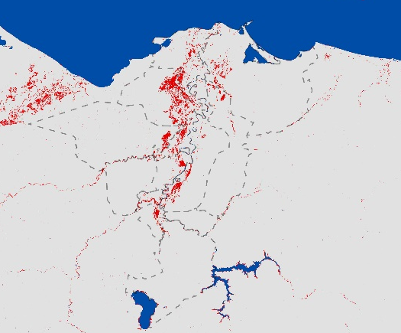
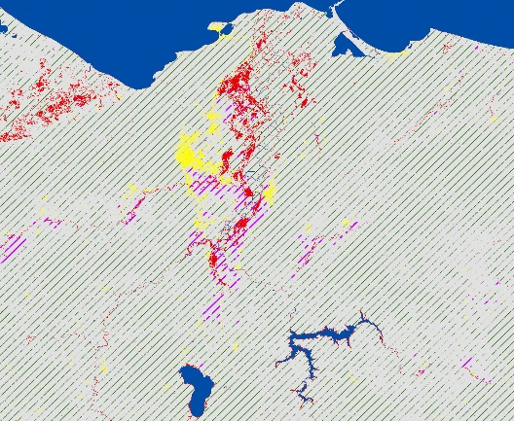
CASE STUDY METHODS
Identify the period of analysis
Identify areas of interest based on partner input
Process SAR and optical imagery using HYDRAFloods in Google Colab
Apply Edge Otsu threshold and aggregate outputs
Export imagery
Overlay landcover
Notes:
Speaker:
We conducted a case study using HYDRAFloods to detect flood patterns in key areas identified by partners as being impacted during Eta and Iota. The period of analysis was divided into two study periods: during the combined event, Oct 31 – Nov 18, 2020, and after (Nov 18 – Dec 2, 2020). The Analysis focused primarily on priority sites impacted during Eta and Iota in Guatemala and Honduras, though one area encompassed the El Salvador / Honduras / Nicaragua borders. These sites were identified by the partner organizations. We zoomed out from these areas to capture surrounding geographic context. We processed SAR and optical imagery using HYDRAFloods in Google Colab. The team then mapped both permanent surface water (e.g. rivers) and flooded areas. Cropland and built-up landcover classes were overlayed to contextualize flooded areas. We then exported processed images based on these two time periods.

Slide 16
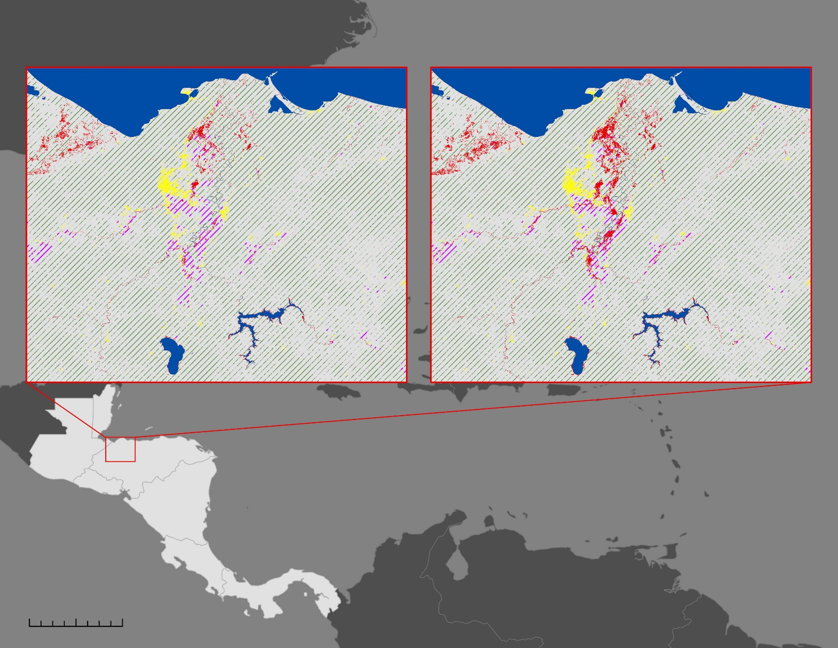
RESULTS: CASE STUDY ANALYSIS
Priority Site, Sula Valley
During Eta/Iota: Oct. 31 - Nov. 18, 2020
Priority Site, Sula Valley
After Eta/Iota: Nov. 18 - Dec. 2, 2020
Flood
Permanent Water
Built-up
Forest
Cropland
SAR Flood Mapping:
Honduras
0
250
500 Km
Coordinates: 87.8290992°W, 15.3533958°N
Notes:
Speaker:
The next few maps illustrate the use of SAR to map flood extent in several priority sites n Guatemala and Honduras identified by our partners. Floods are aggregated by two timeframes: A two-week period combining the events of Eta and Iota, and two weeks after the combined events. Three landcover classes are overlayed for context: built-up areas, cropland, and forest. Not all classes were present in every map extent. This map shows the San Pedro Sula Valley, in the northwestern section of Honduras near the border with Guatemala.

Slide 17
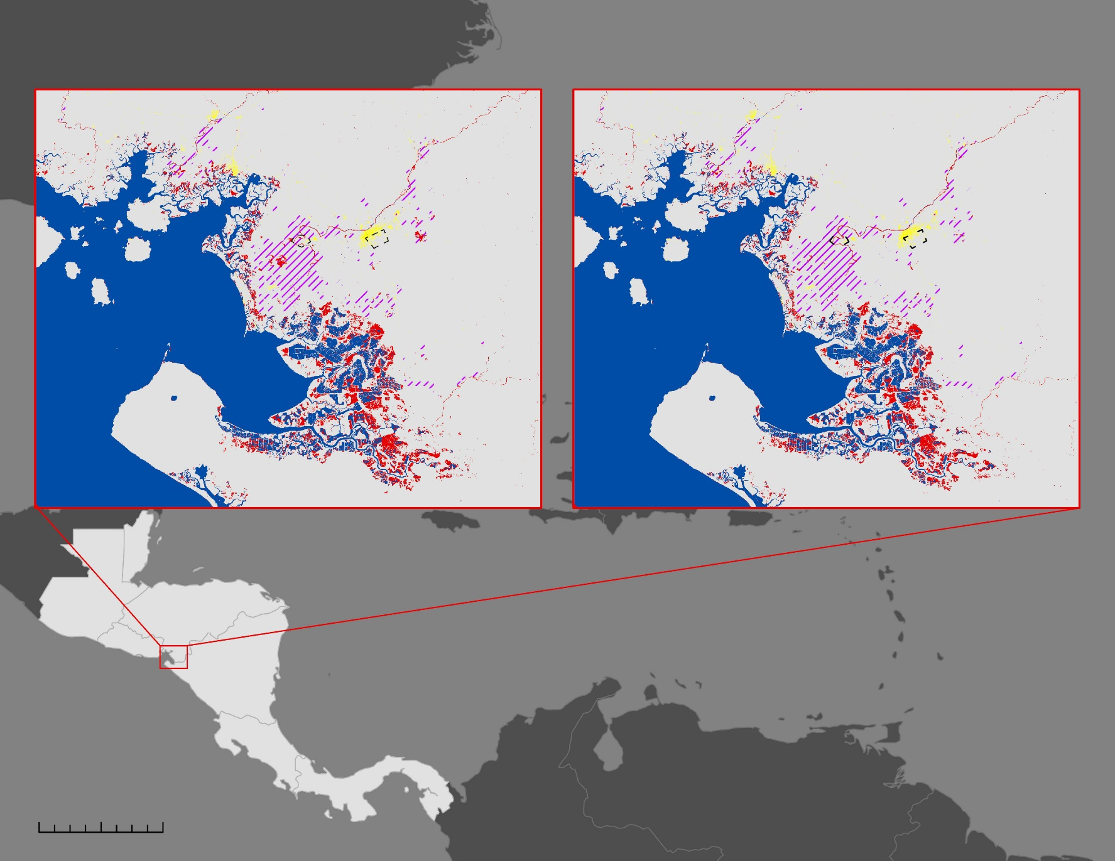
RESULTS: CASE STUDY ANALYSIS
Priority Site, Southwest Coast
During Eta/Iota: Oct. 31 - Nov. 18, 2020
Priority Site, Southwest Coast
After Eta/Iota: Nov. 18 - Dec. 2, 2020
Flood
Permanent Water
Built-up
Cropland
SAR Flood Mapping:
Honduras
*Forest not shown to facilitate visualization.
0
250
500 Km
Coordinates: 87.3444509°W, 13.1764580°N
Notes:
Speaker:
This map shows an area on the southeastern coast of Honduras in which two priority site polygons were also located. The most visible flooding is detected along the coast, with some minimal flooding picked up by SAR within the boundaries of the priority site polygons themselves.

Slide 18
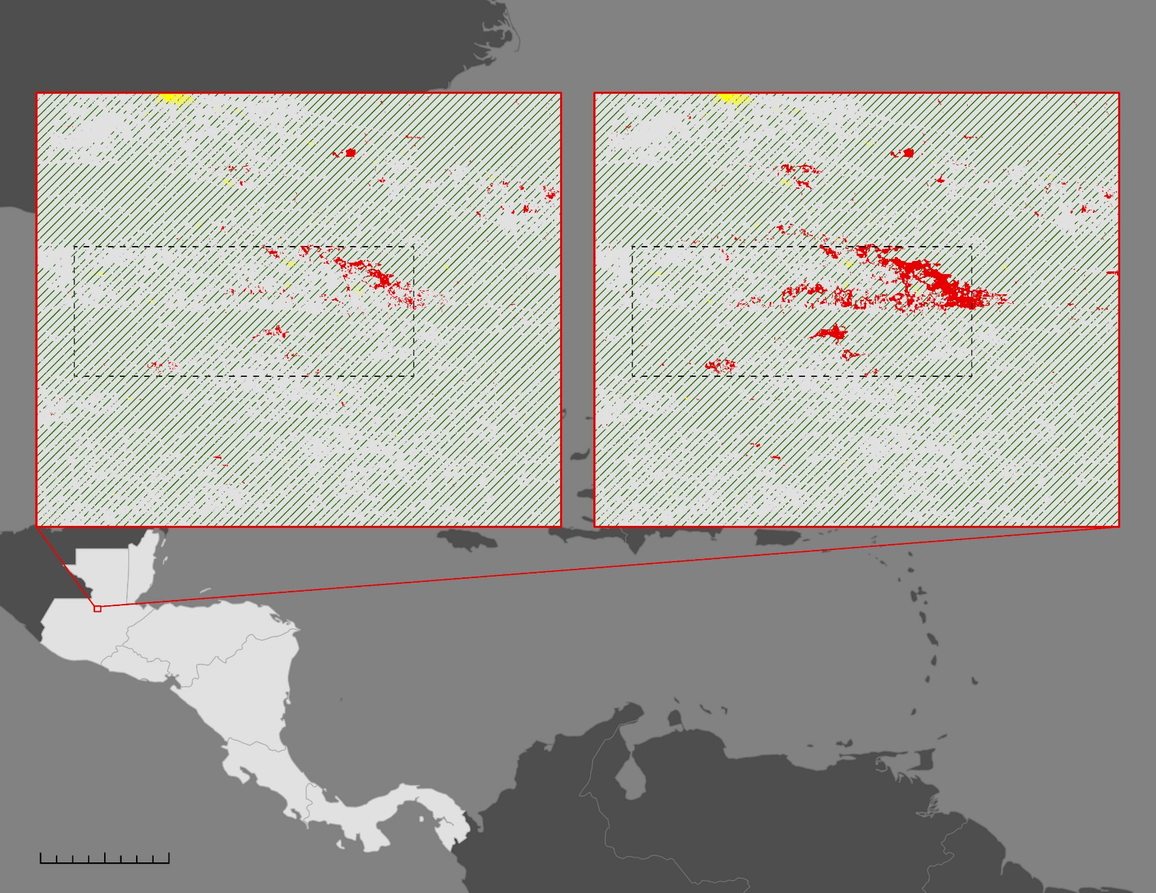
RESULTS: CASE STUDY ANALYSIS
Priority Site, Alta Verapaz
During Eta/Iota: Oct. 31 – Nov. 18, 2020
Priority Site, Alta Verapaz
After Eta/Iota: Nov. 18 - Dec. 2, 2020
Flood
Forest
Built-up
Priority Site
SAR Flood Mapping:
Guatemala
0
250
500 Km
Coordinates: 90.2335790°W, 15.7188720°N
Notes:
Speaker:
This map zooms into one of the priority sites in Alta Verapaz, Guatemala where floods were detected with SAR. Very small built-up areas can be seen adjacent to flooded area.

Slide 19
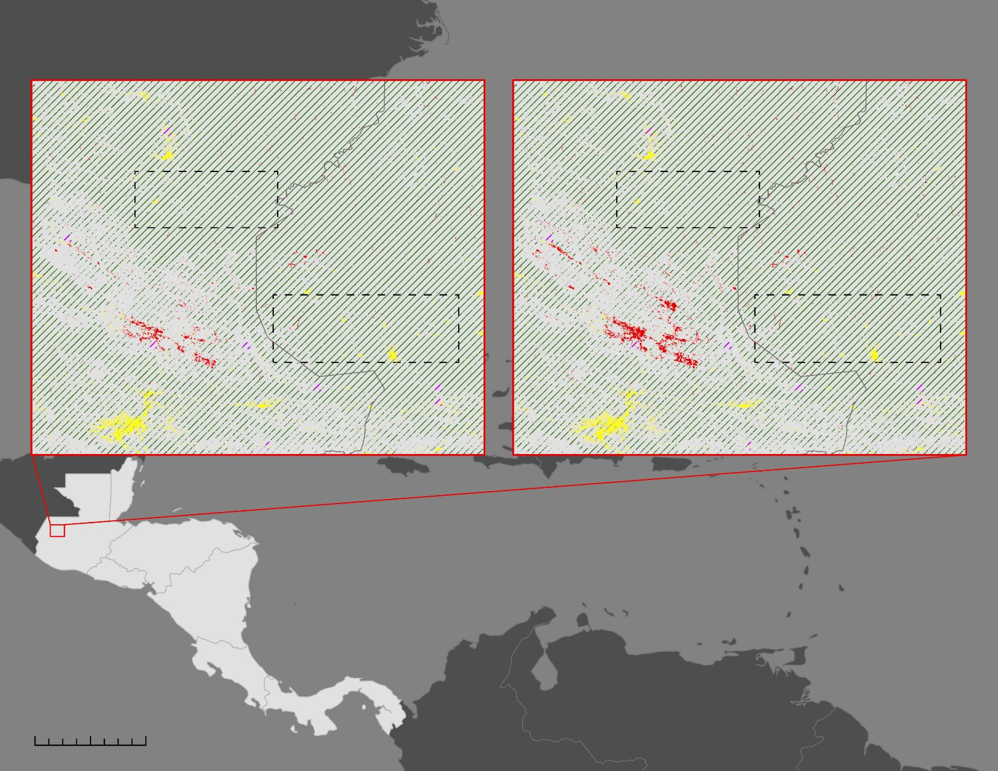
RESULTS: CASE STUDY ANALYSIS
Priority Sites, Huehuetenango / Quiché
During Eta/Iota: Oct. 31 – Nov. 18, 2020
Priority Sites, Huehuetenango / Quiché
After Eta/Iota: Nov. 18 - Dec. 2, 2020
Huehuetenango
Flood
Forest
Built-up
Priority Site
Quiché
SAR Flood Mapping:
Guatemala
0
250
500 Km
Coordinates: 91.3174074°W, 15.5168069°N
Notes:
Speaker:
This map zooms into two of the priority sites; one in the department of Huehuetenango and the other in Quiché, where floods were detected with SAR. In this case, we did not detect flooding in the priority boxes using SAR.

Slide 20

RESULTS: CASE STUDY ANALYSIS
Priority Site, Alta Verapaz
Priority Site, Sula Valley
During Eta/Iota
Flood
Permanent Water
Priority Sites
Cropland
During Eta/Iota
After Eta/Iota
Optical Flood Mapping:
Landsat 7
After Eta/Iota
Priority Site, Reserva de Vida Silvestre San Bernardo
*Maps with little to no flooding present demonstrate limitations due to cloud cover
During Eta/Iota
After Eta/Iota
0
230
450 km
Notes:
Speaker:
In the case study analysis for Hurricanes Eta and Iota, we examined five different satellites and sensors, including Landsat 7 which was used to produce these flood maps. The three inset maps represent different regions of interest with priority sites provided by CEPREDENAC. Each inset map has a during and after flood extent for the back to back hurricanes. During Eta and Iota represents aggregated imagery from October 31, 2020 to November 18, 2020. The After Eta and Iota period is also mosaicked Landsat 7 imagery from November 18, 2020 to December 2, 2020. Red represents flood extent, while permanent water from the JRC Global Surface Water dataset is in blue. Cropland and priority sites are also represented here.
In the Alta Verapaz region, there is not much flooding detected by Landsat 7 in the during or after period. Meanwhile in the Sula Valley, we see extensive flooding in the during period. The After period shows almost no flooding. This lack of flooding in the after period is likely a result of extensive cloud cover preventing the sensor from detecting flood. Lastly, the Reserva de Vida Silvestre San Bernardo is located near other priority sites and areas of interest. Much of the permanent water is pond aquaculture with surrounding floods during and after the two hurricanes.

Slide 21
RESULTS: CASE STUDY ANALYSIS
Priority Site, Alta Verapaz
Priority Site, Sula Valley
During Eta/Iota
Flood
Permanent Water
Priority Sites
Cropland
During Eta/Iota
After Eta/Iota
Optical Flood Mapping:
Landsat 8
After Eta/Iota
Priority Site, Reserva de Vida Silvestre San Bernardo
*Maps with little to no flooding present demonstrate limitations due to cloud cover
During Eta/Iota
After Eta/Iota
0
230
450 km
Notes:
Speaker:
The same sites are represented here for Landsat 8 as well. The results for Landsat 8 were minimal in these regions. The time and area with clear flood extent is in the During Eta and Iota period for the region near the Reserva de Vida Silvestre San Bernado. The other regions being characterized by little to no flood is likely a result of excessive cloud cover and limitation in the temporal resolution of the imagery.

Slide 22
RESULTS: CASE STUDY ANALYSIS
Priority Site, Alta Verapaz
Priority Site, Sula Valley
During Eta/Iota
Flood
Permanent Water
Priority Sites
Cropland
During Eta/Iota
After Eta/Iota
Optical Flood Mapping:
Sentinel-2
After Eta/Iota
Priority Site, Reserva de Vida Silvestre San Bernardo
During Eta/Iota
After Eta/Iota
0
230
450 km
Notes:
Speaker:
In contrast, Sentinel-2 picks up significant flooding most notably in the Sula Valley and in the Reserva de Vida Silvestre San Bernardo. With the flood extent being quite large in the During Sula Valley map, we can see this flooding occurs in nearby cropland.

Slide 23
RESULTS: CASE STUDY ANALYSIS
Priority Site, Alta Verapaz
Priority Site, Sula Valley
During Eta/Iota
Flood
Permanent Water
Priority Sites
Cropland
During Eta/Iota
After Eta/Iota
Optical Flood Mapping:
Suomi NPP VIIRS
After Eta/Iota
Priority Site, Reserva de Vida Silvestre San Bernardo
During Eta/Iota
After Eta/Iota
0
230
450 km
Notes:
Speaker:
We also extracted flood using Suomi NPP VIIRS imagery. Although the images are coarse in spatial resolution, we can still see similar areas indicate flooding around the same time periods.

Slide 24
RESULTS: CASE STUDY ANALYSIS
Priority Site, Alta Verapaz
Priority Site, Sula Valley
During Eta/Iota
Flood
Permanent Water
Priority Sites
Cropland
During Eta/Iota
After Eta/Iota
Optical Flood Mapping:
Terra MODIS
After Eta/Iota
Priority Site, Reserva de Vida Silvestre San Bernardo
During Eta/Iota
After Eta/Iota
0
230
450 km
Notes:
Speaker:
Lastly, we measured flood using Terra MODIS imagery. Similar to the prior optical imagery results we see similar flood patterns and extent, although the satellites and sensors differ.

Slide 25
RESULTS: CASE STUDY ANALYSIS
SAR Flood Mapping:
Sula Valley
0
500 km
SAR
1 Week After: Nov.18, 2020 – Nov. 25, 2020
2 Weeks After: Nov. 25, 2020 – Dec. 2, 2020
3 Weeks After: Dec. 2, 2020 – Dec. 9, 2020
1 Week After
2 Weeks After
3 Weeks After
Permanent Water
Cropland
0
3
6
12 km
Notes:
Speaker:
Here we examined, flood extent across three time periods after Hurricanes Eta and Iota. One week after the events is represented in orange and depicts SAR flood maps from November 18, 2020 to November 25, 2020. Two weeks after is shown in green representing November 25, 2020 to December 2, 2020. The three week after period in purple shows flood extent during December 2, 2020 to December 9, 2020. This example of using SAR flood extent outputs over time indicates how persistent flooding can be following devastating hurricanes like Eta and Iota. Areas in the Sula Valley, with this lasting flooding also overlaps with cropland in the region, thereby impacting local agriculture.

Slide 26
RESULTS: CASE STUDY ANALYSIS
Optical Flood Mapping:
Sula Valley
0
500 km
Landsat 7
During Eta/Iota: Oct. 31, 2020 – Nov. 18, 2020
Flood
Permanent Water
Priority Sites
Cropland
0
3
6
12 km
Notes:
Speaker:
This map shows the zoomed in Sula Valley region which is also detailed in the overview Landsat 7 result. In comparison to the Sula Valley temporal SAR map in the previous slide, we see a larger flood extent with Landsat 7. This could potentially be explained by nearby forest causing a "double bounce" effect in the SAR, thereby reducing the extent of detected flood.

Slide 27
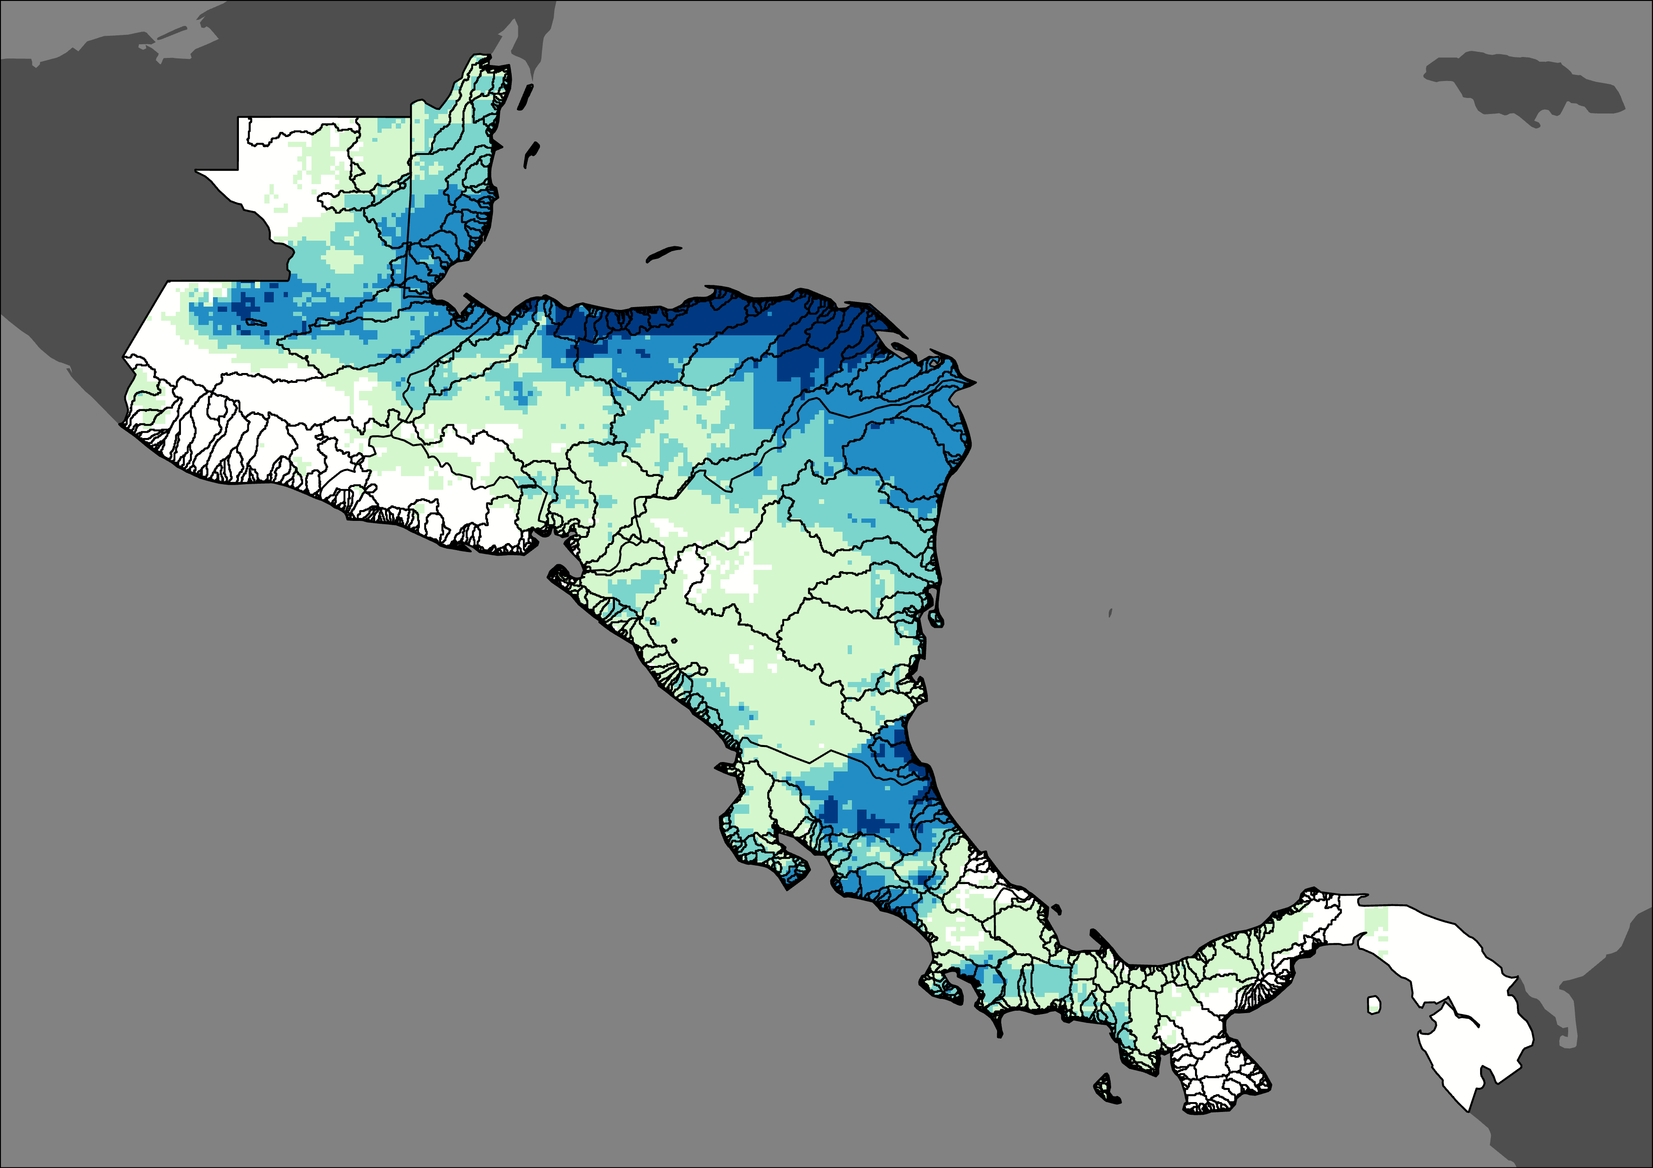
PRECIPITATION ANALYSIS METHODS
Identify the period of analysis
Export total precipitation maps for Hurricanes Eta and Iota
Identify areas of interest
Overlay watersheds on total precipitation maps
Process Climate Hazards Group InfraRed Precipitation (CHIRPS) with Station data in Google Earth Engine (GEE)
Calculate the total event precipitation volume of the El Cajon Dam watershed
Generate daily precipitation maps and figures, including total and daily precipitation by country
Notes:
Speaker:
The precipitation analysis included several steps primarily in using Google Earth Engine (GEE). First, the period of analysis and area of interest was decided. After, using GEE we acquired Climate Hazards Group InfraRed Precipitation with Station data (CHIRPS) data. The Climate Hazards Group InfraRed Precipitation with Station data (CHIRPS) was used to map daily precipitation, total event precipitation and produce a daily precipitation graph per country. Next daily and total precipitation maps were made for Hurricanes Eta and Iota. Watersheds were overlaid to calculate the amount of precipitation per watershed. The watershed analysis focused primarily on El Cajón Dam (Honduras). The partner organizations identified this site.
The period of the analysis was October 31, 2020 to November 18, 2020. We examined Hurricane Eta from October 31, 2020 to November 13, 2020 and Hurricane Iota from November 13, 2020 to November 18, 2020. The analysis focused on Belize, Costa Rica, El Salvador, Guatemala, Honduras, Nicaragua, and Panama; these countries were all impacted by Hurricane Eta and Iota. The partner organizations identified these countries.

Slide 28
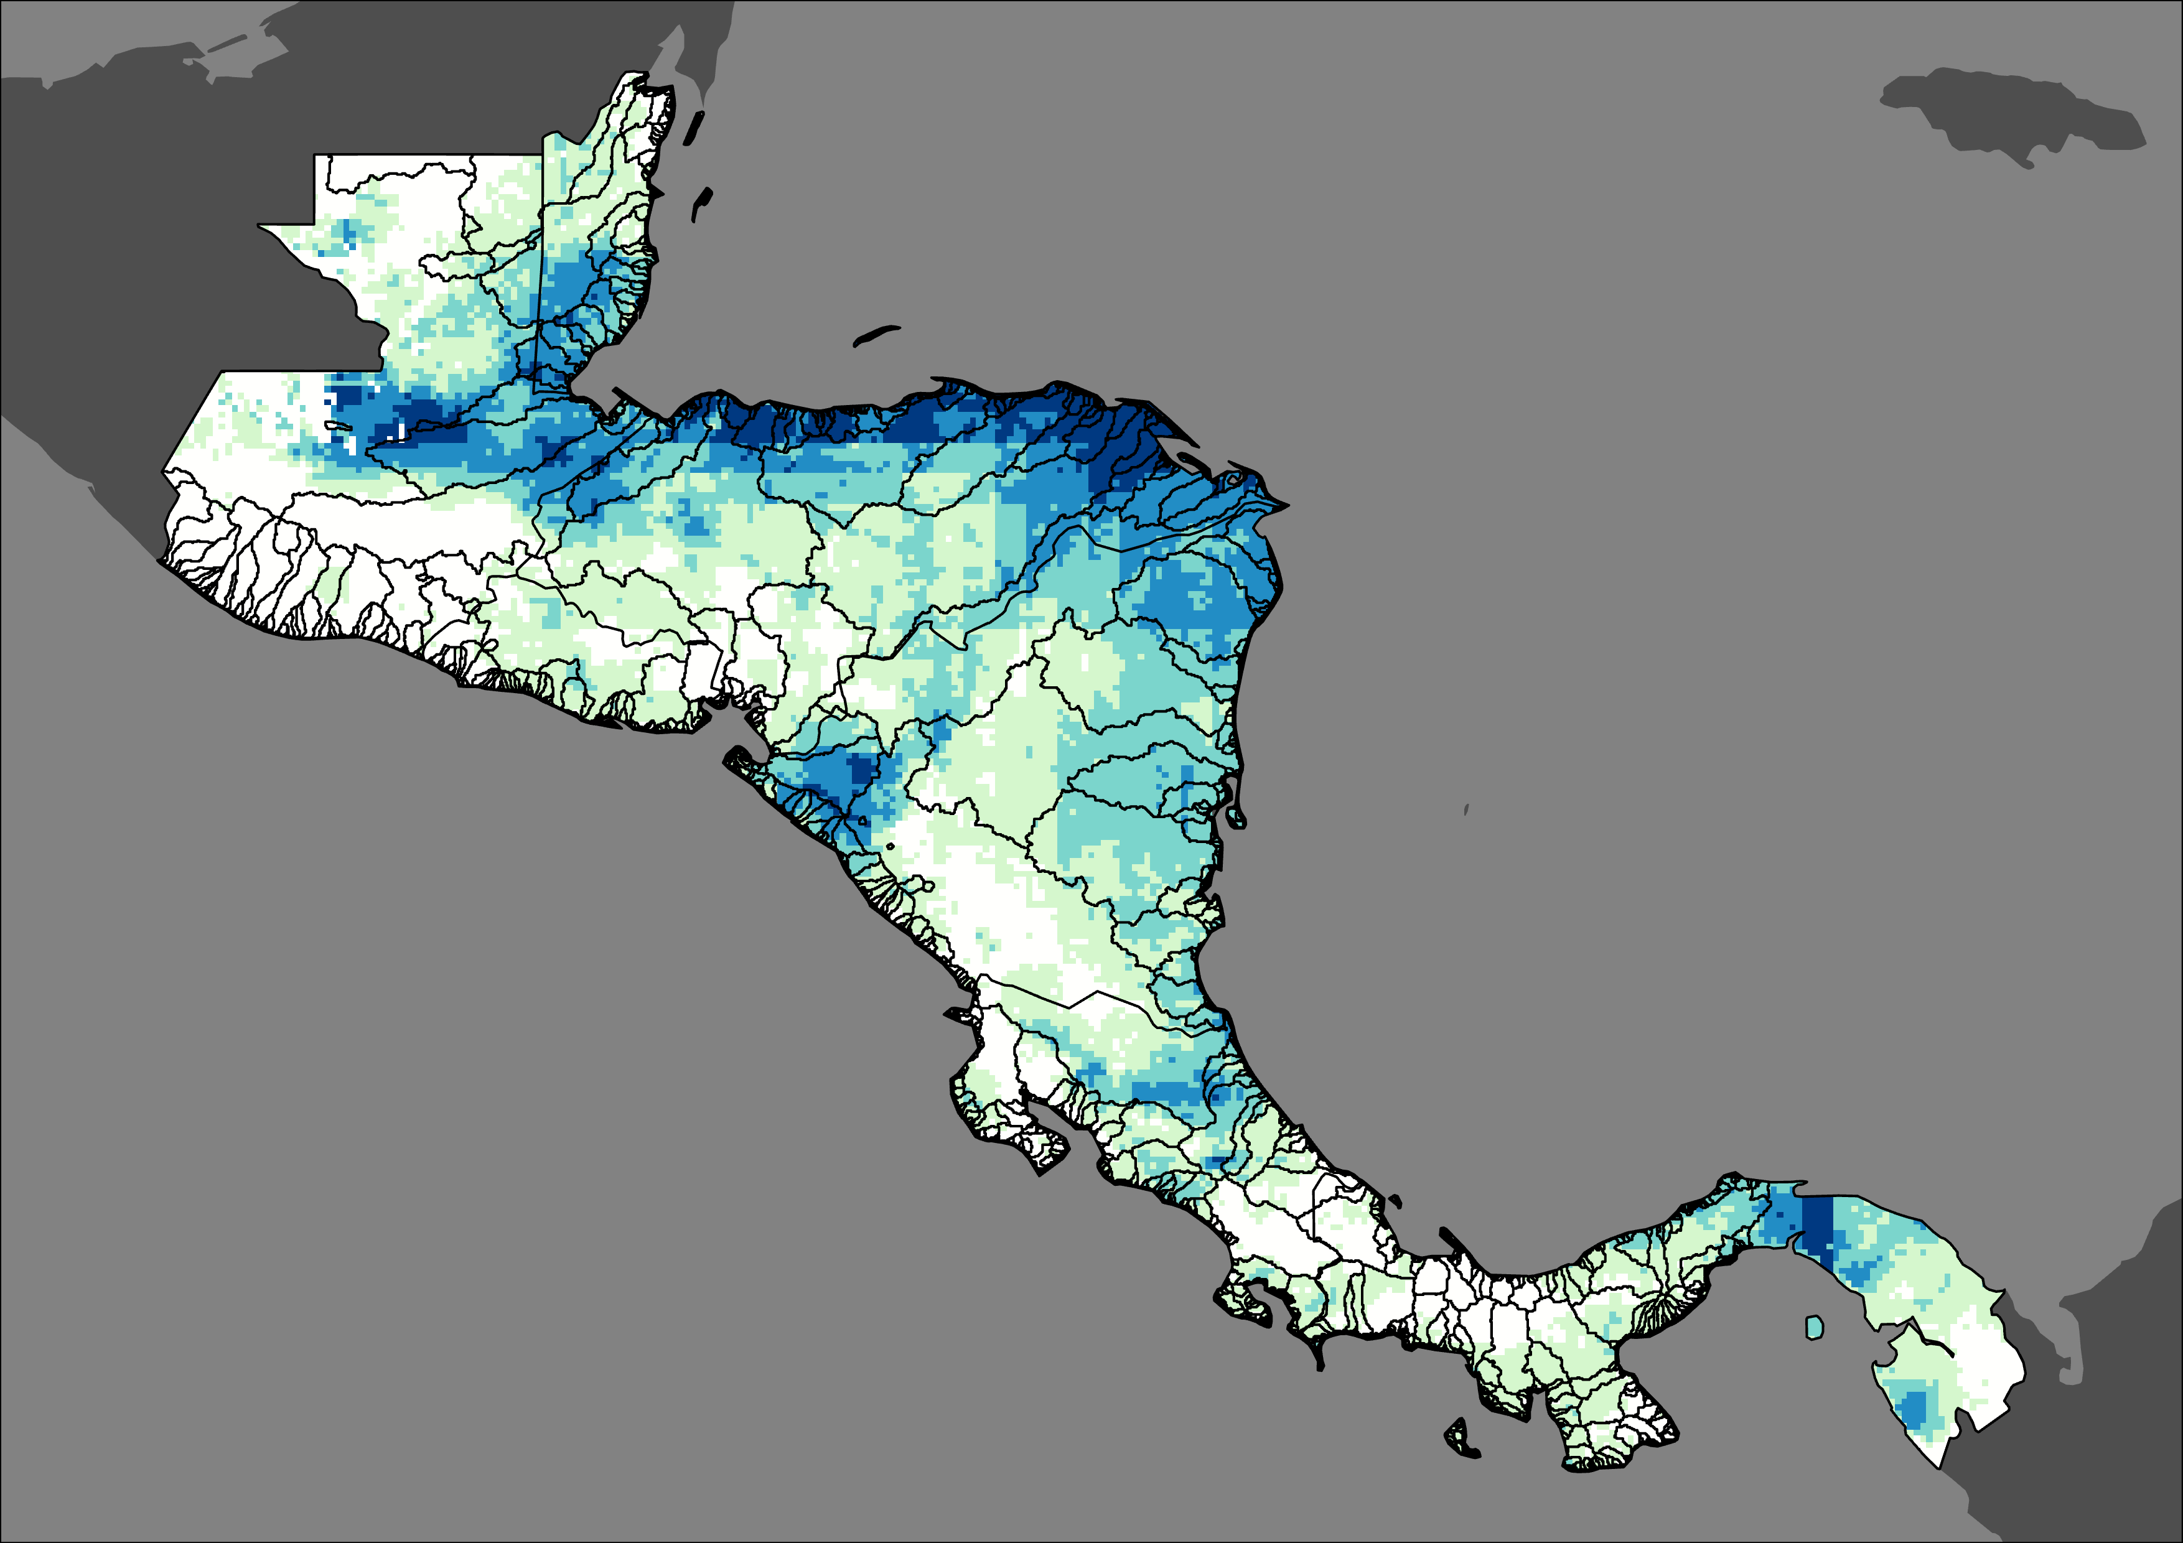

RESULTS: PRECIPITATION ANALYSIS
Total Event Precipitation: Hurricane Eta
Total Event Precipitation: Hurricane Iota
0 160 322 Km
0 160 322 Km
Precipitation in mm:
0.00-131
132-235
236-362
363-546
547-957
Watersheds
Notes:
Speaker:
The precipitation results demonstrate that Hurricane Eta deposited more precipitation on Central America than Hurricane Iota. Most of the precipitation concentrated on the east coast of Central America, with Honduras and Guatemala receiving the majority of the precipitation. Countries like Costa Rica and Panama received less rain than Honduras and Guatemala but still suffered heavy impacts on the community.

Slide 29
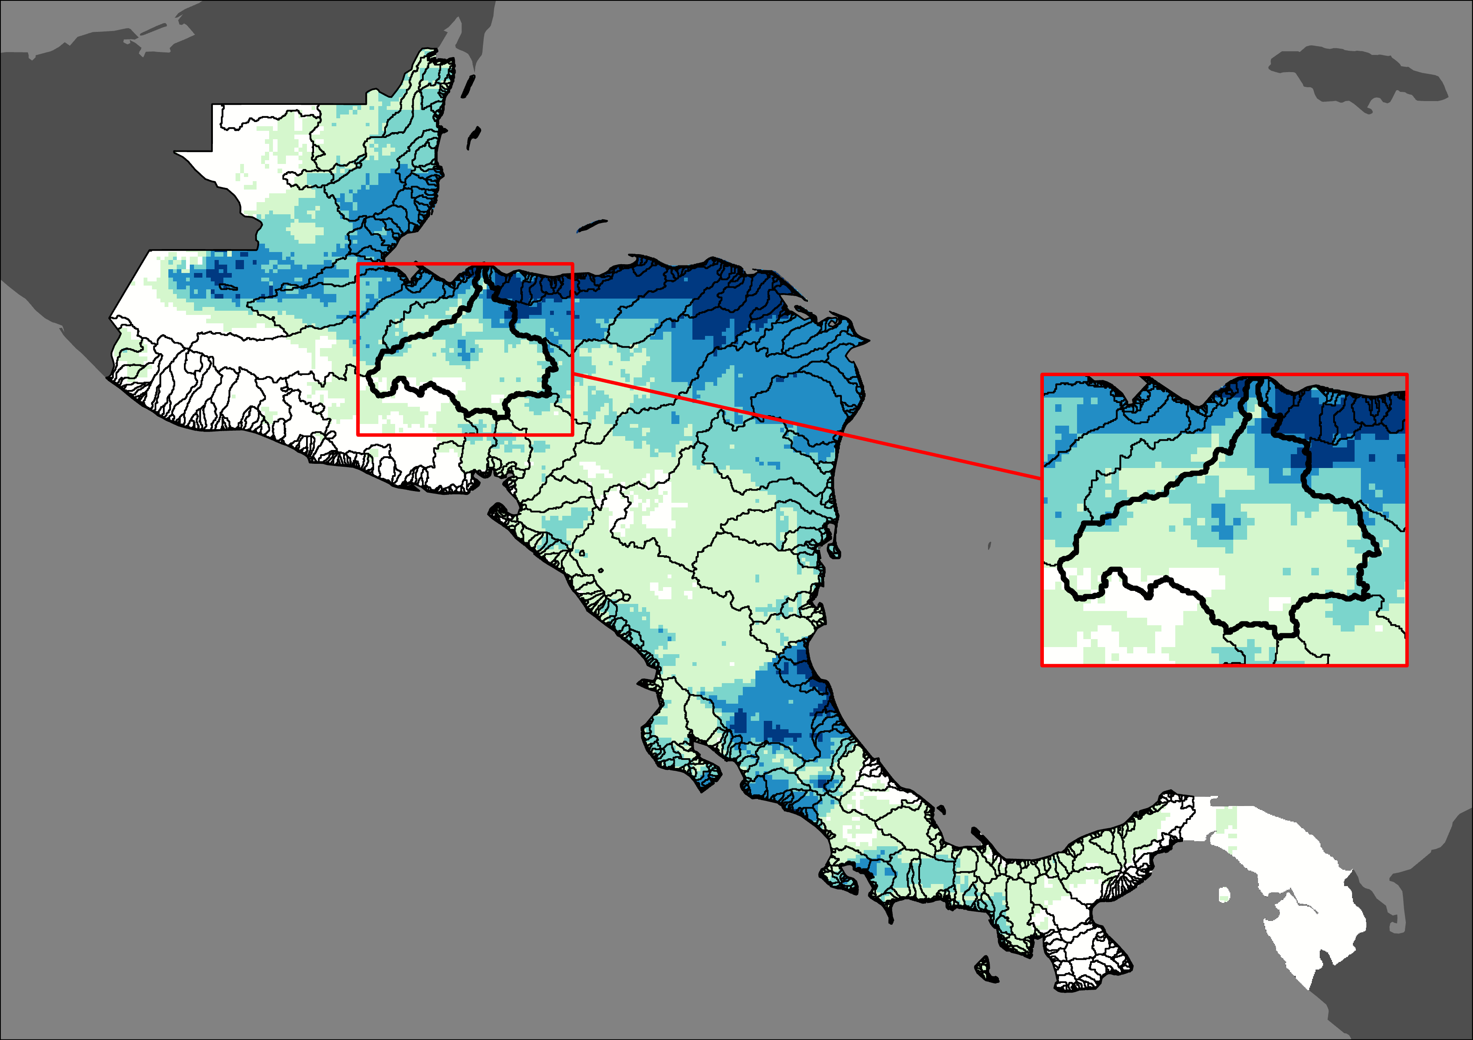
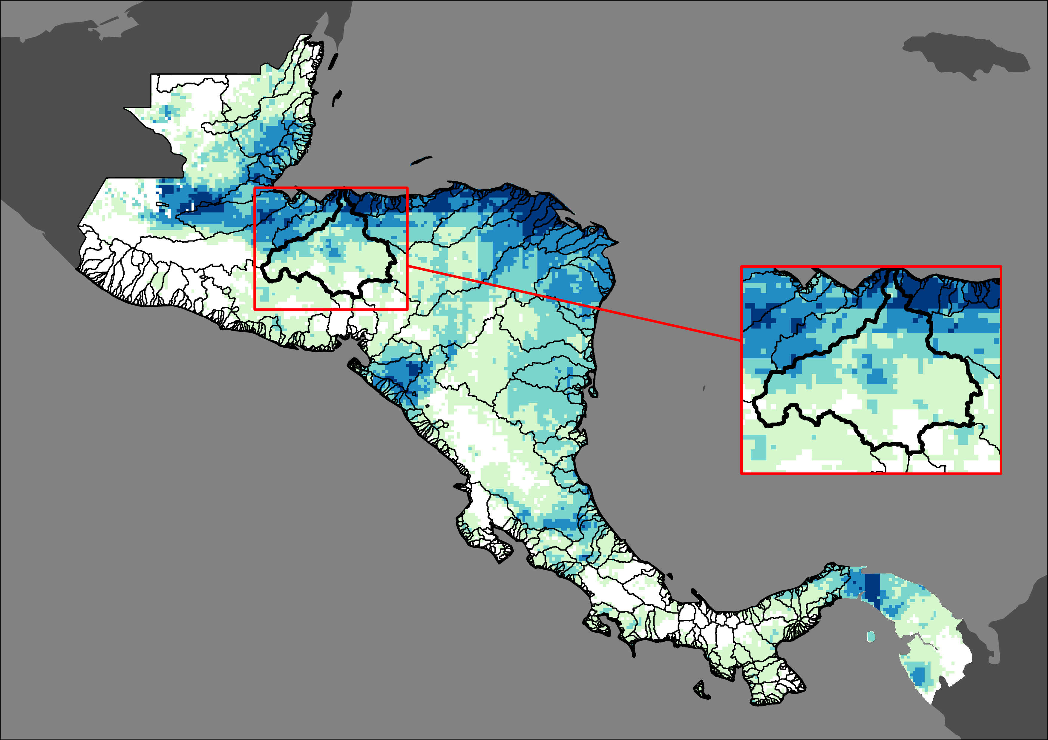
RESULTS: EL CAJON DAM WATERSHED ANALYSIS
Total Event Precipitation: Hurricane Eta
Total Precipitation for El Cajón Dam (Honduras)
Watershed Area: | 21,963 km²
Watershed Precipitation: Hurricane Eta | 649 mm
Watershed Precipitation: Hurricane Iota | 430 mm
Total Watershed Precipitation: Hurricane Eta & Iota | 1,079 mm
Total Precipitation: Hurricane Eta & Iota | 1451 mm
Percent of Total Precipitation: | 74%
Total Event Precipitation: Hurricane Eta
Total Event Precipitation: Hurricane Iota
0 160 322 Km
0 160 322 Km
Precipitation in mm:
0.00-131
132-235
236-362
363-546
547-957
Watersheds
Notes:
Speaker:
El Cajon Watershed experienced 74% of the total precipitation of Hurricane Eta and Iota.

Slide 30
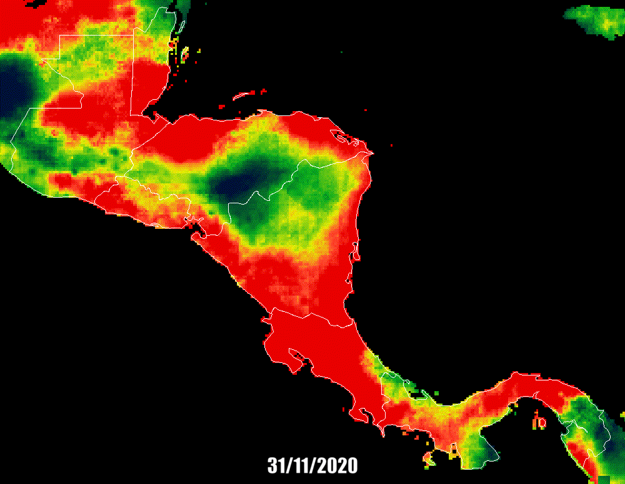
RESULTS: HURRICANE ETA PRECIPITATION ANALYSIS
Hurricane Eta Daily Precipitation 31 Oct-13 Nov
Precipitation in mm/day:
0-21
22-69
70-137
138-258
259-678
0 160 322 Km
Notes:
Speaker:
The precipitation results demonstrate that Hurricane Eta deposited more daily precipitation than Hurricane Iota. Most of the precipitation concentrated on the east coast of Central America, with Honduras and Guatemala receiving the majority of the precipitation.

Slide 31
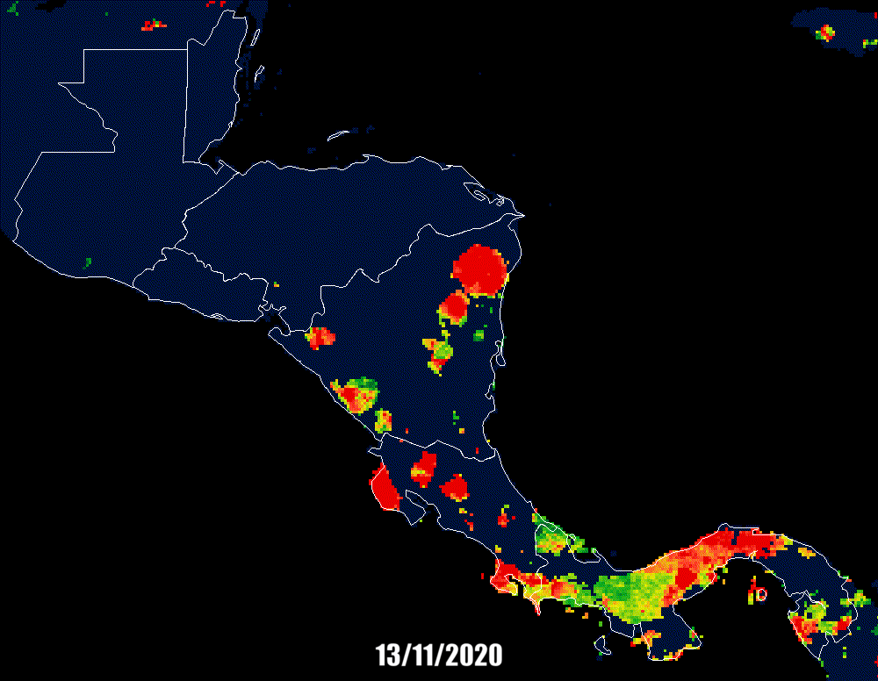
RESULTS: HURRICANE IOTA PRECIPITATION ANALYSIS
Hurricane Iota Daily Precipitation 13 Nov-18 Nov
Precipitation in mm/day:
0-21
22-69
70-137
138-258
259-678
0 160 322 Km
Notes:
Speaker:
The precipitation results demonstrate that Hurricane Eta deposited more daily precipitation than Hurricane Iota. Most of the precipitation concentrated on the east coast of Central America, with Honduras and Guatemala receiving the majority of the precipitation.

Slide 32
RESULTS: PRECIPITATION ANALYSIS
Precipitation By Country
GT BZ SV HN PA NI CR
Hurricane Eta
Hurricane Iota
Precipitation mm/day
Day of Month
Notes:
Speaker:
This graph shows Guatemala received the most precipitation of all the countries in Central America, followed by Honduras. Panama and Belize are the only countries that experienced a downward trend in precipitation over the course of the hurricanes.

Slide 33

CODE TUTORIAL
Written portion contains the methodologies used for the Case Study Analysis and the Precipitation Analysis
Scripted portion contains a workflow for NASA SERVIR's HYDRAFloods tool
Goal: Give partners the capacity to replicate these analyses for future flood events
Image Credit: "coding" by Asep Yopie Hardi Noer from the Noun Project
Notes:
Speaker:
A code tutorial was also produced as part of this project. The code tutorial is divided into two portions: a written tutorial and a scripted tutorial. The written tutorial describes the methods used in the Case Study Analysis and the Precipitation Analysis. The coded portion focuses more on the HYDRAFloods tool and is housed within a Google Colab Notebook that is linked within written document. The ultimate goal of the tutorial is to give our partners the capacity to easily replicate these analyses for future flood events by using open sources such as Google Earth Engine (GEE) and the HYDRAFloods tool developed by NASA SERVIR.
--------------------------------------------------
Other Notes: (For future speakers to be aware)
Methods used in Case Study Analysis that were not methods of HYDRAFloods are not in the scripted tutorial, only in the written portion. This choice made so that partners could have the tutorials faster without having to go through the software release since HYDRAFloods has already been released by NASA SERVIR.
-------------------------Image Information Below-------------------------
Image Credit: "coding" by Asep Yopie Hardi Noer from the Noun Project https://thenounproject.com/search/?q=code&i=4361586 (CC-BY)

Slide 34
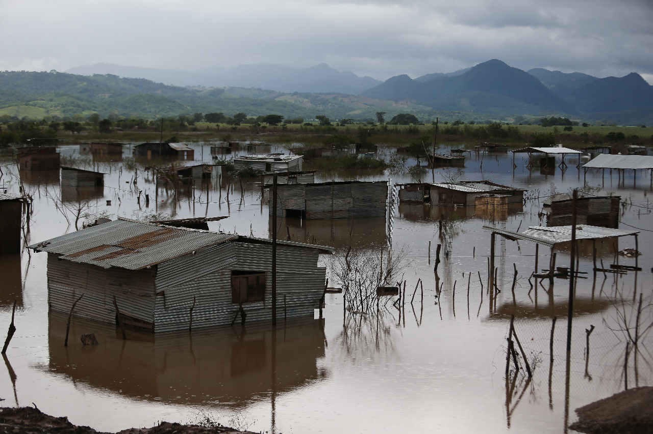
CONCLUSIONS
Although the % of surface water declined slightly between 2015 – 2021 for most countries, the inset maps visibly show that surface water has increased in priority and coastal areas.
In examining Hurricanes Eta and Iota, we observed similar flood patterns and extent during and after the two events using SAR and optical imagery.
Hurrican Eta and Iota deposited more than 1400 mm of rainfall, mainly on the east coast of Central America, with Guatemala and Honduras receiving most of the rain.
The Code Tutorial will allow users to replicate these analyses for future flood events.
Image Credit: D. Membreño
Notes:
Speaker:
The results of the surface water maps indicate that the priority areas identified by the partners that were shown in the inset maps did show an increase in surface water over the study period. This could mean that these areas are more vulnerable to flooding. Additionally, the change detection results showed that the pixels classified as surface water slightly decreased over the study period, but these calculations are reflective of the entire country rather than the specific smaller sites.
The Case Study Analysis with Hurricanes Eta and Iota also showed that using the combination of SAR and optical imagery is effective to detect flood following hurricane events. Additionally, we also saw agreement across these different satellite and sensors indicating that these different Earth observations detected similarpatterns.
We also produced precipitation maps which will help the partners better utilize Earth observations. Hurrican Eta and Iota deposited more than 1400 mm of rainfall, mainly on the east coast of Central America, with Guatemala and Honduras receiving most of the rain.
Additionally, we created a code tutorial of how to use the HYDRAFloods tool. The tutorial also covers how to perform a precipitation analysis and how to cross reference the mapping seen in HYDRAFloods with landcover datasets. The objective of the tutorial is to build the partners capacity to be able to replicate these studies for future flood related events.
------------------------------Image Information Below ------------------------------
Image Credit: D. Membreño
Image Source: https://www.flickr.com/photos/eu_echo/50724915508/in/photolist-2k5whEW-2k2YmLg-2khos9L-2hYTHbt-2khsEtg-2k7vsTc-2kjdi2p-2k7zR9A-2khschS-2khoqVi-2khsbgi-HZaQk-2k7vsXL-DRX861-2k7vtov-2k7zhjb-2k7vsN7-46uZse-2k7zhHC-2k7zRre-2khsCwa-2khoqxz-2khorU2-2khoraM-2khoqx4-2k7vsBW-2mcbkPL (Public Domain CC BY-ND 2.0)

Slide 35
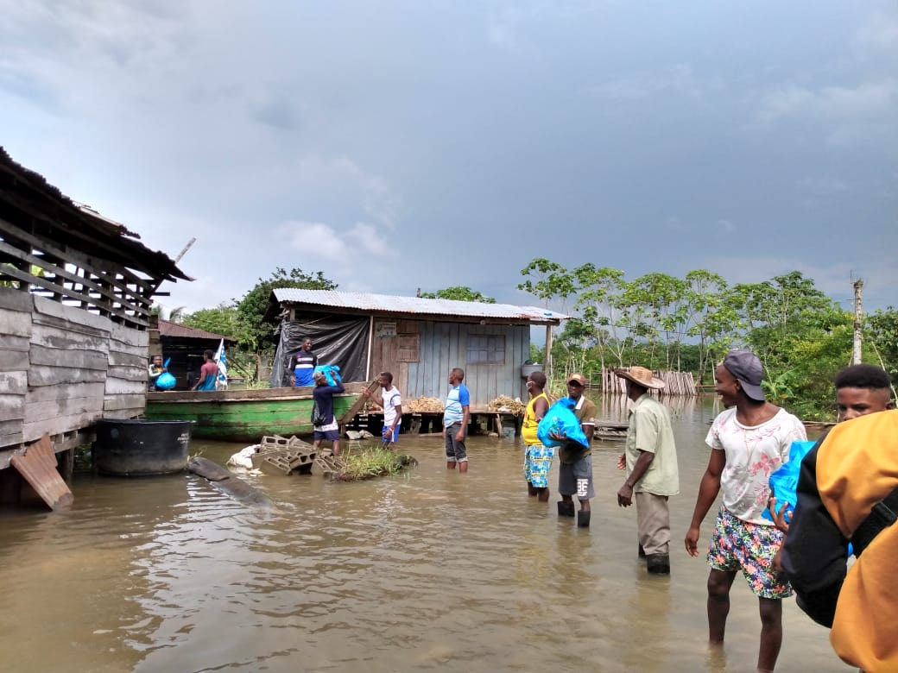
FUTURE WORK
Use HYDRAFloods to create flood depth estimation maps
Find rain thresholds for areas the Surface Water Maps identified as vulnerable
Create a GUI utilizing HYDRAFloods for Central America
Image Credit: EU Civil Protection and Humanitarian Aid
Notes:
Speaker:
Our partner organizations have previously expressed interest in flood depth maps from Hurricanes Eta and Iota. We were unable to take on this task during our term, but it would be a great study for future DEVELOP work. Finding rain thresholds was another area of interest our partners have mentioned. Using our Historical Surface Water maps, it would be helpful to know what the rain thresholds were for these vulnerable areas that we have highlighted. SERVIR Mekong has implemented a GUI for visualizing flooding via HYDRAFloods over southern Asia. It is web-based and only requires users to input the dates of interest and zoom in to the region they wish to view. To do this for the Central American region would be beneficial to all of Central America as it could be used by anyone with access to the internet.
------------------------------Image Information Below ------------------------------
Image Credit: EU Civil Protection and Humanitarian Aid
Image Source: https://www.flickr.com/photos/eu_echo/50725642511/in/photolist-2khsbgi-2khoqVi-2khsCwa-2khoqxz-2khorU2-2khoraM-2khoqx4-91Gr2F-2GbEk-4DgYHU-87iNeM-3iBRiQ-mecyh-8Ewcxn-3ed881-6pdpKL-2hT3Vz-abThMz-crowo-QfipFR-crAb5-87kRFd-8i8EHj-Qfipbc-2hT1og-4DZSPQ-9bTUwJ-8abDmi-9bVNgb-9WuUNH-2hXta3-9c2NxE-i3HE-4DZSZy-4DZT6m-9c2Nnw-4DVBVR-4DZSX5-9c2CAf-9bYF5B-9bYyBT-898qK-9c2MW1-4DZSUy-wEYkZ-9c2L7j-87jmwj-87jcad-87i4CM-87gtba (Public Domain CC BY-ND 2.0)

Slide 36
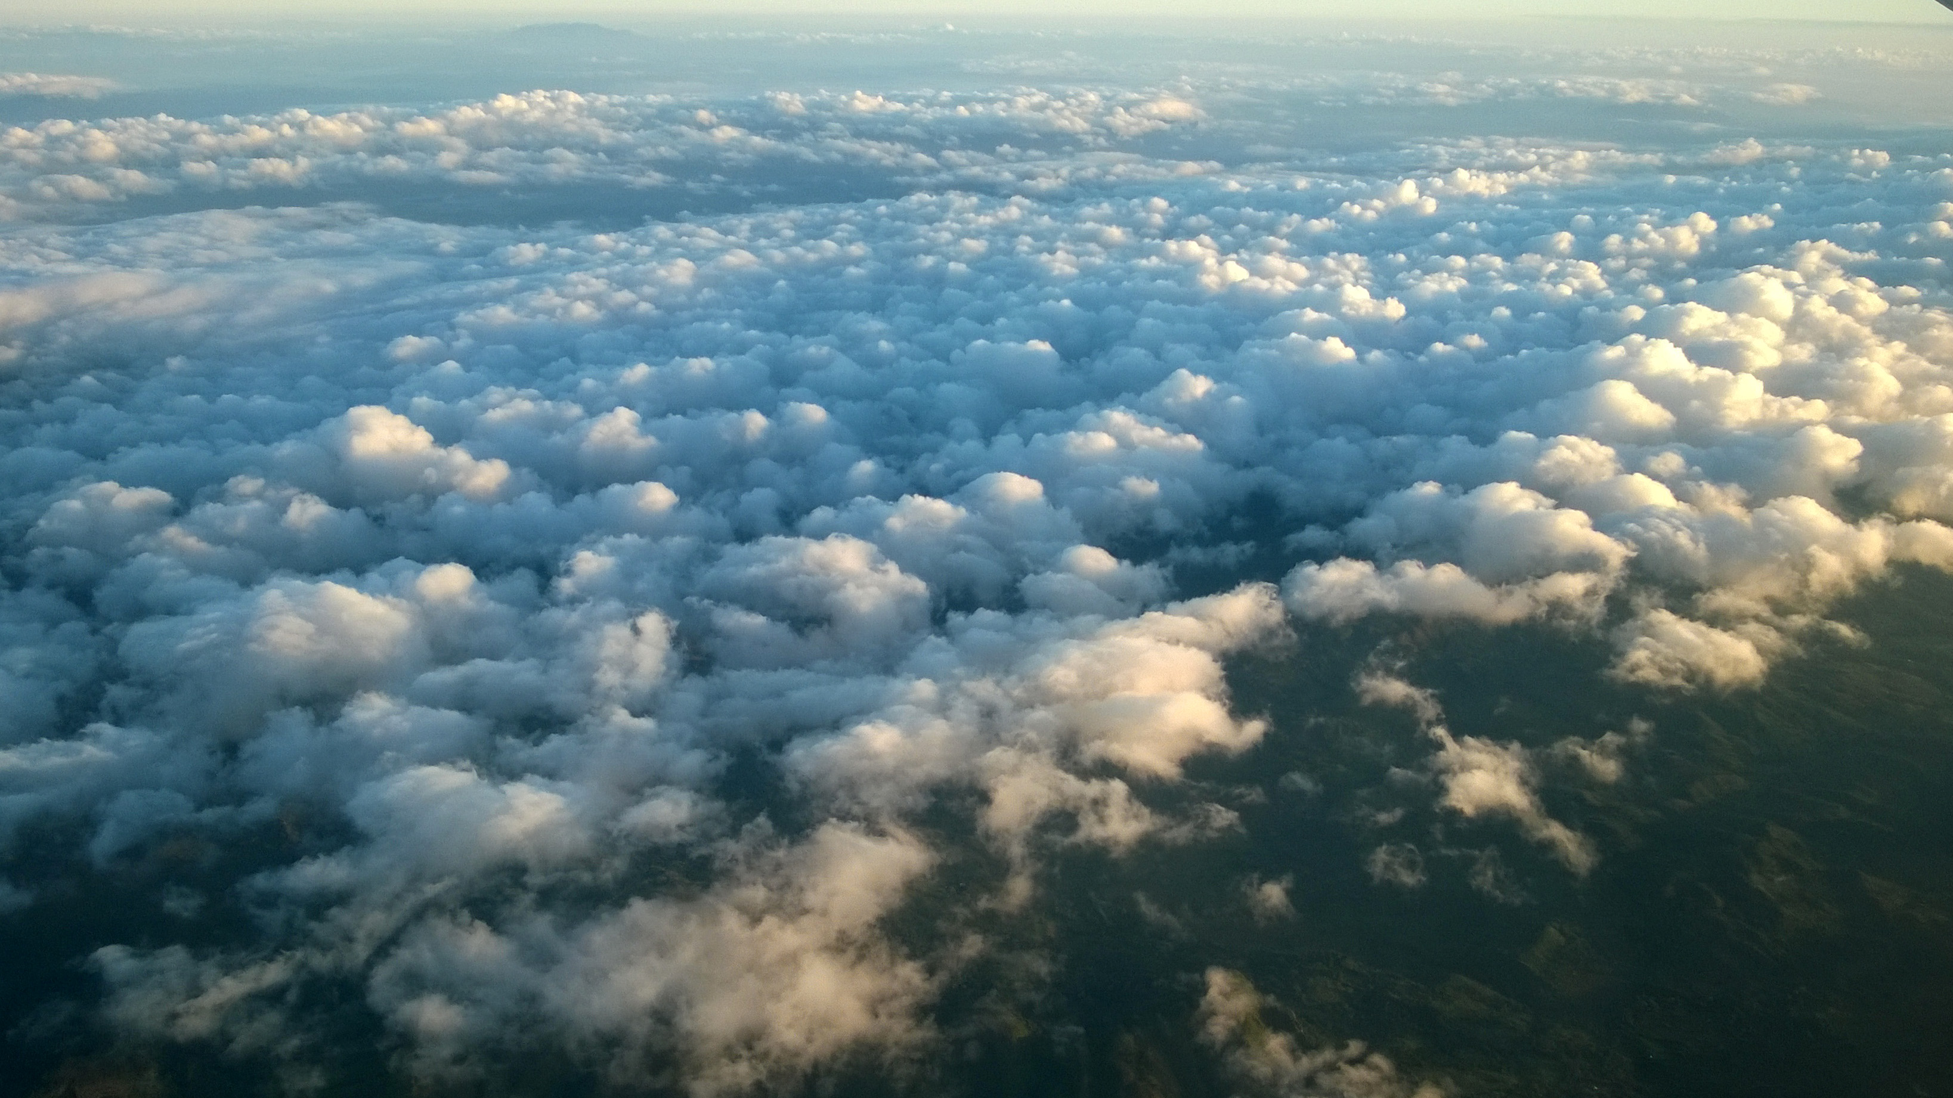
ERRORS &UNCERTAINTIES
Although we used optical imagery in conjunction with SAR, limitations with optical imagery include excessive cloud cover during hurricane and flood events
Using SAR to detect flooding in areas dominated by tree cover or built-up urban areas is not always reliable.
Limitations also include long revisit periods with satellites, which contributes to gaps in data
Detecting and classifying flood water using satellite imagery can be confused with other land cover types such as urban area and pond aquaculture
Image Credit: descubriendoelmundo
Notes:
Speaker:
Limitations and uncertainties in the results are contributed to excessive cloud cover in optical imagery, long satellite revisit times resulting in data gaps, and surface water confusion with land cover types like urban area and pond aquaculture.
------------------------------Image Information Below ------------------------------
Image Credit: descubriendoelmundo
Image Source: https://www.flickr.com/photos/descubriendo-el-mundo/16467345821/in/photolist-E246ac-EoVuzA-9EdYFU-z92Jak-aKSnpK-9ZEGTR-r6ascx-qw5yFV-826GBR-826GMF-8oiYTU (Public Domain CC BY-SA 2.0)

Slide 37
Dr. Jeffrey Luvall, NASA Marshall Space Flight Center
Kel Market, NASA SERVIR Science Coordination Office
Eric Anderson, NASA SERVIR Science Coordination Office
Betzy Hernández, NASA SERVIR Science Coordination Office
Emil Cherrington, NASA SERVIR Science Coordination Office
Vanesa Martin, NASA SERVIR Science Coordination Office
Ronan Lucey, NASA Applied Sciences Disasters Program
Robert Griffin, University of Alabama Huntsville
Paxton LaJoie, NASA DEVELOP
Berta Olmedo Vernaza, CRRH
Marcelo Oyuela, CEPREDENAC
Jorge Cabrera, SICA
This material contains modified Copernicus Sentinel data (2015-2021), processed by ESA.
Notes:
Speaker:
Thank you for joining us for our presentation today! We would like give a shoutout to our Fellow, Paxton LaJoie, for her support on this project, as well as our science advisors at Marshall Space Flight Center and the NASA SERVIR Science Coordination Office. We would also like to recognize our 3 partner organizations and our advisors from the University of Alabama – Huntsville, as well as the NASA Applied Sciences Disasters Program. You have all been extremely supportive and helped make this project what it us.
We can open the floor to questions now.

Slide 38
BACKUP SLIDES

Slide 39

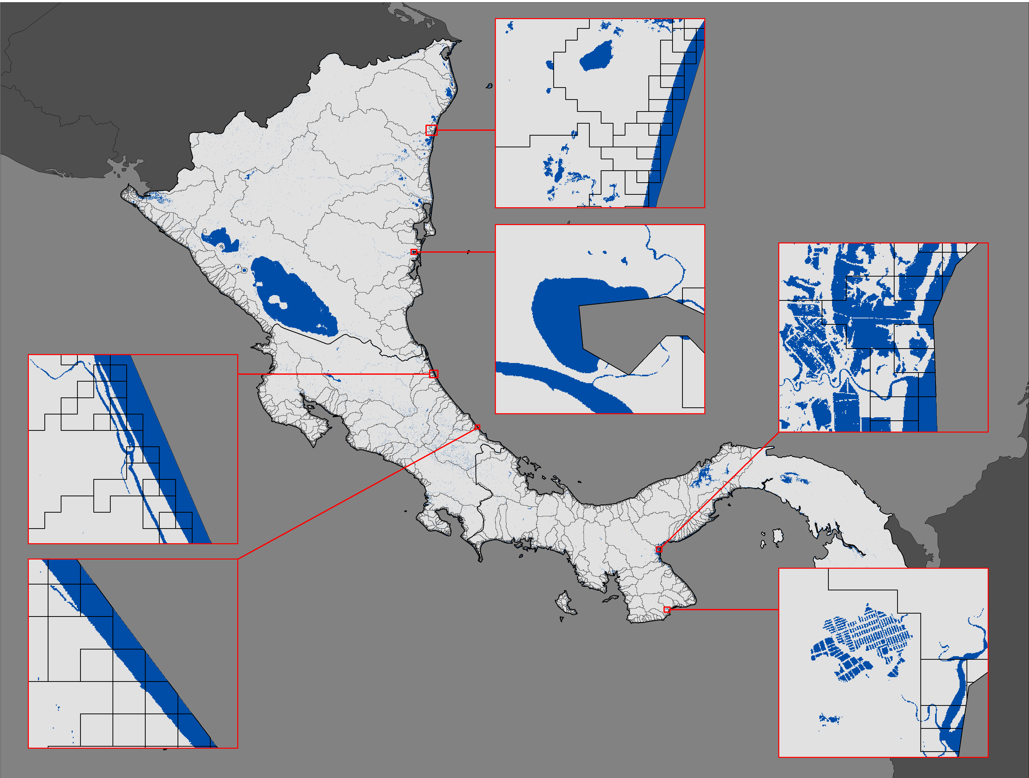
RESULTS: HISTORICAL SURFACE WATER (2016)
2016 Surface Water Map: (Guatemala, Belize, Honduras, El Salvador)
2016 Surface Water Map: (Nicaragua, Costa Rica, Panama)
0 160 322 Km
Surface Water
Study Area
Watersheds
0
80
160 Km
Notes:
Speaker:
These are the surface water maps for 2016. The most obvious changes from 2015 to 2016 occur in Panama. The inset map in the bottom right corner went from having little water in 2015 to a lot of water in 2016. The inset map from Guatemala also showed an increase in surface water between the two years.

Slide 40

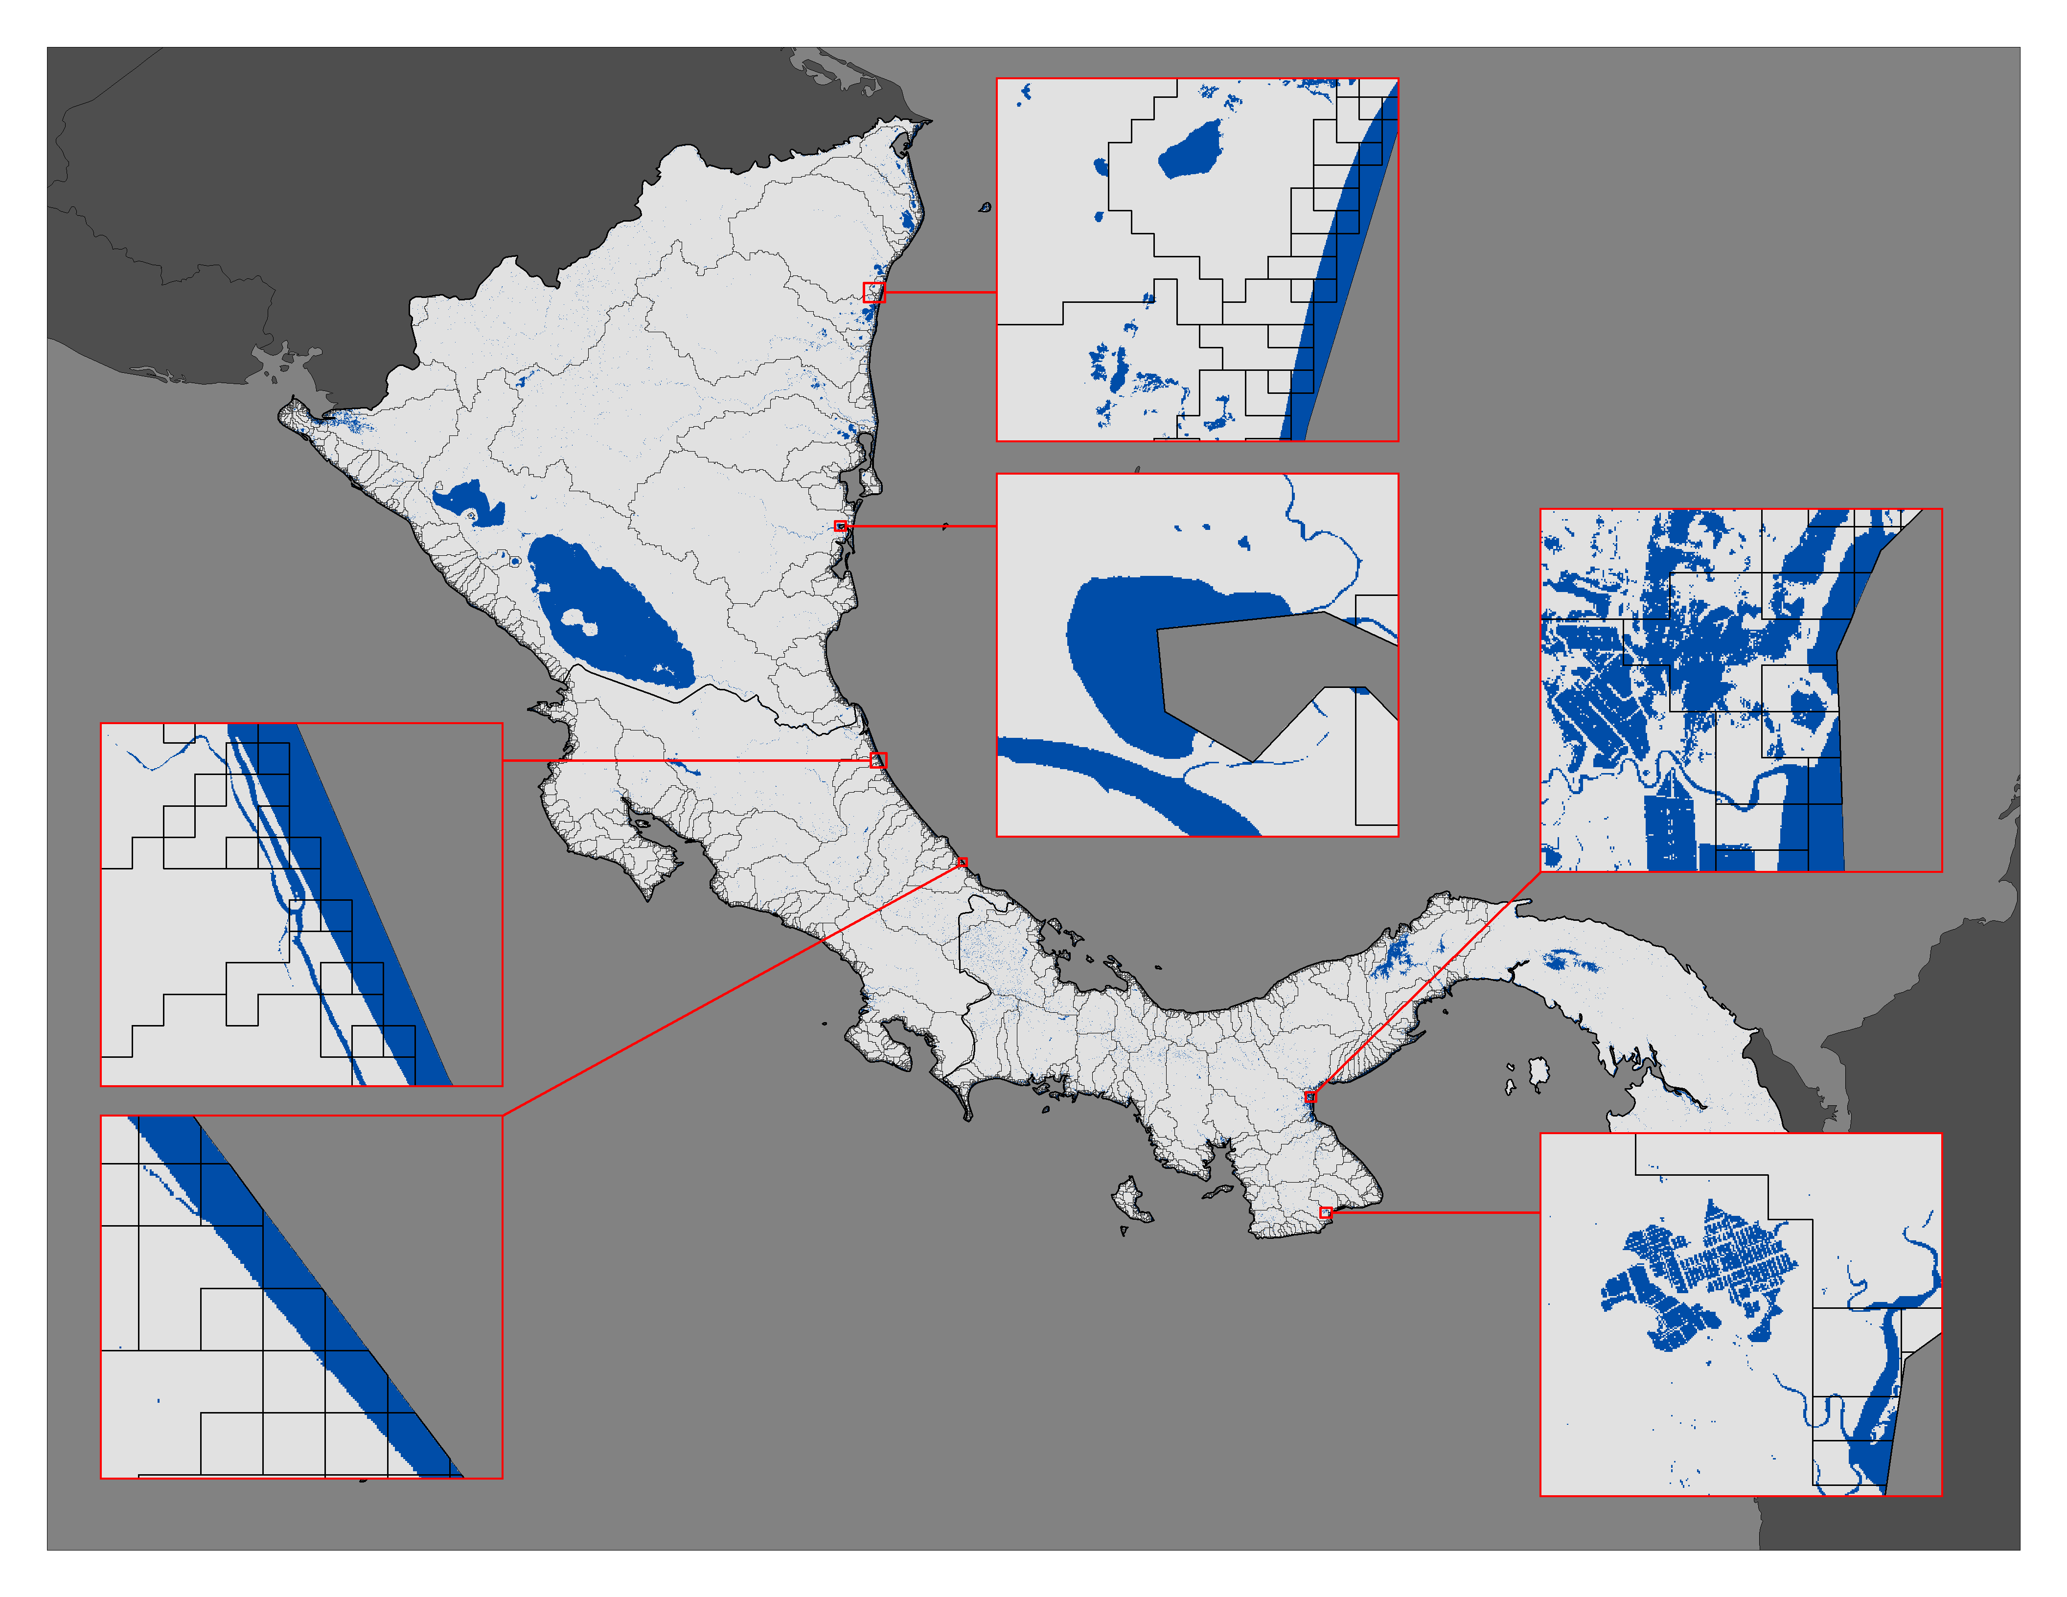
RESULTS: HISTORICAL SURFACE WATER (2017)
2017 Surface Water Map: (Guatemala, Belize, Honduras, El Salvador)
2017 Surface Water Map: (Nicaragua, Costa Rica, Panama)
0 160 322 Km
Surface Water
Study Area
Watersheds
0
80
160 Km
Notes:
Speaker:
Here we have the surface water maps for 2017. They look very similar to the 2016 maps. The inset map in Panama in the bottom right is showing a greater presence of surface water between the two years.

Slide 41


RESULTS: HISTORICAL SURFACE WATER (2018)
2018 Surface Water Map: (Guatemala, Belize, Honduras, El Salvador)
2018 Surface Water Map: (Nicaragua, Costa Rica, Panama)
0 160 322 Km
Surface Water
Study Area
Watersheds
0
80
160 Km
Notes:
Speaker:
These are the surface water maps from 2018, which are also extremely similar to the results from 2017.

Slide 42
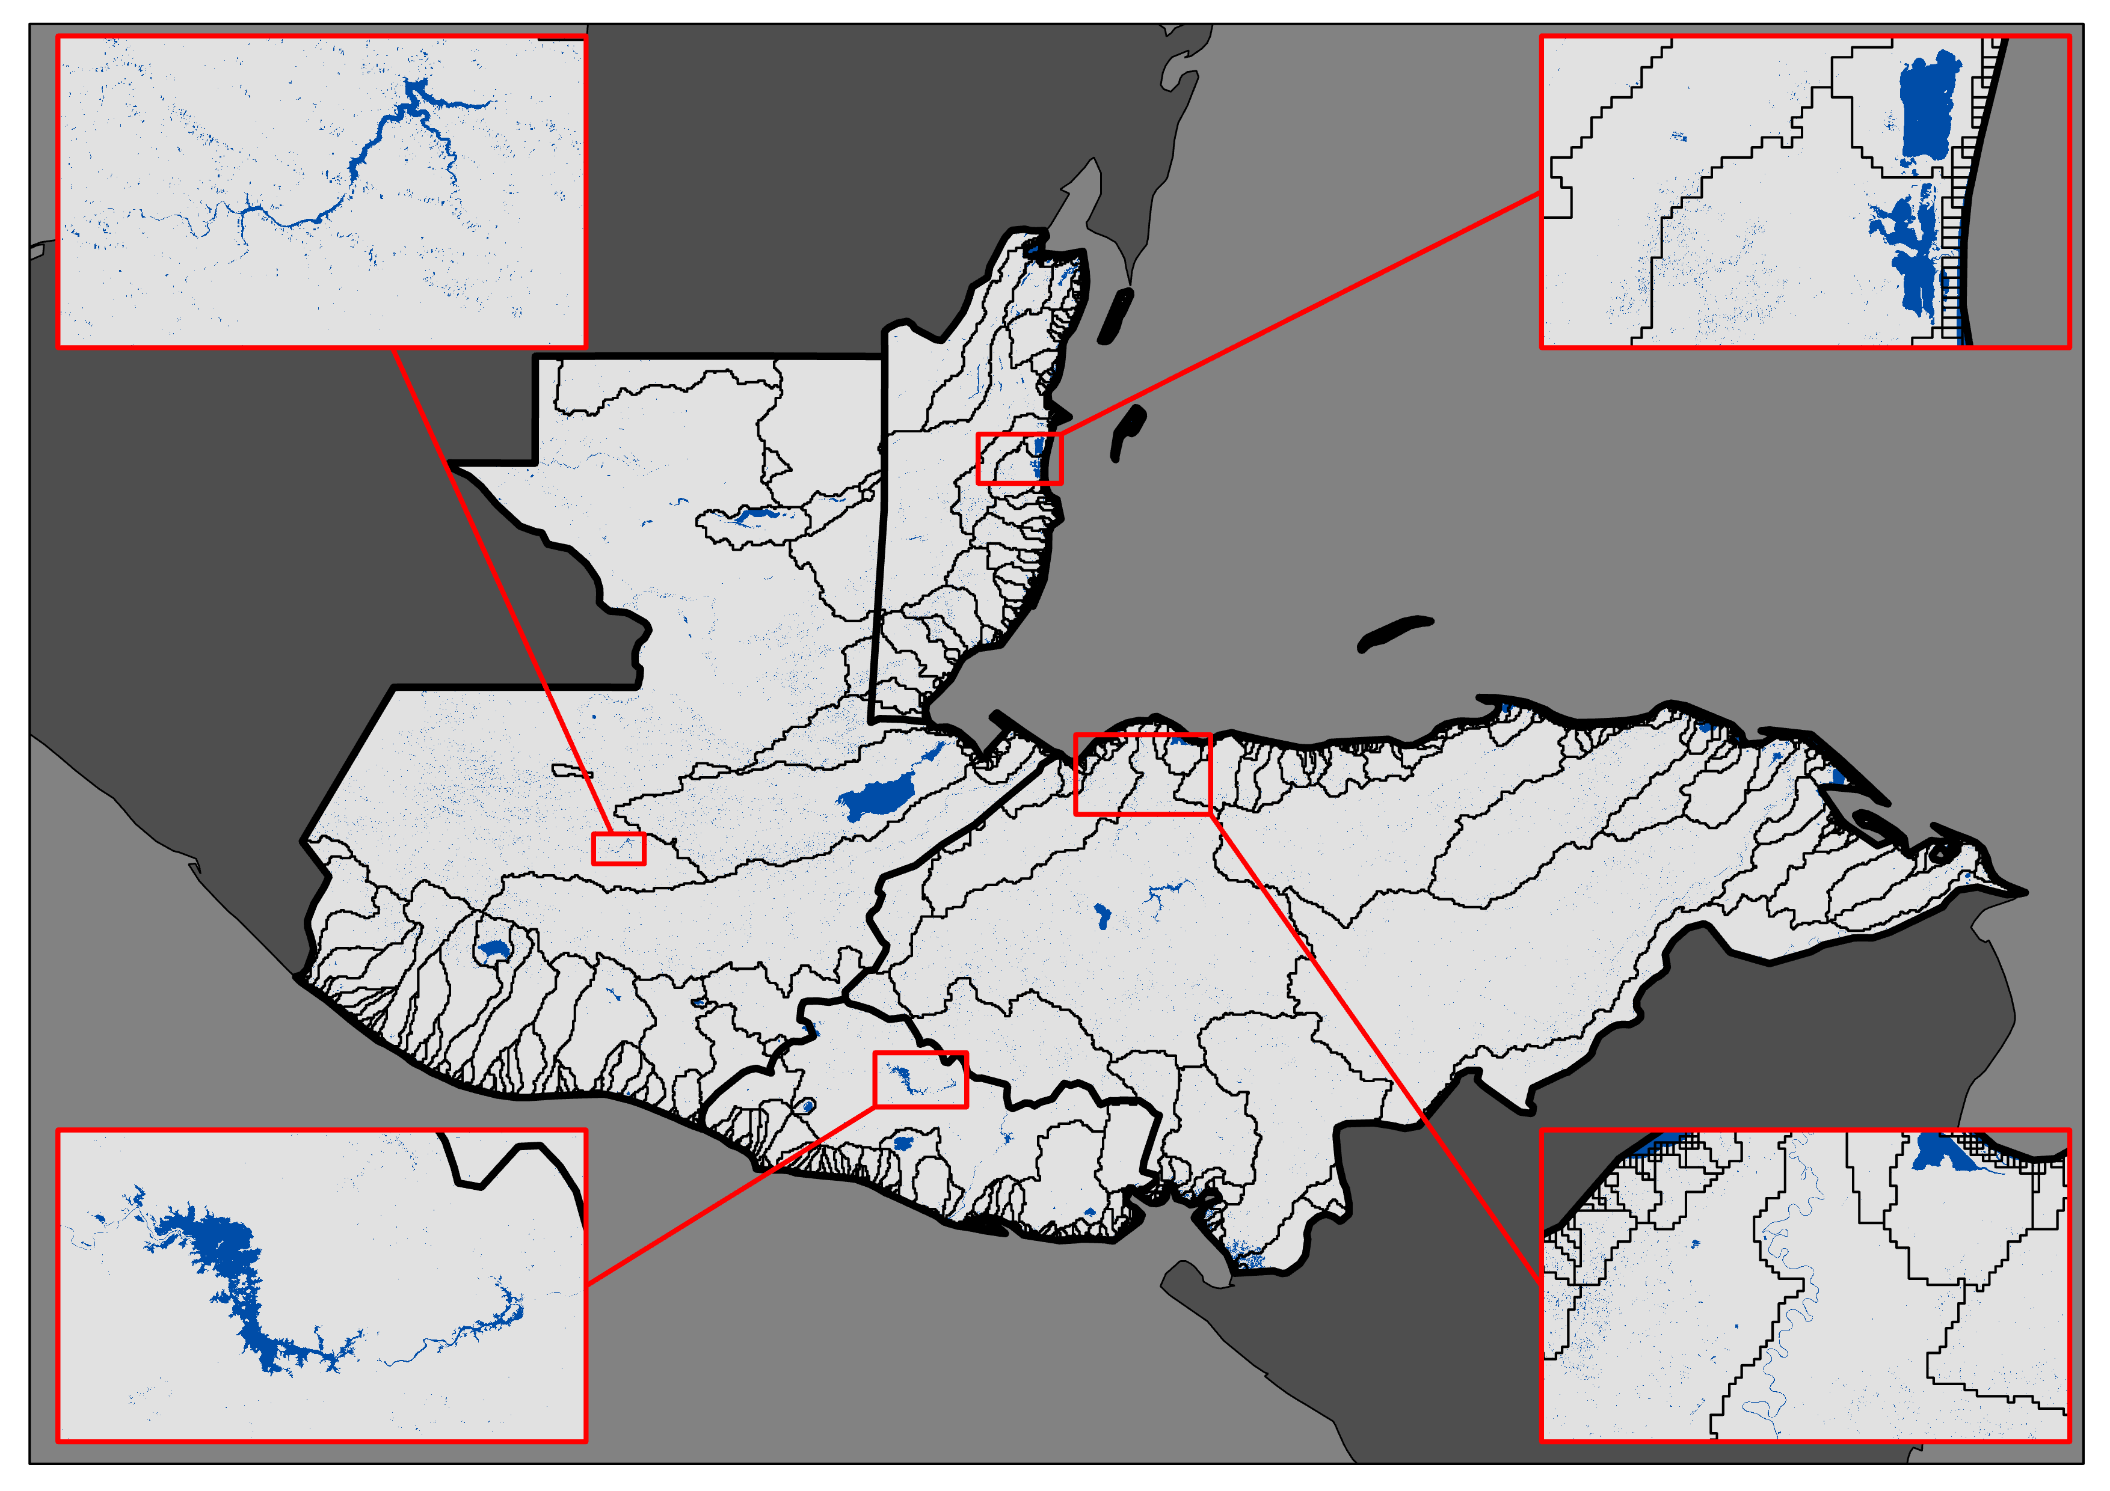

RESULTS: HISTORICAL SURFACE WATER (2019)
2019 Surface Water Map: (Guatemala, Belize, Honduras, El Salvador)
2019 Surface Water Map: (Nicaragua, Costa Rica, Panama)
0 160 322 Km
Surface Water
Study Area
Watersheds
0
80
160 Km
Notes:
Speaker:
Here we have the results from 2019. The maps look very similar to the results from 2018.

Slide 43
RESULTS: HISTORICAL SURFACE WATER CHANGE DETECTION
Country​ | % Change in Surface Water (2015 – 2021)​
Belize​ | -1.31%
Guatemala​ | +0.70%
Honduras​ | -0.68%
El Salvador* (2016-2021)​ | +0.22%
Nicaragua​ | -2.13%​
Costa Rica​ | -0.95%​
Panama​ | -0.84%​
Notes:
Speaker:
This table shows the results of the change detection statistics performed on the change detection output files. As you can see by these statistics, Guatemala and El Salvador experienced an increase in surface water, while the remaining countries slightly declined. The cause of these changes is unknown and would be a good avenue of future research.

Slide 44
RESULTS: CASE STUDY ANALYSIS
Optical Flood Mapping:
Sula Valley
0
500 km
Sentinel-2
During Eta/Iota: Oct. 31, 2020 – Nov. 18, 2020
Flood
Permanent Water
Priority Sites
Cropland
0
3
6
12 km
Notes:
Speaker:
This map similar, to the previous two shows flood extent in the Sula Valley during Hurricanes Eta and Iota using Sentinel-2 imagery. The flood extent is also similar if not slightly larger than the others.

Slide 45
RESULTS: CASE STUDY ANALYSIS
Optical Flood Mapping:
Sula Valley
0
500 km
MODIS
After Eta/Iota: Nov. 18, 2020 – Dec. 2, 2020
Flood
Permanent Water
Priority Sites
Cropland
0
3
6
12 km
Notes:
Speaker:
Lastly, we have an after Hurricanes Eta and Iota zoomed in maps of flood extent using MODIS data. Like the other maps, we see a similar flood extent detected.

Slide 46
RESULTS: EL CAJON DAM WATERSHED ANALYSIS
Total Precipitation for El Cajón Dam (Honduras)
Watershed Area: | 21,963 km²
Watershed Precipitation: Hurricane Eta | 649 mm
Watershed Precipitation: Hurricane Iota | 430 mm
Total Watershed Precipitation: Hurricane Eta & Iota | 1,079 mm
Total Precipitation: Hurricane Eta & Iota | 1451 mm
Percent of Total Precipitation: | 74%
Notes:
Speaker:
El Cajon Watershed experienced 74% of the total precipitation of Hurricane Eta and Iota.

